Slide 1
Spring Semester Exam Content Review

Slide 2
DNA Replication Quiz
Single Strand Binding Proteins
DNA Polymerase
Helicase
RNA Primase
DNA Ligase
A. Unzips DNA
B. Links new nucleotides together
C. Holds DNA Apart
D. Initiates building of new DNA strand
E. Joins DNA Fragments Together

Slide 3
DNA Replication Quiz
Single Strand Binding Proteins
DNA Polymerase
Helicase
RNA Primase
DNA Ligase
A. Unzips DNA
B. Links new nucleotides together
C. Holds DNA Apart
D. Initiates building of new DNA strand
E. Joins DNA Fragments Together

Slide 4
DNA Replication Quiz
Single Strand Binding Proteins
DNA Polymerase
Helicase
RNA Primase
DNA Ligase
A. Unzips DNA
B. Links new nucleotides together
C. Holds DNA Apart
D. Initiates building of new DNA strand
E. Joins DNA Fragments Together

Slide 5
DNA Replication Quiz
Single Strand Binding Proteins
DNA Polymerase
Helicase
RNA Primase
DNA Ligase
A. Unzips DNA
B. Links new nucleotides together
C. Holds DNA Apart
D. Initiates building of new DNA strand
E. Joins DNA Fragments Together

Slide 6
DNA Replication Quiz
Single Strand Binding Proteins
DNA Polymerase
Helicase
RNA Primase
DNA Ligase
A. Unzips DNA
B. Links new nucleotides together
C. Holds DNA Apart
D. Initiates building of new DNA strand
E. Joins DNA Fragments Together

Slide 7
DNA Replication Quiz
Single Strand Binding Proteins
DNA Polymerase
Helicase
RNA Primase
DNA Ligase
A. Unzips DNA
B. Links new nucleotides together
C. Holds DNA Apart
D. Initiates building of new DNA strand
E. Joins DNA Fragments Together

Slide 8
DNA Replication VOCAB
Replication fork
Leading Strand
Lagging Strand
Okazaki Fragment
RNA Primer
Shorter pieces of DNA that are built in the 5’→3’ on the antiparallel strand
Name for A
Beginning of both the leading and lagging strands
Where the DNA is split
Continuous strand of DNA build in the 5’ → 3’

Slide 9
DNA Replication VOCAB
Replication fork
Leading Strand
Lagging Strand
Okazaki Fragment
RNA Primer
Shorter pieces of DNA that are built in the 5’→3’ on the antiparallel strand
Name for A
Beginning of both the leading and lagging strands
Where the DNA is split
Continuous strand of DNA build in the 5’ → 3’

Slide 10
DNA Replication VOCAB
Replication fork
Leading Strand
Lagging Strand
Okazaki Fragment
RNA Primer
Shorter pieces of DNA that are built in the 5’→3’ on the antiparallel strand
Name for A
Beginning of both the leading and lagging strands
Where the DNA is split
Continuous strand of DNA build in the 5’ → 3’

Slide 11
DNA Replication VOCAB
Replication fork
Leading Strand
Lagging Strand
Okazaki Fragment
RNA Primer
Shorter pieces of DNA that are built in the 5’→3’ on the antiparallel strand
Name for A
Beginning of both the leading and lagging strands
Where the DNA is split
Continuous strand of DNA build in the 5’ → 3’

Slide 12
DNA Replication VOCAB
Replication fork
Leading Strand
Lagging Strand
Okazaki Fragment
RNA Primer
Shorter pieces of DNA that are built in the 5’→3’ on the antiparallel strand
Name for A
Beginning of both the leading and lagging strands
Where the DNA is split
Continuous strand of DNA build in the 5’ → 3’

Slide 13
DNA Replication VOCAB
Replication fork
Leading Strand
Lagging Strand
Okazaki Fragment
RNA Primer
Shorter pieces of DNA that are built in the 5’→3’ on the antiparallel strand
Name for A
Beginning of both the leading and lagging strands
Where the DNA is split
Continuous strand of DNA build in the 5’ → 3’

Slide 14
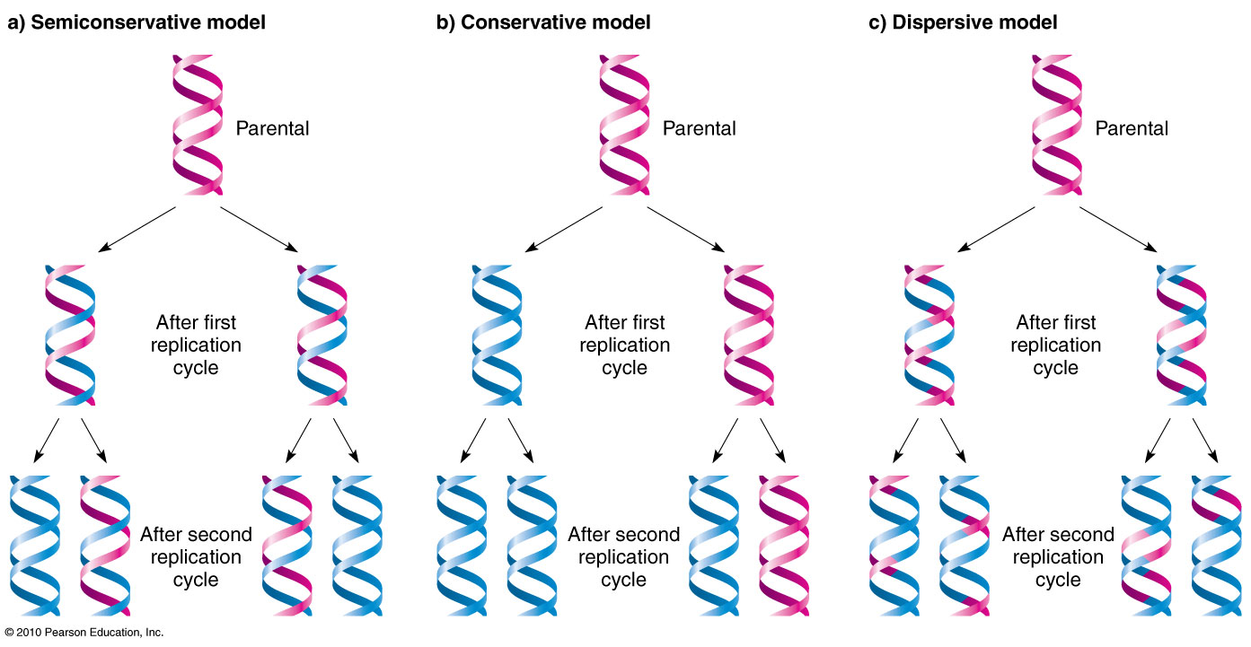
DNA Replication
Which of the following models of replication is the accurate portrayal of the method of replication? What is it called?

Slide 15
DNA Replication
Which of the following models of replication is the accurate portrayal of the method of replication? What is it called?

Slide 16
Protein Synthesis
5’ Cap and Poly A tail added
DNA copied to RNA
UAA, UAG, or UGA stop the process
Thymine replaced with Uracil
tRNA matches to mRNA
Introns removed, Exons spliced
Amino acid chains are built
Start Codon AUG is recongized
Transcription
RNA Modification
Translation

Slide 17
Protein Synthesis
5’ Cap and Poly A tail added
DNA copied to RNA
UAA, UAG, or UGA stop the process
Thymine replaced with Uracil
tRNA matches to mRNA
Introns removed, Exons spliced
Amino acid chains are built
Start Codon AUG is recongized
Transcription
RNA Modification
Translation

Slide 18
Protein Synthesis
5’ Cap and Poly A tail added
DNA copied to RNA
UAA, UAG, or UGA stop the process
Thymine replaced with Uracil
tRNA matches to mRNA
Introns removed, Exons spliced
Amino acid chains are built
Start Codon AUG is recongized
Transcription
RNA Modification
Translation

Slide 19
Protein Synthesis
5’ Cap and Poly A tail added
DNA copied to RNA
UAA, UAG, or UGA stop the process
Thymine replaced with Uracil
tRNA matches to mRNA
Introns removed, Exons spliced
Amino acid chains are built
Start Codon AUG is recongized
Transcription
RNA Modification
Translation

Slide 20
Protein Synthesis
5’ Cap and Poly A tail added
DNA copied to RNA
UAA, UAG, or UGA stop the process
Thymine replaced with Uracil
tRNA matches to mRNA
Introns removed, Exons spliced
Amino acid chains are built
Start Codon AUG is recongized
Transcription
RNA Modification
Translation

Slide 21
Protein Synthesis
5’ Cap and Poly A tail added
DNA copied to RNA
UAA, UAG, or UGA stop the process
Thymine replaced with Uracil
tRNA matches to mRNA
Introns removed, Exons spliced
Amino acid chains are built
Start Codon AUG is recongized
Transcription
RNA Modification
Translation

Slide 22
Protein Synthesis
5’ Cap and Poly A tail added
DNA copied to RNA
UAA, UAG, or UGA stop the process
Thymine replaced with Uracil
tRNA matches to mRNA
Introns removed, Exons spliced
Amino acid chains are built
Start Codon AUG is recongized
Transcription
RNA Modification
Translation

Slide 23
Protein Synthesis
5’ Cap and Poly A tail added
DNA copied to RNA
UAA, UAG, or UGA stop the process
Thymine replaced with Uracil
tRNA matches to mRNA
Introns removed, Exons spliced
Amino acid chains are built
Start Codon AUG is recongized
Transcription
RNA Modification
Translation

Slide 24
Protein Synthesis
5’ Cap and Poly A tail added
DNA copied to RNA
UAA, UAG, or UGA stop the process
Thymine replaced with Uracil
tRNA matches to mRNA
Introns removed, Exons spliced
Amino acid chains are built
Start Codon AUG is recongized
Transcription
RNA Modification
Translation

Slide 25
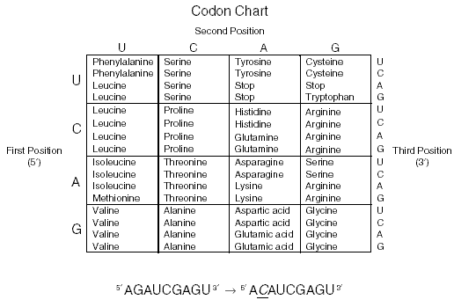
Transcribe and Translate the Following Sequence of DNA
DNA CODE: TAC GCT TTC ATG CGT TGA ACT mRNA CODON: ______ ______ ______ _____ ______ _____ _____ AMINO ACID: ______ ______ ______ _____ ______ _____ _____

Slide 26
Transcribe and Translate the Following Sequence of DNA
DNA CODE: TAC GCT TTC ATG CGT TGA ACT mRNA CODON: AUG CGA AAG UAC GCA ACU UGA AMINO ACID: ______ ______ ______ _____ ______ _____ _____

Slide 27
Transcribe and Translate the Following Sequence of DNA
DNA CODE: TAC GCT TTC ATG CGT TGA ACT mRNA CODON: AUG CGA AAG UAC GCA ACU UGA AMINO ACID: Meth Arg Lys Tyr Ala Thr STOP

Slide 28
DNA Mutations
Original DNA
TAC GCT TTC ATG CGT TGA ACT
Which of the following is a Point Mutation, Insertion or Deletion?
TAC GCT TTA TGC GTT GAA CT
TAC GCT TTC ATG CGT TTG AAC T
TAC GCT TAC ATG CGT TGA ACT

Slide 29
DNA Mutations
Original DNA
TAC GCT TTC ATG CGT TGA ACT
Which of the following is a Point Mutation, Insertion or Deletion?
TAC GCT TTA TGC GTT GAA CT
TAC GCT TTC ATG CGT TTG AAC T
TAC GCT TAC ATG CGT TGA ACT

Slide 30
DNA Technology Terms
Restriction Enzymes
GMO
PCR
DNA Electrophoresis
An organism that has been changed with the DNA of another organism: Golden rice, Bacteria that produce human insulin, Spider Goats
Process of replicating DNA without cells
Separating DNA fragments for analysis
Cut DNA at specific nucleotide sequences to form sticky ends – allows for genetic recombination or analysis

Slide 31
DNA Technology Terms
Restriction Enzymes
GMO
PCR
DNA Electrophoresis
An organism that has been changed with the DNA of another organism: Golden rice, Bacteria that produce human insulin, Spider Goats
Process of replicating DNA without cells
Separating DNA fragments for analysis
Cut DNA at specific nucleotide sequences to form sticky ends – allows for genetic recombination or analysis

Slide 32
DNA Technology Terms
Restriction Enzymes
GMO
PCR
DNA Electrophoresis
An organism that has been changed with the DNA of another organism: Golden rice, Bacteria that produce human insulin, Spider Goats
Process of replicating DNA without cells
Separating DNA fragments for analysis
Cut DNA at specific nucleotide sequences to form sticky ends – allows for genetic recombination or analysis

Slide 33
DNA Technology Terms
Restriction Enzymes
GMO
PCR
DNA Electrophoresis
An organism that has been changed with the DNA of another organism: Golden rice, Bacteria that produce human insulin, Spider Goats
Process of replicating DNA without cells – polymerase chain reaction
Separating DNA fragments for analysis
Cut DNA at specific nucleotide sequences to form sticky ends – allows for genetic recombination or analysis

Slide 34
DNA Technology Terms
Restriction Enzymes
GMO
PCR
DNA Electrophoresis
An organism that has been changed with the DNA of another organism: Golden rice, Bacteria that produce human insulin, Spider Goats
Process of replicating DNA without cells – polymerase chain reaction
Separating DNA fragments for analysis
Cut DNA at specific nucleotide sequences to form sticky ends – allows for genetic recombination or analysis

Slide 35
Five samples of DNA were analyzed using DNA electrophoresis with the following results.
Which end of the gel was near the positive electrode?

Slide 36
Five samples of DNA were analyzed using DNA electrophoresis with the following results.
Which end of the gel was near the positive electrode?
Explanation: The wells( ) are where the DNA is initially placed. The DNA is negatively charged due to the phosphates (PO4⁻³) and therefore move toward the positive electrode.

Slide 37
Five samples of DNA were analyzed using DNA electrophoresis with the following results.
2) Which segment of DNA is the smallest?

Slide 38
Five samples of DNA were analyzed using DNA electrophoresis with the following results.
The agarose gel is like a jungle of vines and plants. Smaller pieces are able to move faster and farther.
2) Which segment of DNA is the smallest?

Slide 39
Five samples of DNA were analyzed using DNA electrophoresis with the following results.
If the five samples are from a domesticated dog, a wolf, a coyote, a cat, and a pig, which sample most likely belongs to the organisms?
(Hint: Domesticated Dogs are descended from Wolves, not coyotes, although all three species can successfully interbreed)
A B C D E

Slide 40
Five samples of DNA were analyzed using DNA electrophoresis with the following results.
If the five samples are from a domesticated dog, a wolf, a coyote, a cat, and a pig, which sample most likely belongs to the organisms?
(Hint: Domesticated Dogs are descended from Wolves, not coyotes, although all three species can successfully interbreed)
A = Pig – herbivore, most different from other four B & E = Wolf and Dog – Basically the same thing D = Coyote – slight difference, but almost the same as wolf and dog
C = Cat, not because cat starts with “c” but because it is similar to the other carnivore profiles. Cats are more like dogs than they are like pigs.
A B C D E

Slide 41
Five samples of DNA were analyzed using DNA electrophoresis with the following results.
Draw a cladogram for the pig, wolf, cat, coyote, dog data.
A B C D E

Slide 42
Five samples of DNA were analyzed using DNA electrophoresis with the following results.
Draw a cladogram for the pig, wolf, cat, coyote, dog data.
Wolf
Dog
Coyote
Cat
Pig
A B C D E
Note: This cladogram doesn’t actually represent the evolutionary lineage of dogs and cats. Cats actually would be farther down the line on the cladogram since they have a more specialized diet and retractable claws. But the limited data from the DNA analysis supports this tree. Any cladograms you must draw on the exam must represent the data you are given, not necessarily the actual reality.

Slide 43
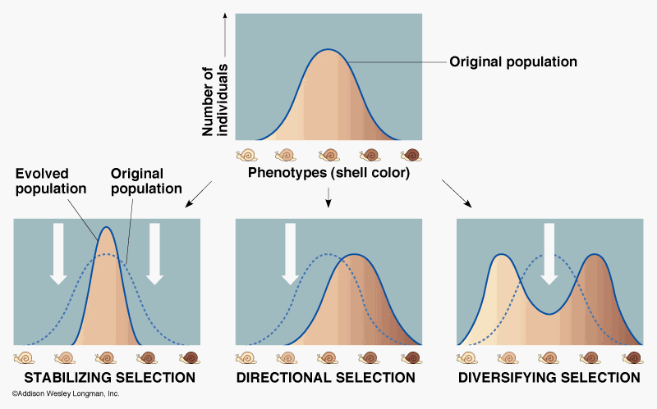
Identify the following types of natural selection as stabilizing, directional, or diversifying (disruptive).

Slide 44
Identify the following types of natural selection as stabilizing, directional, or diversifying (disruptive).

Slide 45
Evolution Terms
Fitness
Speciation
Genetic Drift
Bottle Neck Effect
Founder Effect
The formation of a new species
Loss of genetic diversity due to separation of a few individuals from the main population
The loss of genetic diversity due to random chance (Ex: Wind pollination)
Loss of genetic diversity due to a natural disaster
The ability to survive and reproduce to make viable offspring.

Slide 46
Evolution Terms
Fitness
Speciation
Genetic Drift
Bottle Neck Effect
Founder Effect
The formation of a new species
Loss of genetic diversity due to separation of a few individuals from the main population
The loss of genetic diversity due to random chance (Ex: Wind pollination)
Loss of genetic diversity due to a natural disaster
The ability to survive and reproduce to make viable offspring.

Slide 47
Evolution Terms
Fitness
Speciation
Genetic Drift
Bottle Neck Effect
Founder Effect
The formation of a new species
Loss of genetic diversity due to separation of a few individuals from the main population
The loss of genetic diversity due to random chance (Ex: Wind pollination)
Loss of genetic diversity due to a natural disaster
The ability to survive and reproduce to make viable offspring.

Slide 48
Evolution Terms
Fitness
Speciation
Genetic Drift
Bottle Neck Effect
Founder Effect
The formation of a new species
Loss of genetic diversity due to separation of a few individuals from the main population
The loss of genetic diversity due to random chance (Ex: Wind pollination)
Loss of genetic diversity due to a natural disaster
The ability to survive and reproduce to make viable offspring.

Slide 49
Evolution Terms
Fitness
Speciation
Genetic Drift
Bottle Neck Effect
Founder Effect
The formation of a new species
Loss of genetic diversity due to separation of a few individuals from the main population
The loss of genetic diversity due to random chance (Ex: Wind pollination)
Loss of genetic diversity due to a natural disaster
The ability to survive and reproduce to make viable offspring.

Slide 50
Evolution Terms
Fitness
Speciation
Genetic Drift
Bottle Neck Effect
Founder Effect
The formation of a new species
Loss of genetic diversity due to separation of a few individuals from the main population
The loss of genetic diversity due to random chance (Ex: Wind pollination)
Loss of genetic diversity due to a natural disaster
The ability to survive and reproduce to make viable offspring.

Slide 51
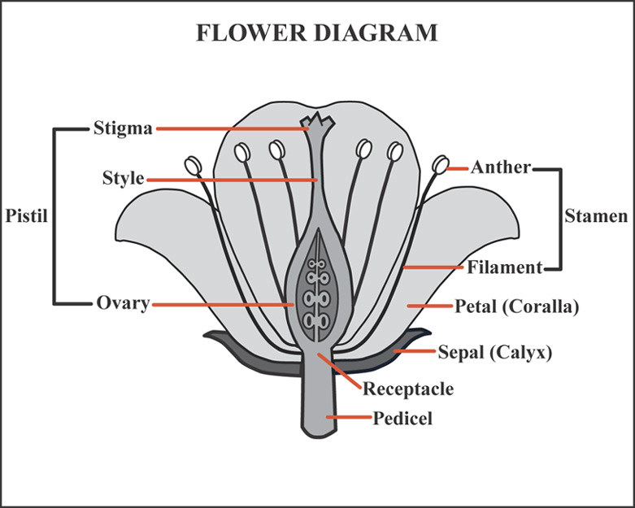
Label the following diagram:

Slide 52
Label the following diagram:

Slide 53
Plant Group Characteristics
Plant Group | Spore Producing | Motile Sperm (Need Water) | Vascular Tissue | Seed Producing | Seeds Covered with Fruit
Bryotphytes
Ferns
Gymnosperms
Angiosperms

Slide 54
Plant Group Characteristics
Plant Group | Spore Producing | Motile Sperm (Need Water) | Vascular Tissue | Seed Producing | Seeds Covered with Fruit
Bryotphytes
Ferns
Gymnosperms
Angiosperms

Slide 55
Complete the following charts for the animal characteristics.
Hint: Rather than trying to remember a bunch of facts, remember what these animals look like. Pictures are easier to remember and carry more information than individual points of information.
If you don’t remember what they look like go to the Animal Powerpoint or use the Google Box.

Slide 56
Group | Radial Symmetry | Bilateral Symmetry | Gastrovascular Cavity | Complete Digestive System | Gills | Lungs | Exoskeleton | Cartilagenous Skeleton | Bony Skeleton
Sponges
Cnidarians
Acoelomate
Pseudocoelomate
Coelomate
Annelids
Mollusks
Arthropods
Echinoderms
Agnatha
Chondrichthes
Osteoichthes
Amphibians
Reptiles
Birds
Mammals

Slide 57
Group | Radial Symmetry | Bilateral Symmetry | Gastrovascular Cavity | Complete Digestive System | Gills | Lungs | Exoskeleton | Cartilagenous Skeleton | Bony Skeleton
Sponges | - | - | - | - | - | - | - | - | -
Cnidarians | + | - | + | - | - | - | - | - | -
Acoelomate | - | + | + | - | - | - | - | - | -
Pseudocoelomate | - | + | - | + | - | - | - | - | -
Coelomate | - | + | - | + | - | - | - | - | -
Annelids | - | + | - | + | - | - | - | - | -
Mollusks | - | + | - | + | + | - | - | - | -
Arthropods | - | + | - | + | + | - | + | - | -
Echinoderms | + | - | - | + | + | - | - | - | -
Agnatha | - | + | - | + | + | - | - | + | -
Chondrichthes | - | + | - | + | + | - | - | + | -
Osteoichthes | - | + | - | + | + | - | - | - | +
Amphibians | - | + | - | + | +/- | -/+ | - | - | +
Reptiles | - | + | - | + | - | + | - | - | +
Birds | - | + | - | + | - | + | - | - | +
Mammals | - | + | - | + | - | + | - | - | +

Slide 58
Group | Leathery Egg | Hard Shelled Egg | 2 Chambered Heart | 3 Chambered Heart | 4 Chambered Heart | Endotherm | Exotherm | Hair | Nurse Young
Sponges
Cnidarians
Acoelomate
Pseudocoelomate
Coelomate
Annelids
Mollusks
Arthropods
Echinoderms
Agnatha
Chondrichthes
Osteoichthes
Amphibians
Reptiles
Birds
Mammals

Slide 59
Group | Leathery Egg | Hard Shelled Egg | 2 Chambered Heart | 3 Chambered Heart | 4 Chambered Heart | Endotherm | Exotherm | Hair | Nurse Young
Sponges | - | - | - | - | - | - | + | - | -
Cnidarians | - | - | - | - | - | - | + | - | -
Acoelomate | - | - | - | - | - | - | + | - | -
Pseudocoelomate | - | - | - | - | - | - | + | - | -
Coelomate | - | - | - | - | - | - | + | - | -
Annelids | - | - | - | - | - | - | + | - | -
Mollusks | - | - | - | - | - | - | + | - | -
Arthropods | - | - | - | - | - | - | + | - | -
Echinoderms | - | - | - | - | - | - | + | - | -
Agnatha | - | - | + | - | - | - | + | - | -
Chondrichthes | - | - | + | - | - | - | + | - | -
Osteoichthes | - | - | + | - | - | - | + | - | -
Amphibians | - | - | - | + | - | - | + | - | -
Reptiles | + | - | - | + | - | - | + | - | -
Birds | - | + | - | - | + | + | - | - | -
Mammals | + | - | - | - | + | + | - | + | +

