Slide 1
Protists and Fungus

Slide 2
Protista: the hodgepodge group
Originally a kingdom of the miscellaneous organisms that didn’t exactly fit in the other groups
Has been split into numerous separate kingdoms although there is wide disagreement on how they should be classified
Common Characteristics: Eukaryotes

Slide 3
General Classifications: 1) Animal like protists = protozoa 2) Plant like protists = algae 3) Fungus like protists = slime molds

Slide 4
Animal Like Protists: - unicellular - heterotrophic

Slide 5
Groups: Ciliates: move using numerous hair like structures called cilia

Slide 6
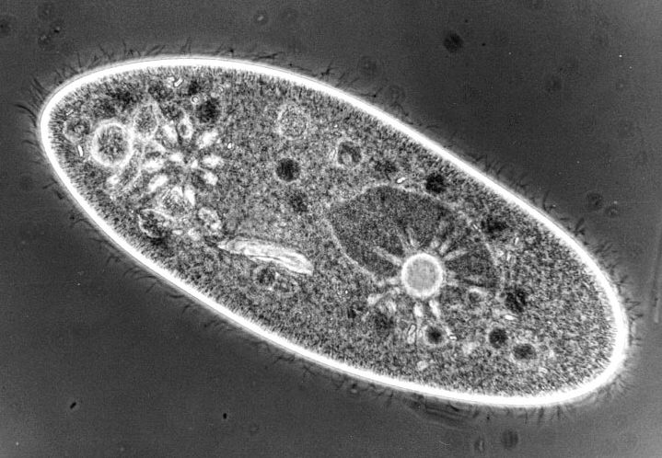
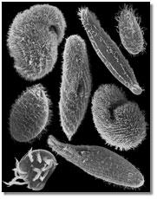
Paramecia

Slide 7
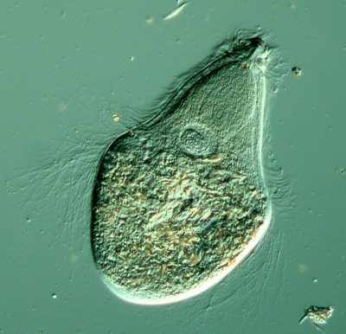
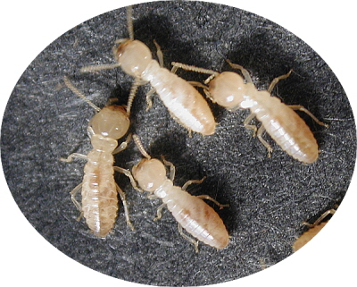
-Trychonympha – guts of termites – mutualism

Slide 8
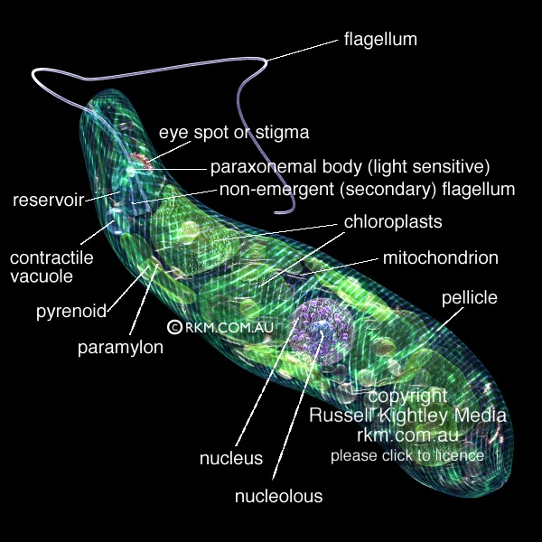
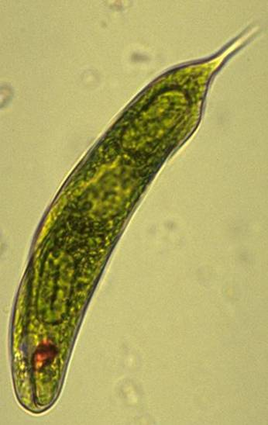
Flagellates: move using numerous whip like structures called flagella - Euglena - mixotrophic

Slide 9
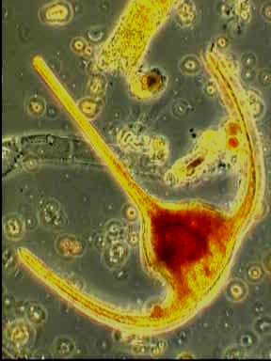
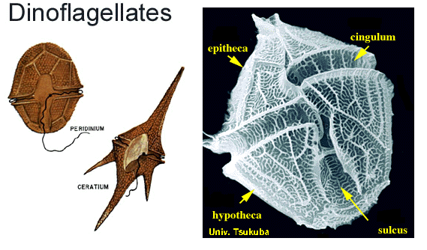
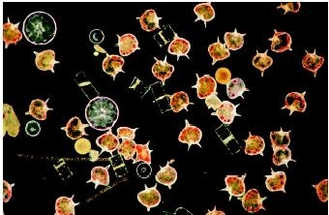
- Dinoflagellates – cause Red Tide

Slide 10
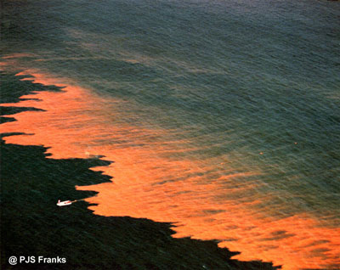
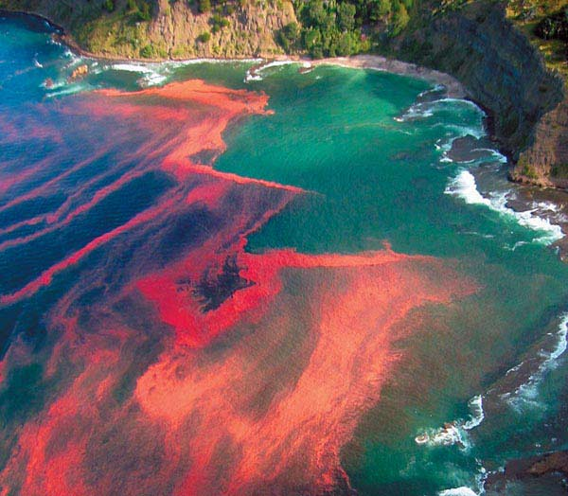
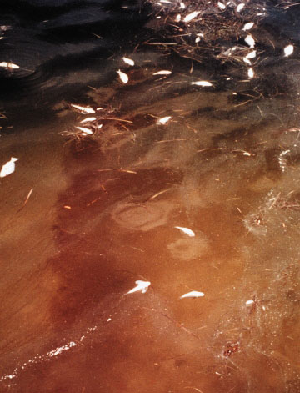
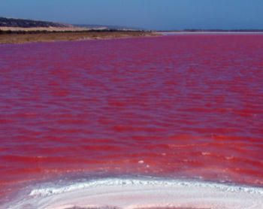
Red Tide
Temperature and nutrient conditions cause rapid growth of dinoflagellates - gives water a red color - large amounts of dinoflagellates secrete toxins and kill fish - mussels (clams and oysters) eat dinoflagellates and become poisonous

Slide 11
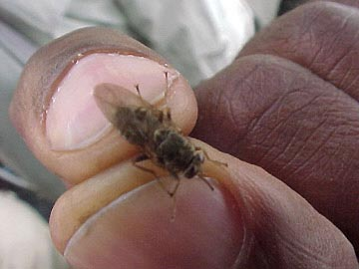
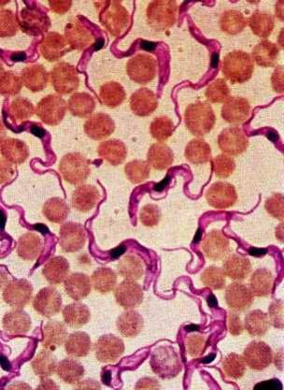
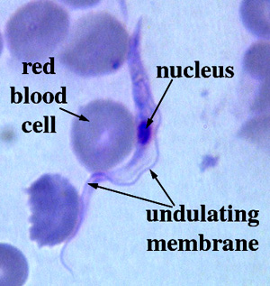
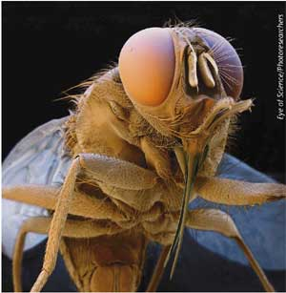
- Trypanosome – Causes African Sleeping Sickness – transferred by Tse-Tse Fly

Slide 12
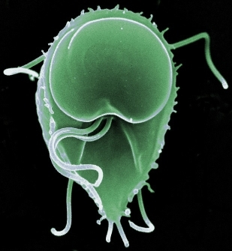
- Giardia – “beaver fever”

Slide 13
Psuedopodia: move using extensions of the cell membrane and cytoplasm called pseudopods (“false foot”) that are also used to surround and engulf food by phagocytosis

Slide 14
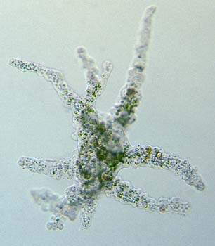
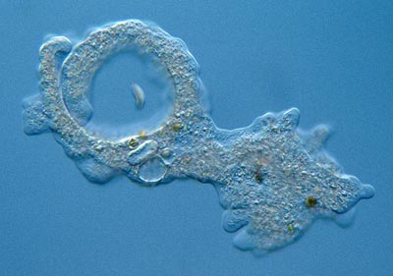
- Amoebas - can cause disease – Amoebic dysentery

Slide 15
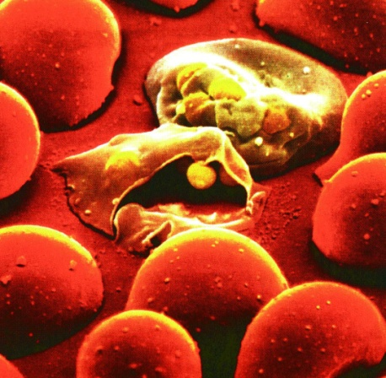
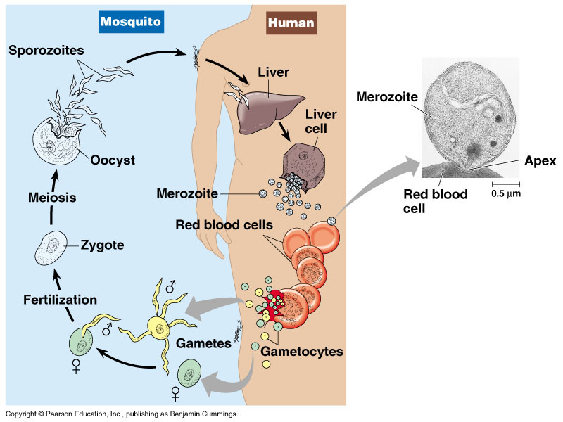
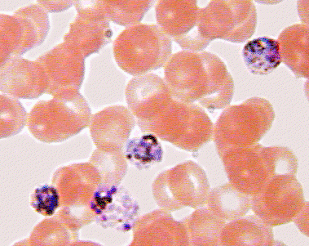
Sporozoans: spore forming - Plasmodium – causes malaria
- transferred by Mosquitos

Slide 16
Plant Like Protists: - unicellular and multicellular - photosynthetic

Slide 17
Diatoms: cell walls made of silica – glass like – complex shapes - unicellular - - very abundant in fresh and salt water - many layers can form Diatomaceous Earth – used in filters and toothpaste

Slide 18
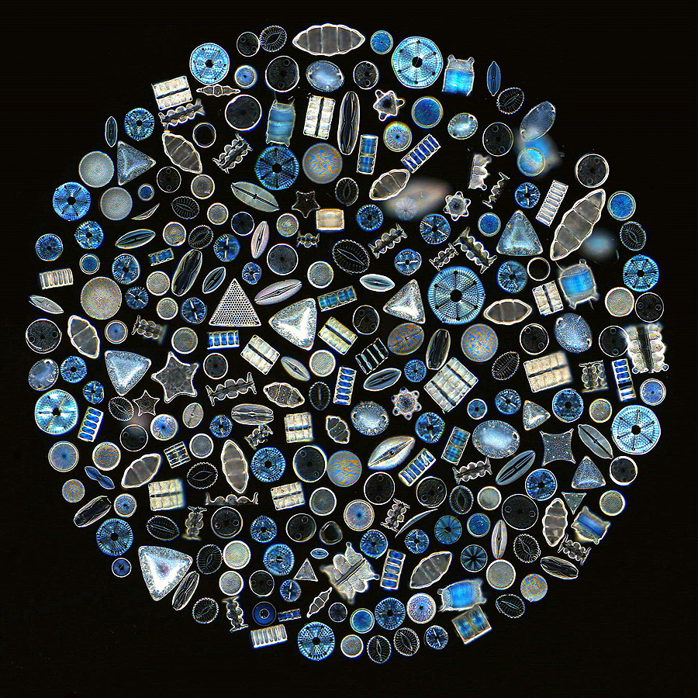

Slide 19
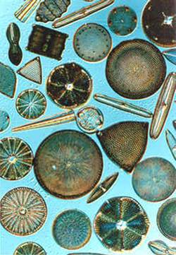
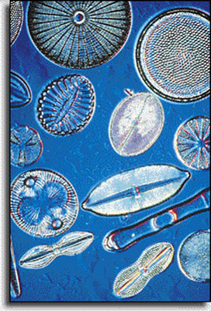

Slide 20
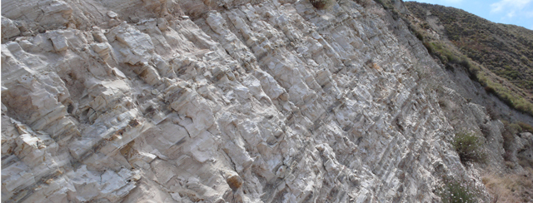
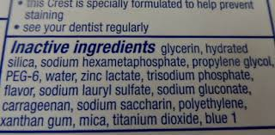

Slide 21
Algae: 3 Types: Classified based on the major photosynthetic pigment color 1) Red Algae – manly red in color – although it can appear green or black

Slide 22
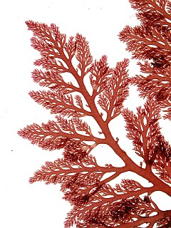
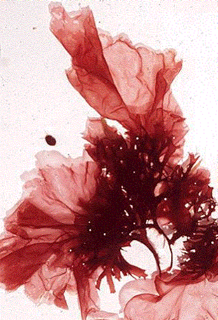

Slide 23
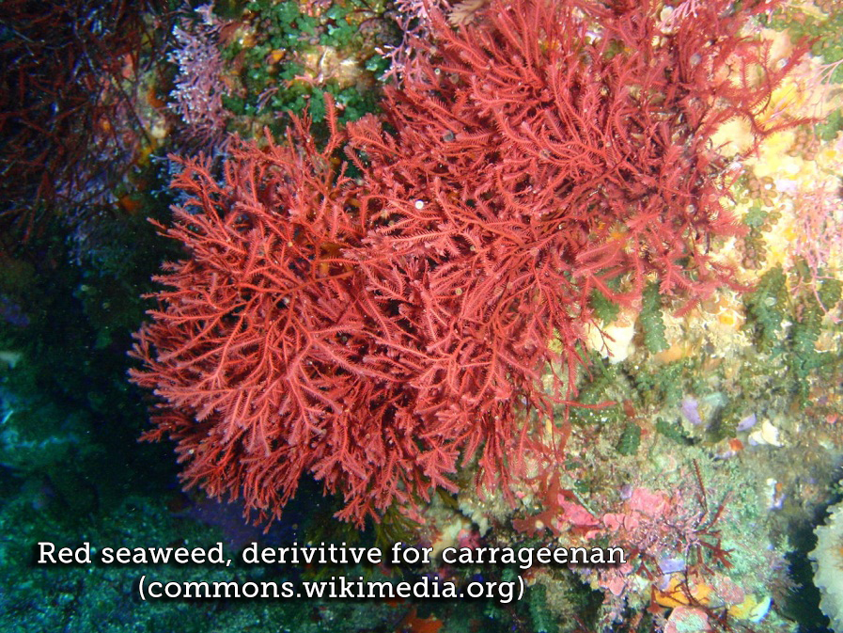
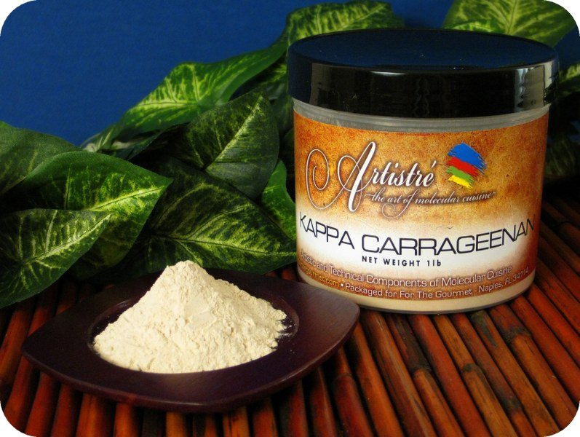
Ex: Carageenan – food stabilizer

Slide 24
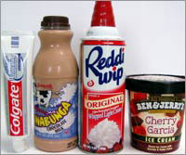

Slide 25
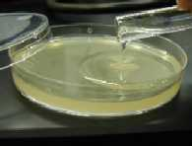
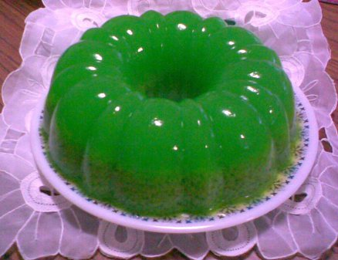
Agar – food stabilizer and microbiology

Slide 26
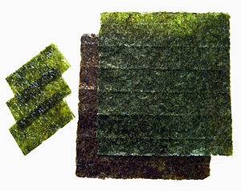
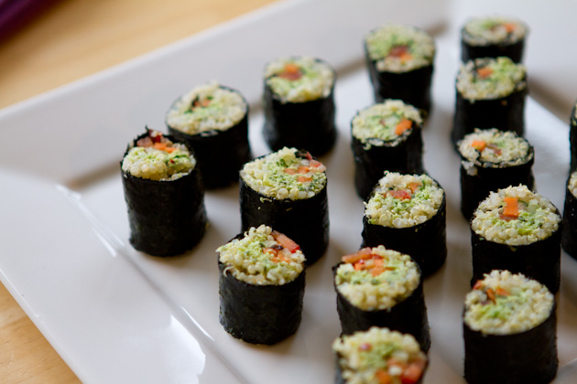
Nori – edible seaweed used to wrap sushi

Slide 27
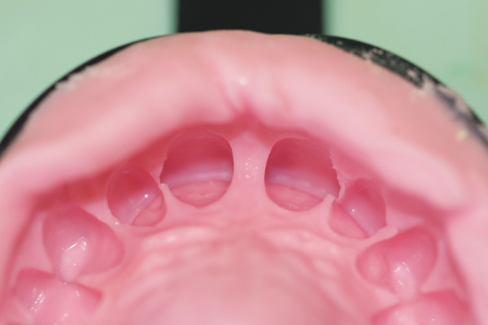
2) Brown Algae – largest of all algae Ex: Kelp – food for many organisms - creates a kelp forest which supports many organisms - Alginate: food stabilizer and mold cast

Slide 28
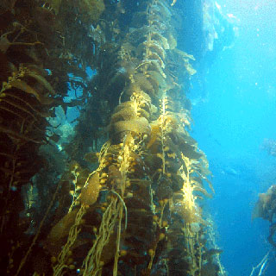
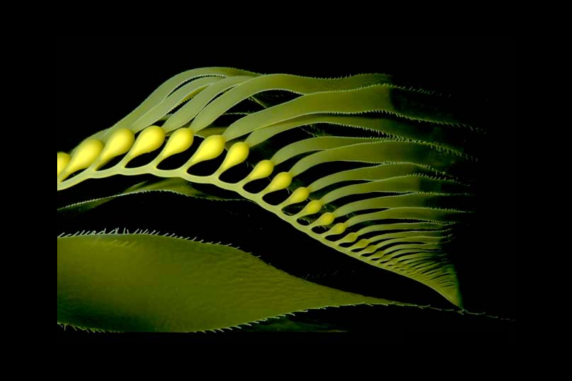
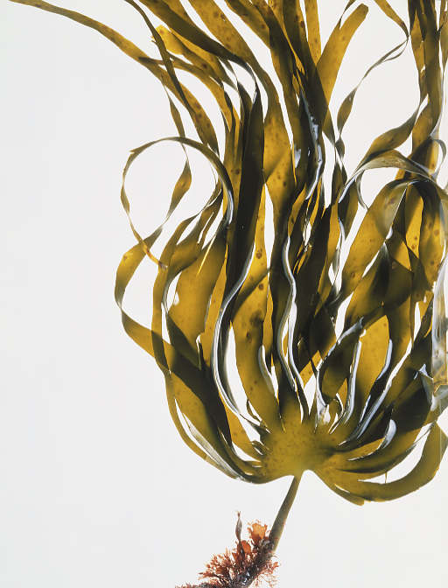

Slide 29
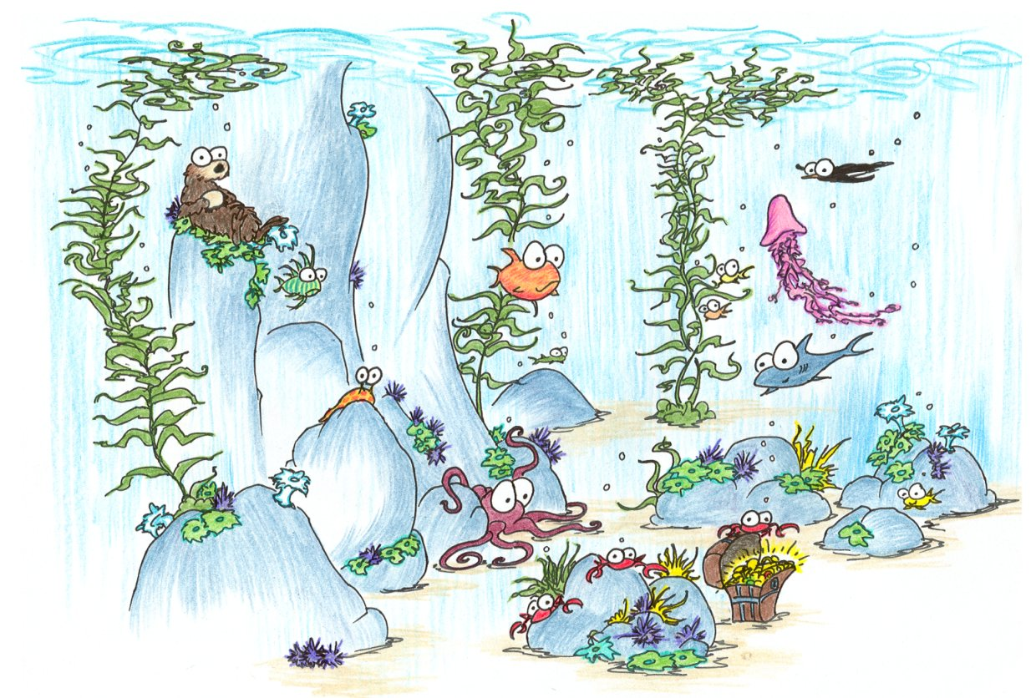
Ecologic Importance of Kelp
Kelp Video #1
Kelp Video #2

Slide 30
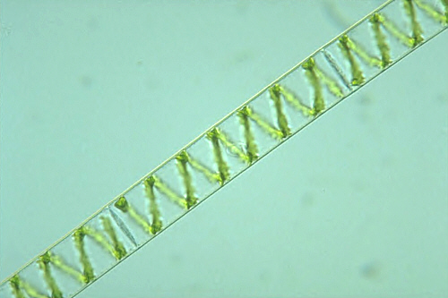
3) Green Algae – debate over classification – protists or plants Ex: Spirogyra - pond scum

Slide 31
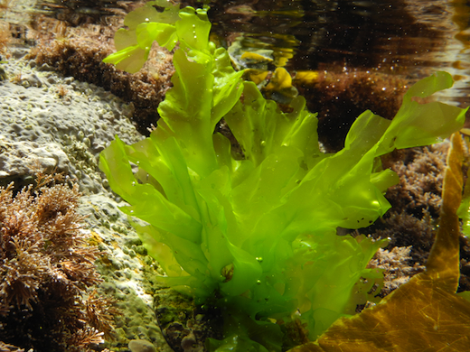
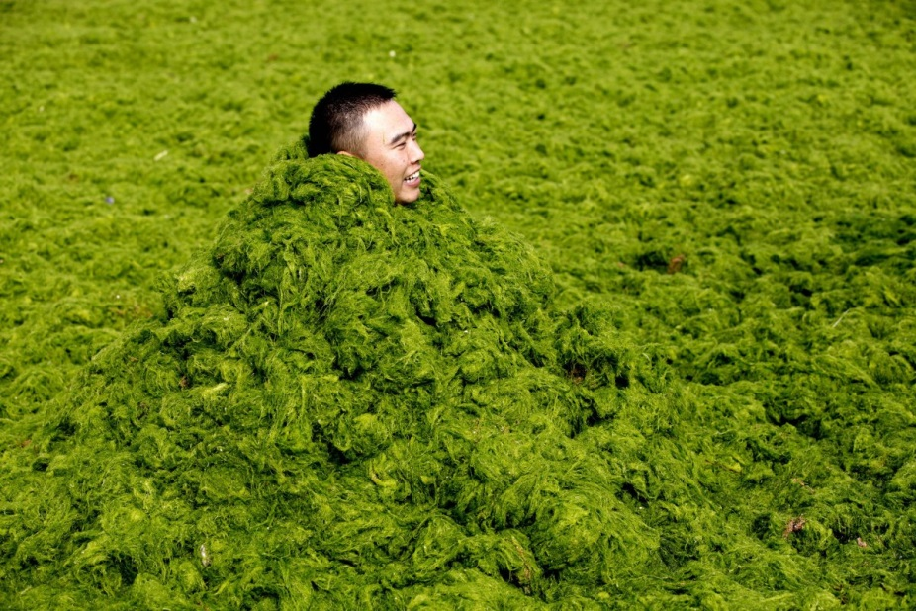
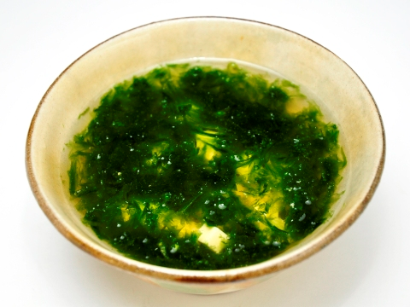
Sea Lettuce – used as food

Slide 32
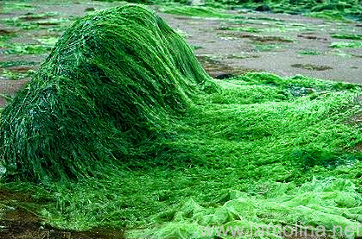
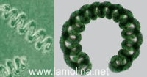
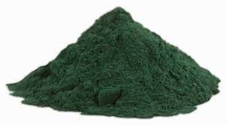
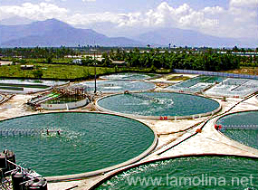
Spirulina – nutritional supplement

Slide 33
Lichen – mutualism with fungus

Slide 34
Fungus Like Protists: slime molds and water molds - multicellular – - decomposers - many feed on bacteria and fungi - cell walls made of cellulose Cause many diseases: - Ick in fish

Slide 35
Kingdom Fungi: - unicellular and multicellular - decomposers - cell walls made of chitin – -reproduce using spores - excrete digestive enzymes outside of their cells to digest their food and then absorb the nutrients

Slide 36
Examples: - yeast – bread making

Slide 37
Club Fungi – mushrooms - Mushroom is actually the reproductive structure (fruiting body) while the main body of the fungus is underground breaking down dead material and growing into a mass of thin filaments (hyphae) called the mycelium

Slide 40
(b) Maiden veil fungus (Dictyphora), a fungus with an odor like rotting meat
(a) Fly agaric (Amanita muscaria), a common species in conifer forests in the northern hemisphere
(d) Puffballs emitting spores
Figure 31.18a–d
(c) Shelf fungi, important decomposers of wood

Slide 41
- Mold Fungi – bread mold

Slide 42
- Lichens – mutualism between fungi and algae – important for primary succession and the formation of soil from rocks
Ascocarp of fungus
Soredia
Fungal
hyphae
Algal
layer
Algal cell
Fungal hyphae
Figure 31.24
^{10 μm}

Slide 44
- Mycorrhizae – symbiosis between fungus and plant roots – the fungus increases the surface area of the plant roots allowing them to absorb more water and nutrients while the plant provide the fungus with sugars

Slide 46
Other Roles of Fungus: - parasites and disease: huge impact on crops – corn smut and wheat rust - attack animals: Cordyceps, athlete’s foot fungus, ring “worm”

