Slide 1
Prokaryotes and Viruses

Slide 2
Diversity of Life: Prokayotes
Review: Pro. vs. Eu.
Prokaryotic:
- “no” nucleus = nucleoid – simple, circular genome + plasmids
- unicellular
Eukaryotic:
- “true” nucleus
- unicellular and multicellular

Slide 3
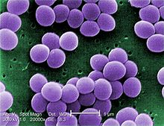
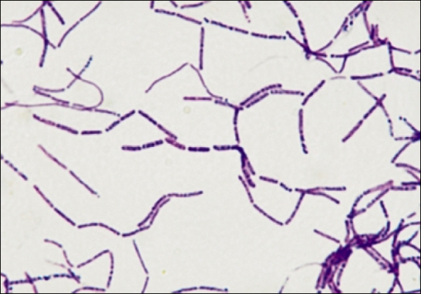
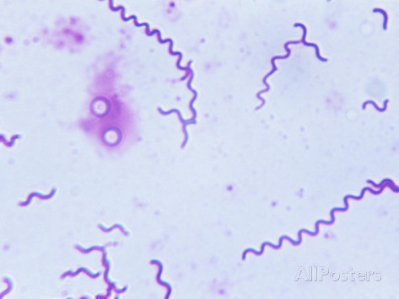
Structure
Shape:
coccus/cocci - round
baccillus/bacilli - rod
spirillum - helix
Colony Types:
Strepto = chains
Staphylo = cluster

Slide 4
Structure of Prokaryotes
Shapes and Colonies
1. Strepto = chains
- strep = stripe
Cocci
Bacilli
Ex: Streptococus
Spirillum
- spirochetes
2. Staphylo - cluster
Ex: Staphylococcus

Slide 5
Cell Wall Composition
Bacteria Wall Structure: Archae Wall Structure:
Gram Positive Plates of Proteins
Gram Negative
Flagella

Slide 6
Wall Structure of Bacteria: Gram Positive Vs. Gram Negative
Composition of Wall = Peptidoglycan +/- Outer Membrane
Peptidoglycan:
Polymers of modified sugar
Cross linked by short polypeptides (proteins)
Outer Membrane: Determines if cell is Gram + or Gram -
How: Use of “Gram Stain” – series of dyes and stains applied to bacteria
Binds to Peptidoglycan – used for identifying bacteria
Gram +
Gram -
= more peptidoglycan = much stain
Positive
= less peptidoglycan = little stain
Negative

Slide 7
Cross-Section of Gram Positive Wall
Peptidoglycan
Plasma Membrane
Cross-Section of Gram Negative Wall
Outer Membrane
Peptidoglycan
Plasma Membrane

Slide 8
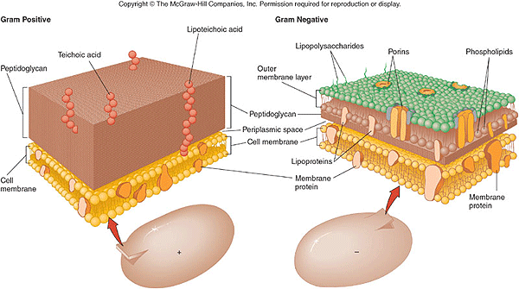

Slide 9
Negative vs. Positive: Importance of Classification
Gram Negative Wall
Trouble for the Infected
1. Outer Membrane Contains Lipopolysaccharides
- Can be toxic!
2. Outer Membrane “hides” bacteria from host’s immune system
3. Outer Membrane gives extra resistance to Antibiotics
– impedes transport of antibiotic into the cell
RESULT: Identify Bacteria to determine treatment.

Slide 10
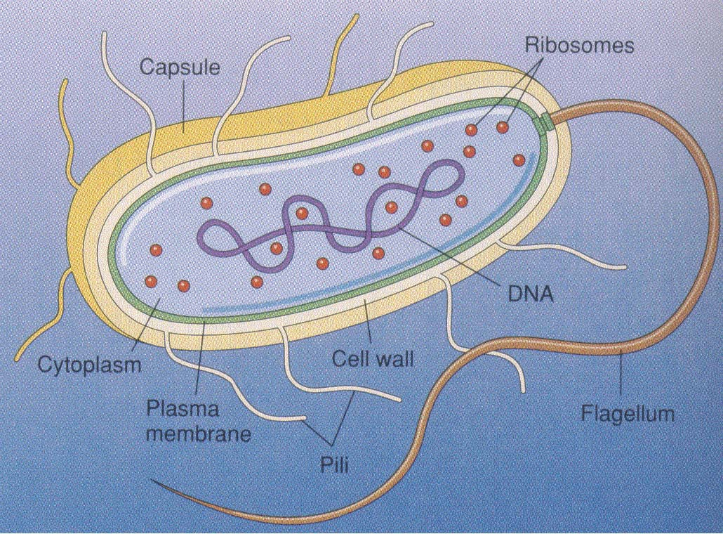

Slide 11
Bacterial Flagellum

Slide 12
Classification of Prokaryotes: Based on Signature Sequences of rRNA and Nucleic Acids
Archaea: the ancient extremists – usually live in harsh environments

Slide 13
Archae
Methanogens
- methane producers
live in anaerobic environments
use H2 to convert CO2 to CH4 = methane gas
Location:
swamps
guts of animals (cows – symbionts – help digest large quantities of cellulose)

Slide 14
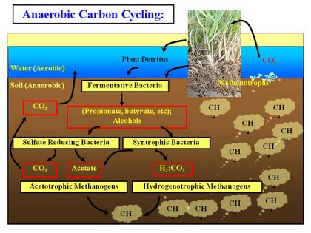

Slide 15
Archae
Extreme Halophiles
salt lovers
Live in very saline conditions – up to ten times more than sea water
Form a purple-red scum
– due to bacteriorhodopsin (photosynthetic)

Slide 16
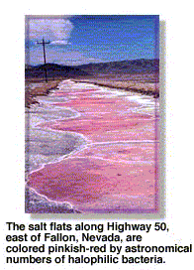
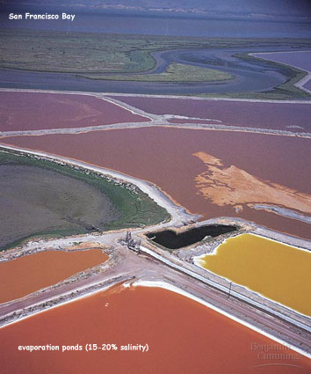

Slide 17
Archae
Extreme Thermophiles
heat lovers
Live in very warm environments (60º – 80º Celsius)
Ex. Hot springs or Undersea Hydrothermal vents (105º C)

Slide 18
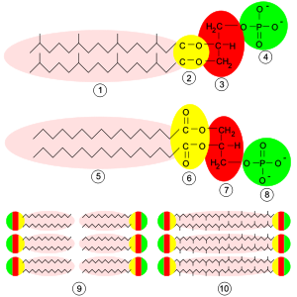
Normal Thermophilic

Slide 19
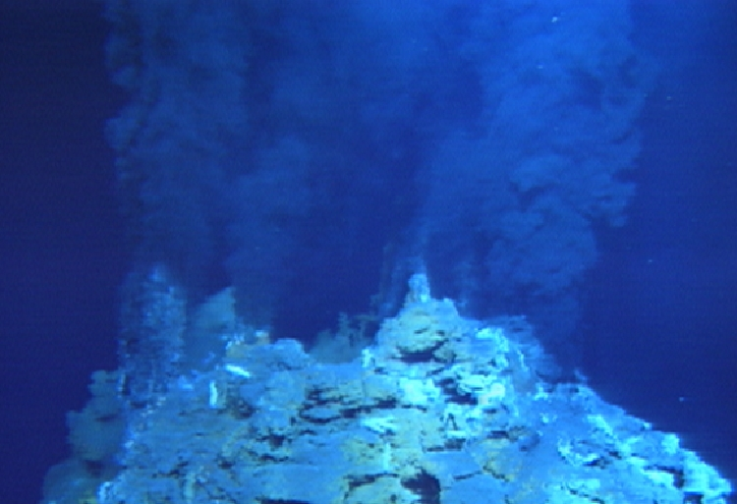

Slide 20
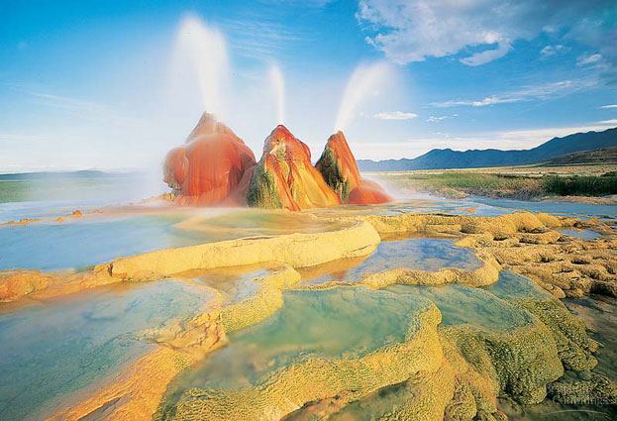

Slide 21
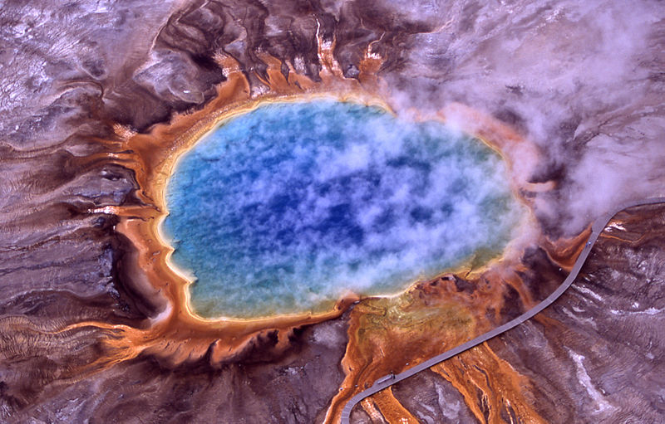

Slide 22
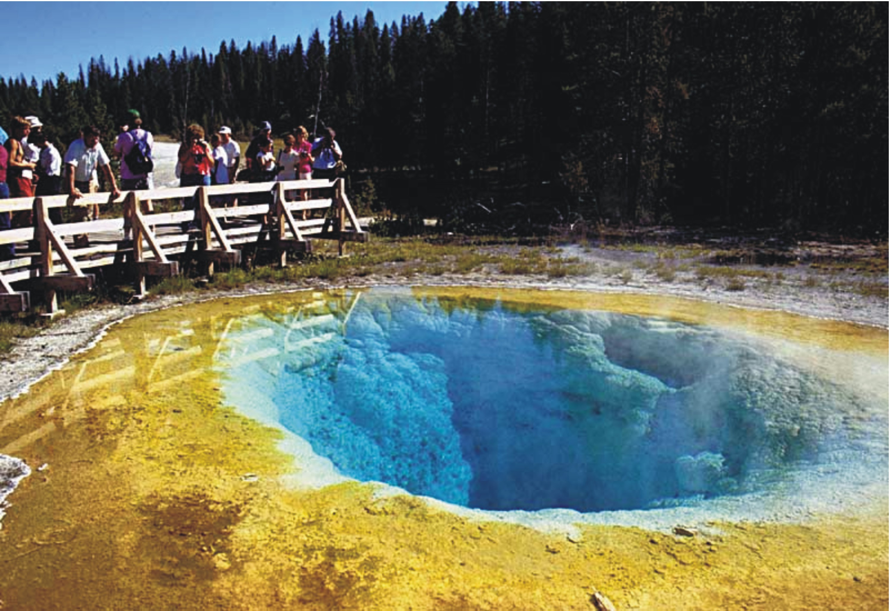

Slide 23
Bacteria: most common type of prokaryote
Types:
Oodles – classification based on structure and metabolism

Slide 24
Ecological Roles of Prokaryotes
Saprobes = decomposers
Parasites = absorb nutrients from body fluids of living hosts
Nitrogen Metabolism = Nitrogen Fixation
- key to nitrogen cycle
- fix atmospheric nitrogen (N₂) into ammonia (NH₃) for uptake by plants
Denitrification
converting NH₃, NO₂⁻ or NO₃⁻ to N₂

Slide 25
Ecological Roles of Prokaryotes
Producers: photosynthetic bacteria – cyanobacteria → blue green algae
Mutualism: Methanogens: guts of cows
Root nodules of Legumes for nitrogen fixation

Slide 26
Prokaryotes in Research and Technology
Food: cheese and yogurt
Bioremediation: using a living organism to clean the environment
Ex: decompose sewage, breakdown radioactive waste and oil spills
Industry: ore refining
Ex: remove copper from copper sulfides, extract gold from ore
Genetic Engineering:
Ex: produce vitamins, antibiotics, hormones, gene cloning

Slide 27
Viruses
Common Characteristics:
Tiny
Protein Shell (Capsid)
Nucleic Acid Core (RNA or DNA)
Optional Upgrades - External Membranous Envelope - Results due to mode of infection

Slide 28
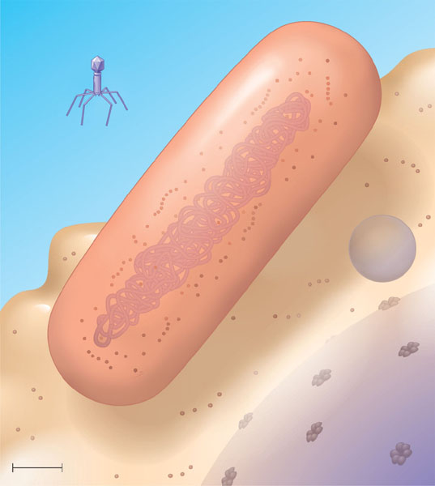
Virus
Bacterium
Animal cell
Animal cell nucleus
0.25 μm

Slide 29
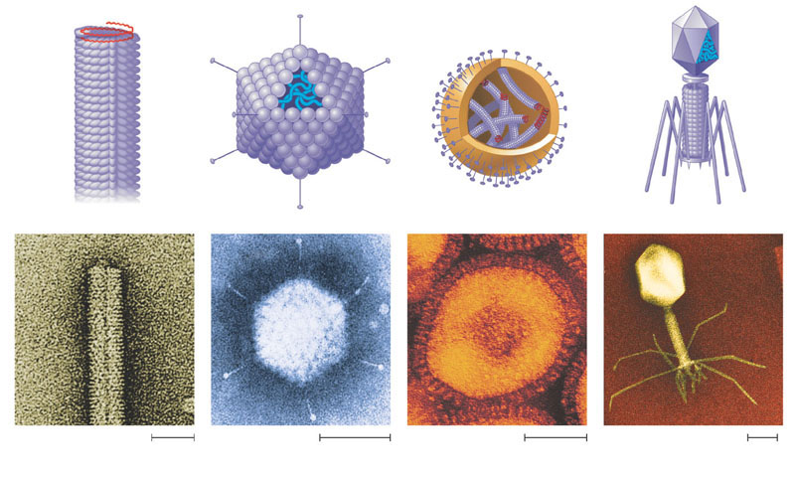
Capsomere of capsid
RNA
Membranous envelope
Capsomere
DNA
Head
Capsid
Tail sheath
DNA
RNA
Tail fiber
Glycoprotein
Glycoprotein
18 × 250 mm
70–90 nm (diameter)
80–200 nm (diameter)
80 × 225 nm
20 nm
50 nm
50 nm
50 nm
(a) Tobacco mosaic virus
(b) Adenoviruses
(c) Influenza viruses
(d) Bacteriophage T4

Slide 30
Viral Infection Patterns
Lytic Cycle
Lysogenic Cycle
Viral Envelopes

Slide 31
Lytic Cycle
Virus attaches to host.
Virus injects DNA into host.
Viral DNA directs host cell to copy viral DNA and make components for protein shell.
Viral parts assemble until the host cell lyses (splits open) releasing new viruses.

Slide 32
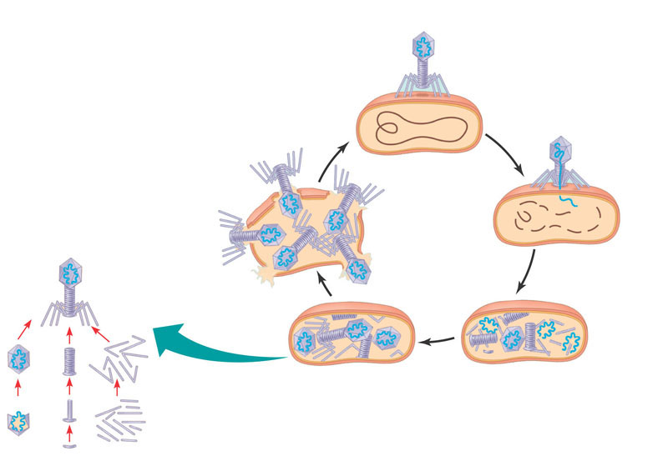
1
Attachment. The T4 phage uses its tail fibers to bind to specific receptor sites on the outer surface of an E. coli cell.
2
Entry of phage DNA and degradation of host DNA. The sheath of the tail contracts, injecting the phage DNA into the cell and leaving an empty capsid outside. The cell’s DNA is hydrolyzed.
5
Release. The phage directs production of an enzyme that damages the bacterial cell wall, allowing fluid to enter. The cell swells and finally bursts, releasing 100 to 200 phage particles.
Phage assembly
4
3
Synthesis of viral genomes and proteins. The phage DNA directs production of phage proteins and copies of the phage genome by host enzymes, using components within the cell.
Assembly. Three separate sets of proteins self-assemble to form phage heads, tails, and tail fibers. The phage genome is packaged inside the capsid as the head forms.
Head
Tails
Tail fibers

Slide 33
Lysogenic Cycle
Virus attaches to host and injects DNA.
Viral DNA integrates into the host DNA.
Host reproduces normally while replicating the viral DNA at the same time.
Something triggers the viral DNA to leave the host DNA triggering the lytic cycle.

Slide 34
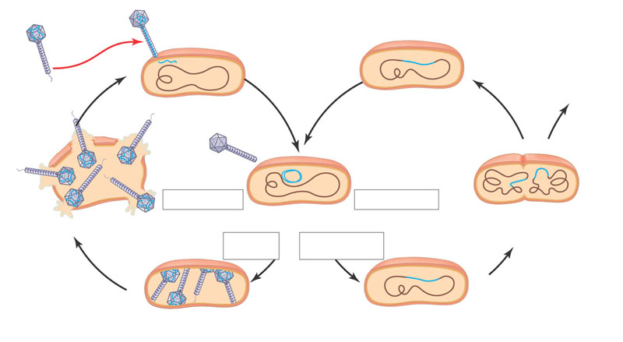
Phage
DNA
The phage attaches to a
host cell and injects its DNA.
Many cell divisions produce a large population of bacteria infected with the prophage.
Phage DNA
circularizes
Phage
Occasionally, a prophage exits the bacterial chromosome,
initiating a lytic cycle.
Bacterial
chromosome
Lytic cycle
Lysogenic cycle
Certain factors
determine whether
The bacterium reproduces
normally, copying the prophage
and transmitting it to daughter cells.
The cell lyses, releasing phages.
Lytic cycle
is induced
or
Lysogenic cycle
is entered
Prophage
New phage DNA and proteins are synthesized and assembled into phages.
Phage DNA integrates into the bacterial chromosome, becoming a prophage.

Slide 35
Enveloped Viruses
Envelope is a phospholipid bilyer with surface glycoproteins that bind to specific proteins of the host’s cell membrane.
If the binding proteins are not present then the virus cannot infect the cell. Thus, since different species have different surface proteins, viruses tend to be species specific unless two species share common surface proteins.

Slide 36
Enveloped Virus Cycle
Virus envelope binds to surface of host cell’s membrane.
Envelope fuses with the host’s membrane and dumps the protein capsid and nucleic acids into the cell.
Host cell makes copies of the viral genome, capsid proteins and glycoproteins.
Viral components assemble in the cell and exits by exocytosis picking up the envelope with the glycoproteins on the outside.
Video

Slide 37
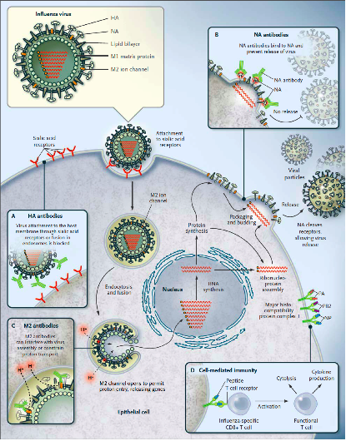

Slide 38
Viral Classification
Based on type of nucleic acids
DNA: double or single stranded
RNA: double or single stranded
Further classification is based on what the RNA does once infection occurs
May act as mRNA, a template for mRNA or a template for DNA
Last type manufactures an enzyme called REVERSE TRANSCRIPTASE and is called a RETROVIRUS - Ex: HIV - Human Immunodeficiency Virus - attacks white blood cells

Slide 39
ANTIBIOTICS treat BACTERIA.
They DO NOT treat VIRUSES.
Measles
Ebola

