Slide 1
Polypeptide Synthesis -Making Proteins

Slide 2
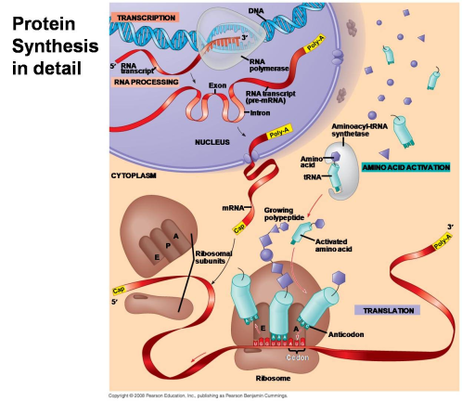

Slide 3
DNA controls the cell by directing the manufacture of proteins.
Proteins are macromolecules made up of long chains of amino acids.
Amino acids are held together by chemical bonds called peptide bonds. Thus a long chain of amino acids is also called a polypeptide. (Remember: Proteins are digested in the stomach by the enzyme PEPSIN.)

Slide 4
Three Main Steps of Polypeptide (Protein) Synthesis
1. DNA is copied into RNA = Transcription Three types of RNA are made:
Messenger = mRNA
Transfer = tRNA
Ribosomal = rRNA

Slide 5
2. Messenger RNA is altered to its final form = RNA Processing
3. RNA (m, t, r) work together to assemble the amino acid chain = Translation

Slide 6
BACKGROUND:
RNA Structure: - Single stranded - Uracil instead of Thymine - Ribose instead of Deoxyribose

Slide 7
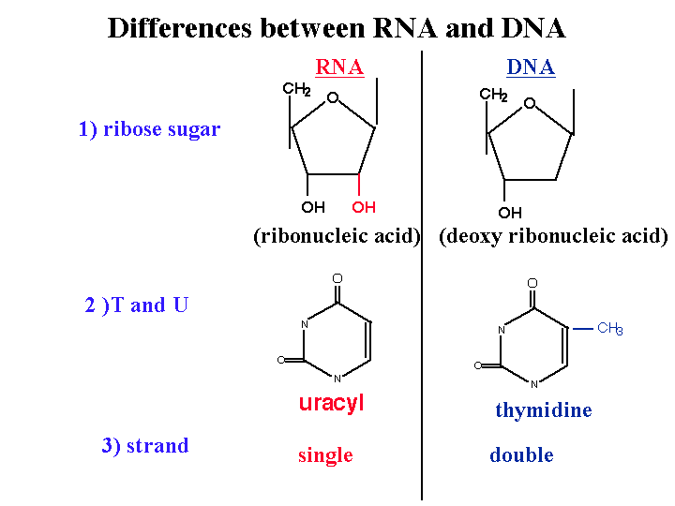

Slide 8
mRNA Structure: - single strand - linear - hundreds to thousands of nucleotides long - 5’ end gets capped with a Guaninosine Triphosphate (GTP) - 3’ end gets a long tail of Adenines

Slide 9
tRNA Structure:
about 80 nucleotides long
attaches to itself and forms double stranded RNA sections and then folds into a upside down L shape
3’ end is where the amino acids attaches for the process of translation
in the middle of the tRNA is a three segment nucleotide sequence called the anti-codon
this matches to the mRNA nucleotide sequences which are called the codon

Slide 10
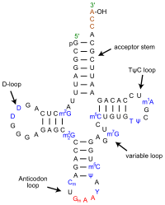
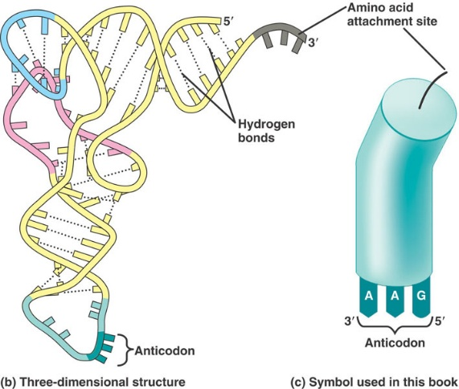

Slide 11
rRNA Structure:
- rRNA combines with proteins in the nucleolus to form two ribosomal structures: small and large sub-units
- small subunit holds the mRNA
- large subunit holds the tRNA in place so amino acids can link together to make the amino acid chain (protein)
- the large subunit has three reaction sites, E site, P site, A site, where the amino acid chain is built

Slide 12
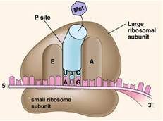

Slide 13
Polypeptide Synthesis: the Details
1) Transcription: WHERE: In the nucleus
WHAT: DNA, RNA polymerase, RNA nucleotides

Slide 14
HOW:
RNA Polymerase bonds to the beginning of the gene
RNA Polymerase unzips the DNA and moves along the gene
RNA is built complimentary to the DNA in the 5’ to 3’ direction
A → U, G → C, T → A, C → G

Slide 15
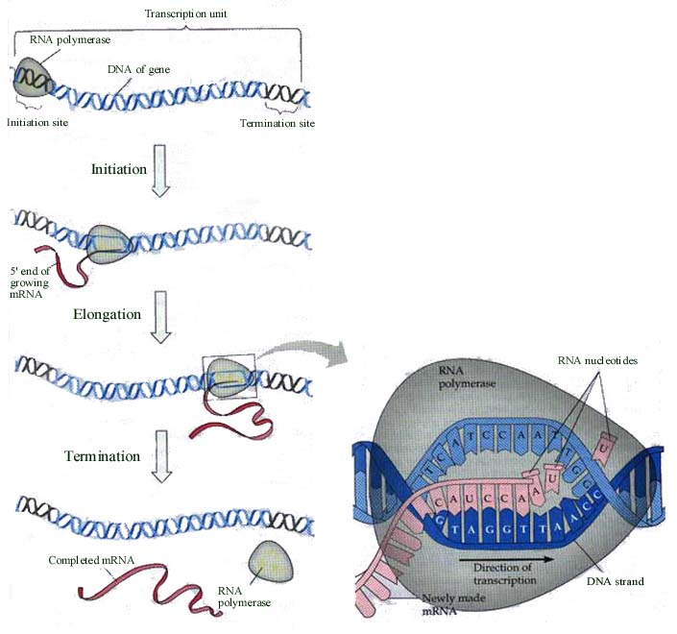

Slide 16
2) RNA Processing: WHERE: Nucleus WHAT: tRNA, rRNA, mRNA, GTP, Adenine, Enzymes

Slide 17
HOW: tRNA folds into its correct shape rRNA goes to nucleolus to become the ribosome
mRNA undergoes three main changes

Slide 18
1) 5’ end is capped with Guanosine Tri-phosphate – this is called the 5’ cap
2) 3’ end gets a polyadenylated tail – lots of adenines are added – helps keep the mRNA from falling apart
3) RNA is edited for interrupting information DNA contains two types of nucleic acid sequences in a gene. Exons: nucleotides that will be EXpressed as amino acids Introns: nucleotides that will not be expressed into amino acids and INterrupt the exons. INTRONS are cut out of the mRNA and the EXONS are pieced (Spliced) together

Slide 19
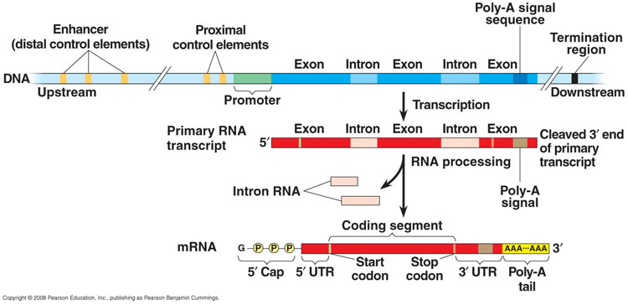

Slide 20
3) Translation:
WHERE: Cytoplasm WHAT: mRNA, tRNAs with attached amino acids, ribosomes, ATP

Slide 21
HOW:
The whole system is based on the basic reading frame of three nucleotides. DNA is called the CODE. Three nucleotide sequences in mRNA are called CODONS. Three nucleotide sequences in tRNA are called ANTI-CODONS – the anti-codon is complementary to the codon, which is complementary to the code.

Slide 22
1. tRNAs attach to the correct amino acid in the cytoplasm – directed by enzymes
2. Small subunit of the ribosome binds to the 5’ cap of the mRNA

Slide 23
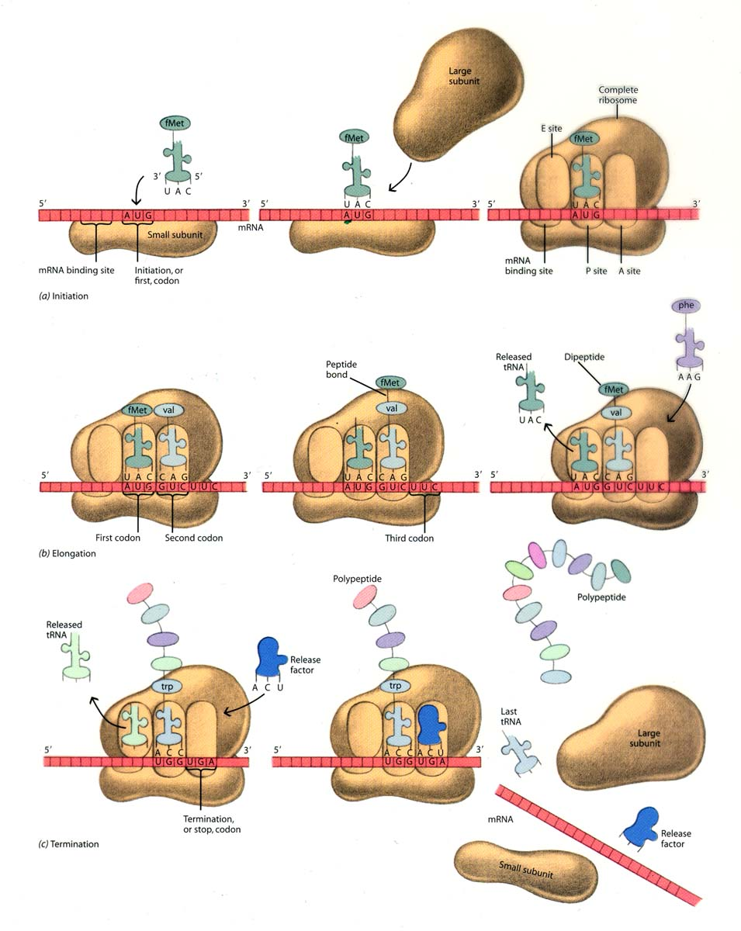

Slide 24
3. The first tRNA attaches to the first three nucleotides of the mRNA The first three nucleotides of every mRNA is AUG. This codes for the amino acid Methoinine.

Slide 26
4. The large subunit slides into place so the tRNA is in the middle slot of the ribosome, the P site.

Slide 28
5. The next tRNA with the appropriate amino acid enters the A site matching to the mRNA codon.
- Determine the amino acid coming in based on the mRNA codon sequence – use mRNA codon chart.

Slide 30
6. The amino acid on the tRNA in the P site attaches to the amino acid on the tRNA in the A site and forms a peptide bond.

Slide 32
7. The ribosome shifts down the mRNA causing the tRNAs (which are still attached to the mRNA) to translocate (move) into the adjacent site on the ribosome. - the tRNA in the A site moves to the P site - the tRNA in P site moves to the E site and then leaves

Slide 34
8. This process (steps 5 – 7) repeats over and over building the amino acid chain until a STOP codon is reached. - STOP codons = UGA, UAG, UAA - bring in a protein called a Release Factor and this causes the amino acid chain (protein) to be freed and the ribosome to detach from the mRNA.

Slide 36
Translation Animation

Slide 37
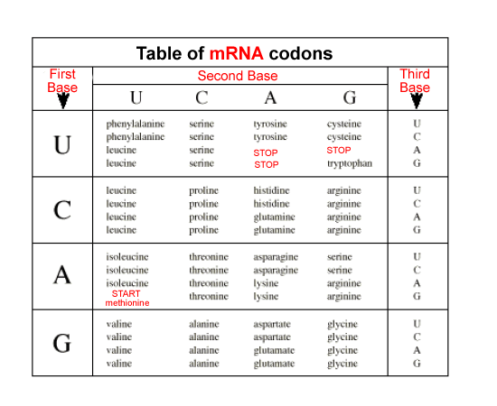
Determining the Amino Acid Sequence Based on the mRNA Codon
Step 1: Transcribe the DNA into RNA Step 2: Use Codon Chart to determine the amino acid brought in by tRNA

Slide 38
DNA CODE: TAC GAA CTG TGC GGG CCA ATC mRNA CODON: ______ ______ ______ _____ ______ _____ _____ AMINO ACID: ______ ______ ______ _____ ______ _____ _____

Slide 39
DNA CODE: TAC GAA CTG TGC GGG CCA ATC mRNA CODON: _AUG _CUU_ _GAC_ _ACG_ _CCC_ _GGU _UAG AMINO ACID: ______ ______ ______ _____ ______ _____ _____

Slide 40
DNA CODE: TAC GAA CTG TGC GGG CCA ATC mRNA CODON: _AUG _CUU_ _GAC_ _ACG_ _CCC_ _GGU _UAG AMINO ACID: _MET_ ______ ______ _____ ______ _____ _____

Slide 41
DNA CODE: TAC GAA CTG TGC GGG CCA ATC mRNA CODON: _AUG _CUU_ _GAC_ _ACG_ _CCC_ _GGU _UAG AMINO ACID: _MET_ _LEU_ ______ _____ ______ _____ _____

Slide 42
DNA CODE: TAC GAA CTG TGC GGG CCA ATC mRNA CODON: _AUG _CUU_ _GAC_ _ACG_ _CCC_ _GGU _UAG AMINO ACID: _MET_ _LEU_ _ASP _ ____ ______ _____ _____

Slide 43
DNA CODE: TAC GAA CTG TGC GGG CCA ATC mRNA CODON: _AUG _CUU_ _GAC_ _ACG_ _CCC_ _GGU _UAG AMINO ACID: _MET_ _LEU_ _ASP _ _THR_ _____ _____ _____

Slide 44
DNA CODE: TAC GAA CTG TGC GGG CCA ATC mRNA CODON: _AUG _CUU_ _GAC_ _ACG_ _CCC_ _GGU _UAG AMINO ACID: _MET_ _LEU_ _ASP _ _THR_ _PRO_ _____ _____

Slide 45
DNA CODE: TAC GAA CTG TGC GGG CCA ATC mRNA CODON: _AUG _CUU_ _GAC_ _ACG_ _CCC_ _GGU _UAG AMINO ACID: _MET_ _LEU_ _ASP _ _THR_ _PRO_ GLY_ _____

Slide 46
DNA CODE: TAC GAA CTG TGC GGG CCA ATC mRNA CODON: _AUG _CUU_ _GAC_ _ACG_ _CCC_ _GGU _UAG AMINO ACID: _MET_ _LEU_ _ASP _ _THR_ _PRO_ GLY_ STOP

Slide 47
Crash Course in Protein Synthesis

Slide 48
Proteins and the Human Diet
We need protein in our diet so we can build new proteins.
Of the 20 amino acids, our cells can make 11 of them. The remaining 9 are called Essential Amino Acids because we must get them from the foods we eat. All animal protein (meat, dairy, eggs) are Complete Proteins meaning they contain ALL 20 amino acids. Most plant proteins (except soy beans) are Incomplete meaning they lack some of the essential amino acids or have some in low levels. Plant proteins must be eaten in the correct combinations to supply the body with all the amino acids → corn and beans, beans and rice

Slide 49
Once we have ingested the proteins, our body breaks them down into amino acids in the digestive system which are absorbed and circulated throughout the body in the blood.
Use of Amino Acids 1. To build new proteins 2. Help regulate the pH of the blood 3. As a source of energy in cell respiration

Slide 51
Using an amino acid as a source of energy causes the generation of ammonia, which is poisonous.
To get rid of ammonia, our body converts it to urea, which is removed by our excretory system making urine.

Slide 52
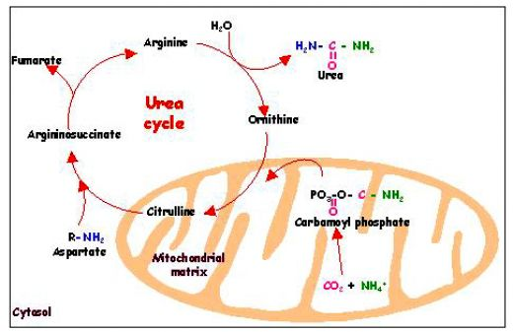

Slide 53
Urea leaves the cell and enters the blood stream. The blood reaches the kidneys and is filtered by a structure called the nephron.
Nephron takes almost all of the liquid out of the blood and passes it through a system of tubes that reabsorbs all the important good stuff (sugars, water, salt) and leaves the bad stuff (urea) behind.

Slide 54
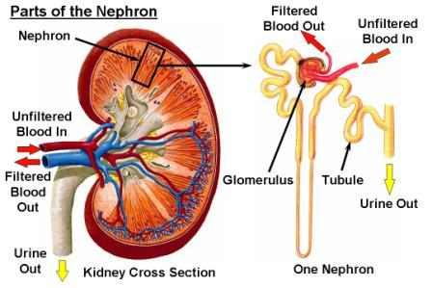
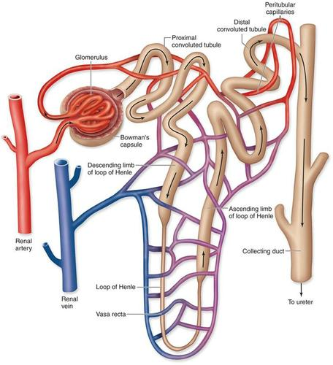

Slide 55
This is where the body also balances (homeostasis) the level of water and salt in your body.
If you have too much water, your urine will be lighter.
If you have too little water, the urea will be more concentrated and your urine will be darker. This is regulated by a hormone called Anti-diuretic Hormone, or ADH. When you don’t have enough water in your blood, your hypothalamus in your brain senses this and releases ADH. This causes your kidneys to reabsorb more water making your urine darker. Certain chemicals called diuretics (such a caffeine and alcohol) have the opposite effect and make you absorb less water → PEE more!

