Slide 1
Plant Transport

Slide 2
Plants
Plant: terrestrial (mostly), multicellular, photoautotrophic, eukaryote, true tissues and organs

Slide 3
Plant Structure
Tissue Basic Tissue Types:
- give rise to specialized cells
Dermal - outer coat - protection
Vascular – transport tubes
Ground – between Dermal and Vascular

Slide 4
Basic Tissue Layout
Dermal
Ground
Vascular

Slide 5
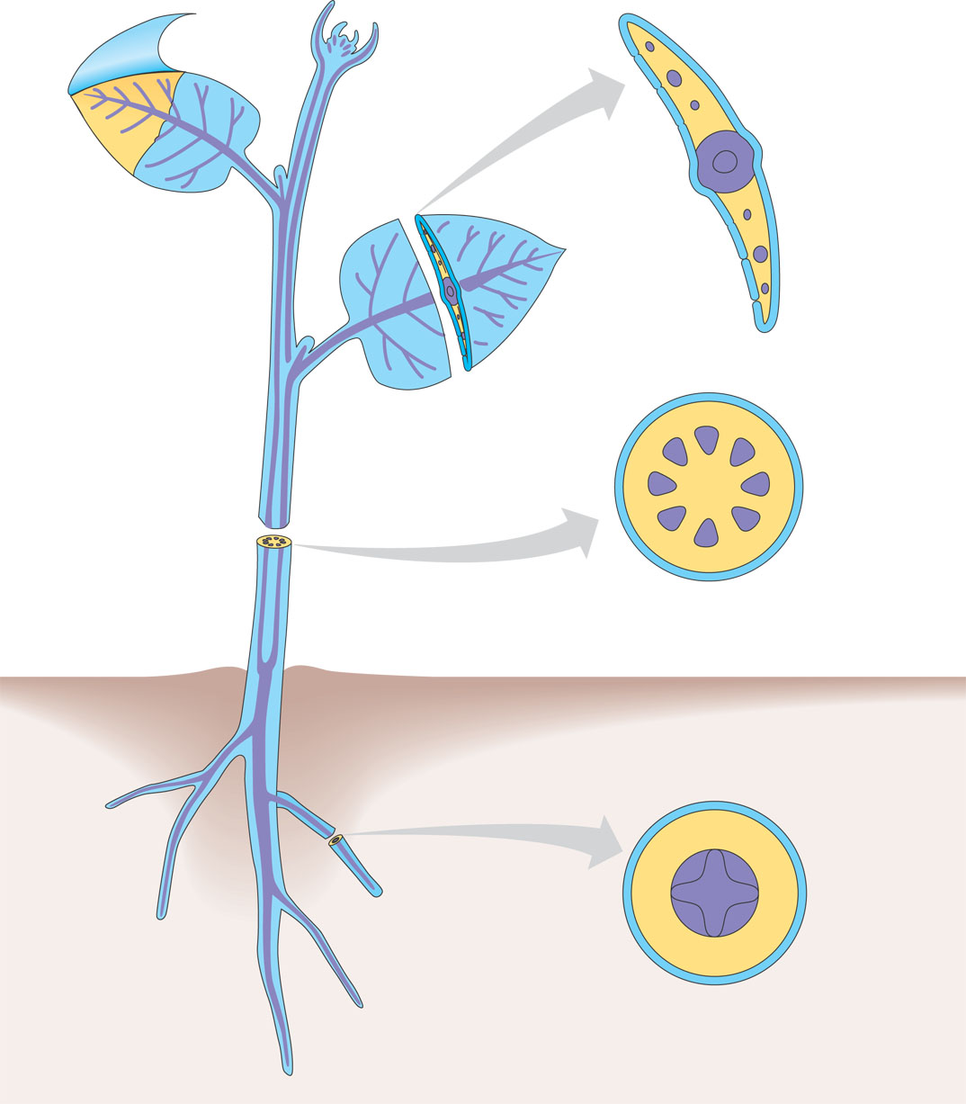
Dermal
tissue
Ground
tissue
Vascular
tissue

Slide 6
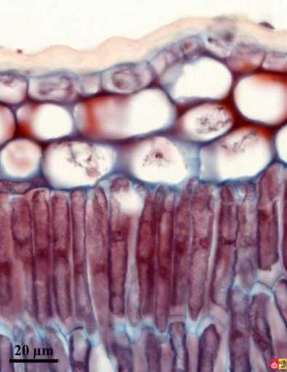
Dermal Tissue
Epidermis
Function: protection: secretes the cuticle (waxy coat on leaves)

Slide 7
Vascular Tissue
Xylem: Water movement – unidirectional (up)
Phloem: Sugar movement – bidirectional

Slide 8
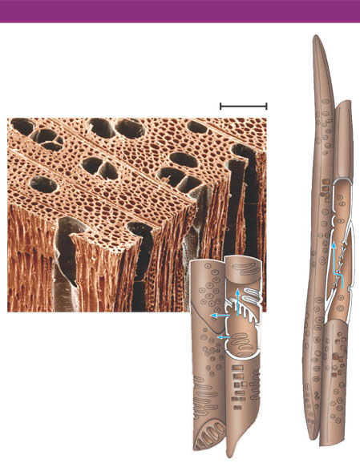
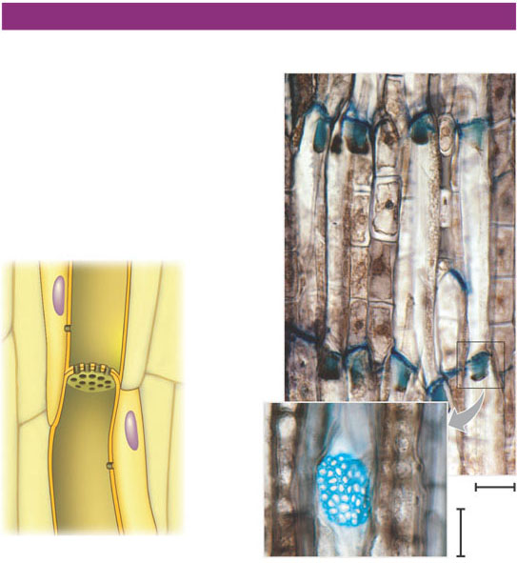
WATER-CONDUCTING CELLS OF THE XYLEM
SUGAR-CONDUCTING CELLS OF THE PHLOEM
Sieve-tube members:
longitudinal view
Vessel
Tracheids
100 μm
Pits
Sieve
plate
Vessel
element
30 μm
15 μm
Companion
cell
Cytoplasm
Figure. 35.9

Slide 9
Ground Tissue
Occupies the space between the vascular tissue and the dermal tissue
Functions:
Storage – roots and stems
Support – stems
Photosynthesis – leaves and some stems

Slide 10
Plant Parts: Roots, Stems and Leaves
Roots:
Functions:
- absorb water, nutrients and minerals
- anchor plant in soil
- store food and water
- support the plant

Slide 11
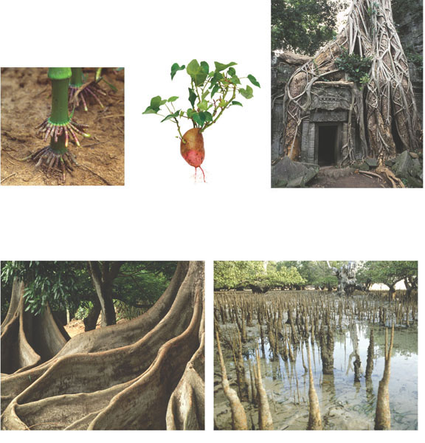
(a) Prop roots
(b) Storage roots
(c) “Strangling” aerial roots
(d) Buttress roots
(e) Pneumatophores

Slide 12
Stems
Function:
- support leaves and flowers
- photosynthesis (non-woody plants – herbaceous)
- storage: food (tubers – potato) and water (cactus)

Slide 13
Leaves
Functions:
- photosynthesis
- storage (succulent leaves, Aloe)
- protection: spines, toxins, trichomes
- reproduction: flowers (modified leaves)

Slide 14
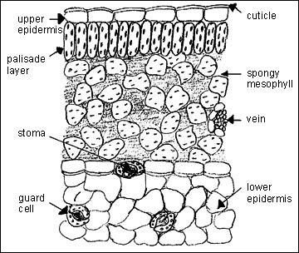
Leaves: Internal Structure

Slide 15
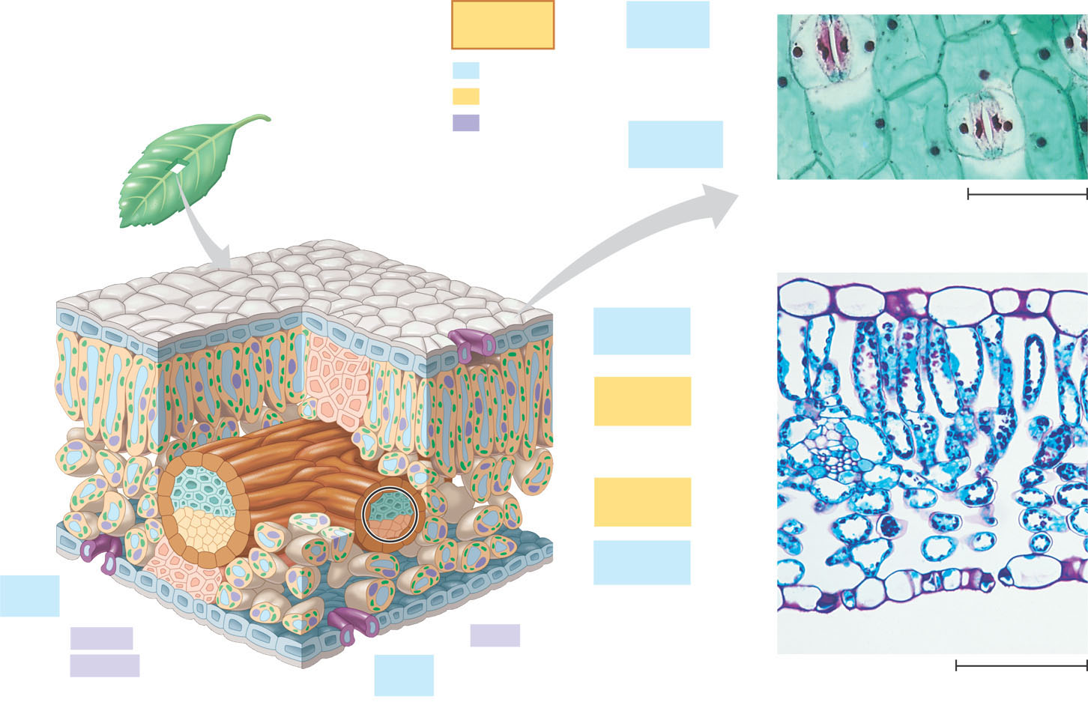
Key
to labels
Guard
cells
Dermal
Ground
Stomatal pore
Vascular
Epidermal
cell
Sclerenchyma
fibers
Cuticle
50 µm
Stoma
(b)
Surface view of a spiderwort
(Tradescantia) leaf (LM)
Upper
epidermis
Palisade
mesophyll
Bundle-
sheath
cell
Spongy
mesophyll
Lower
epidermis
Guard
cells
Cuticle
Xylem
Vein
Vein
Air spaces
Guard cells
Phloem
Guard
cells
Figure 35.17a–c
(a)
Cutaway drawing of leaf tissues
(c)
Transverse section of a lilac
(Syringa) leaf (LM)
100 µm

Slide 16
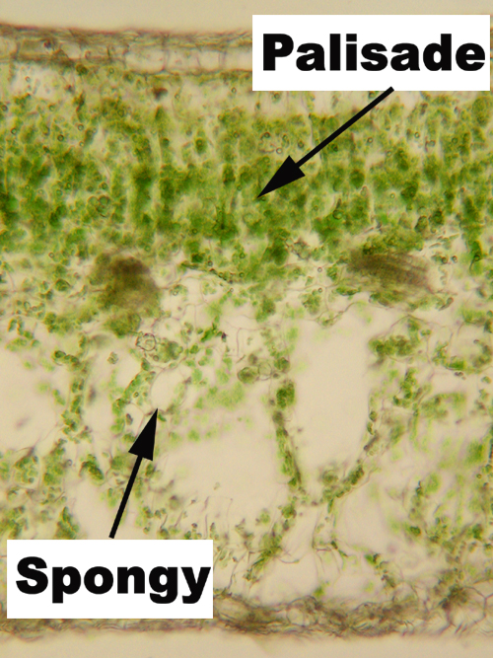
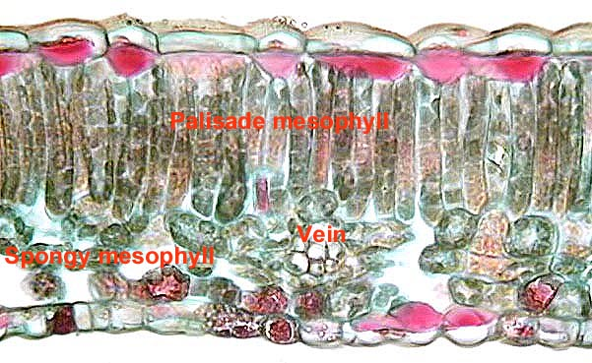
Leaf Mesophyll

Slide 17
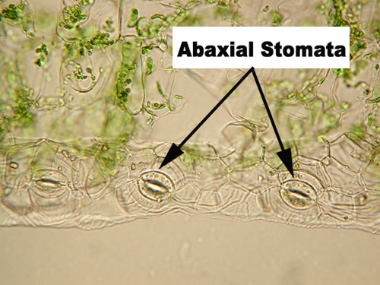
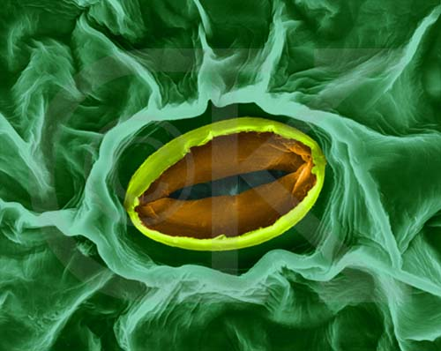
Leaf Stomata

Slide 18
Transpiration
Transpiration: Moving water from the roots to the leaves through the xylem
regulation of the photosynthesis/transpiration compromise by the guard cells and stomata
Proper gas exchange causes the loss of water from the air spaces in the spongy mesophyll
pulls water out of the mesophyll which gets the water from the xylem

Slide 19
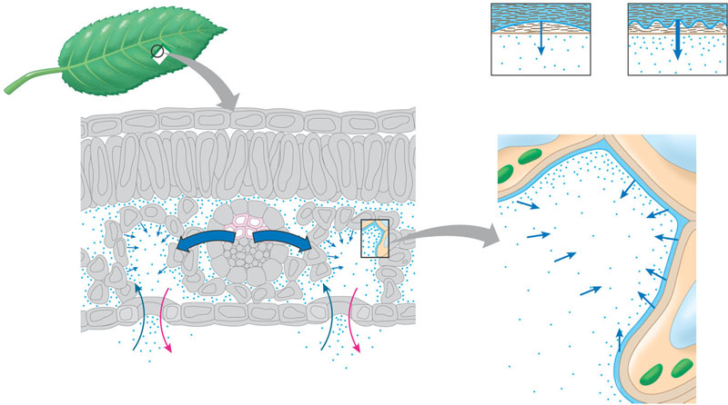
3
Evaporation causes the air-water interface to retreat farther into
the cell wall and become more curved as the rate of transpiration
increases. As the interface becomes more curved, the water film’s
pressure becomes more negative. This negative pressure, or tension,
pulls water from the xylem, where the pressure is greater.
Ψ = –0.15 MPa
Ψ = –10.00 MPa
Cell wall
Air-water
interface
Airspace
Cuticle
Low rate of
transpiration
High rate of
transpiration
Upper
epidermis
Evaporation
Cytoplasm
Mesophyll
Airspace
Air- space
Cell wall
Lower
epidermis
Evaporation
Water film
Vacuole
Cuticle
CO₂
O₂
Xylem
CO₂
O₂
Stoma
Water vapor
Water vapor
1
2
In transpiration, water vapor (shown as blue dots) diffuses from the moist air spaces of the leaf to the drier air outside via stomata.
At first, the water vapor lost by
transpiration is replaced by
evaporation from the water film
that coats mesophyll cells.

Slide 20
Transpirational pull results from the properties of cohesion and adhesion
As one water molecule moves out of the xylem it tugs on the water molecule behind it because they are bound to each other (cohesion).
Water does not move down the xylem because it is sticks to the sides of the xylem (adhesion).

Slide 21
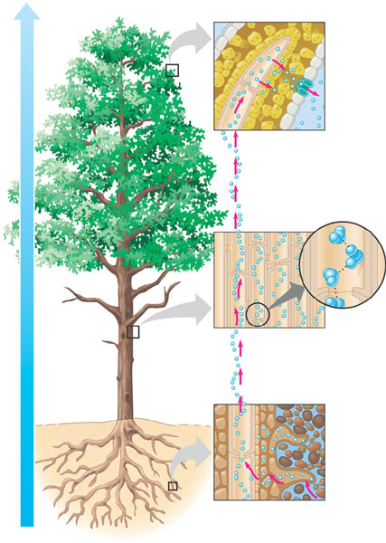
Xylem
sap
Mesophyll
cells
Stoma
Water
molecule
Transpiration
Atmosphere
Xylem
cells
Adhesion
Cell
wall
Water potential gradient
Cohesion,
by
hydrogen
bonding
Cohesion
and adhesion
in the xylem
Water
molecule
Root
hair
Soil
particle
Water uptake
from soil
Water

Slide 22
Factors Affecting Transpiration:
Temperature: Hotter = more
Humidity: Higher = less
Air flow (wind): Higher = more

Slide 23
Regulation of Transpiration: Guard Cells
Guard Cells: Regulate the size of stomata for gas exchange – responsible for the photosynthesis/transpiration compromise
Anatomy of Guard Cell:
unevenly thickened cell walls (stomatal side is thicker)

Slide 24
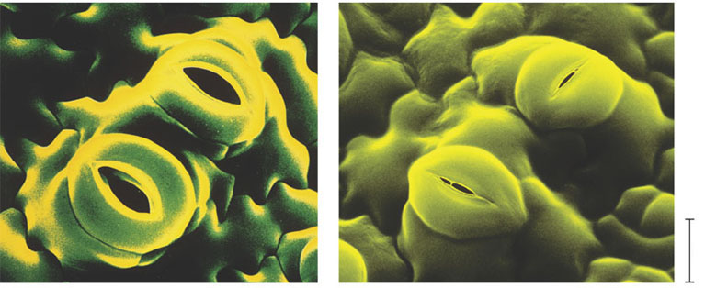
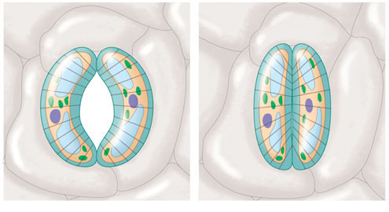
20 µm
Figure 36.14
(a)
Changes in guard cell shape and stomatal opening
and closing (surface view). Guard cells of a typical
angiosperm are illustrated in their turgid (stoma open)
and flaccid (stoma closed) states. The pair of guard
cells buckle outward when turgid. Cellulose microfibrils
in the walls resist stretching and compression in the
direction parallel to the microfibrils. Thus, the radial
orientation of the microfibrils causes the cells to increase
in length more than width when turgor increases.
The two guard cells are attached at their tips, so the
increase in length causes buckling.
Cells turgid/Stoma open
Cells flaccid/Stoma closed
Radially oriented
cellulose microfibrils
Cell
wall
Vacuole
Figure 36.15a
Guard cell

Slide 25
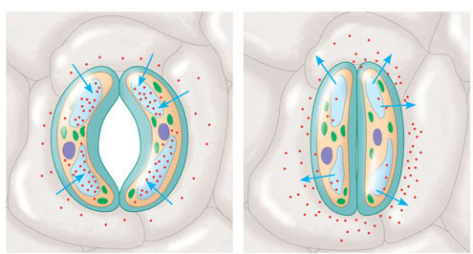
Physiology Of the Guard Cell
Potassium ions are pumped into the vacuole of the guard cell from surrounding cells
Higher concentration of K+ causes an influx of water
More water causes the cell to swell
Uneven thickness of the cell wall causes the cell to curve and open
(b)
Role of potassium in stomatal opening and closing.
The transport of K⁺ (potassium ions, symbolized
here as red dots) across the plasma membrane and
vacuolar membrane causes the turgor changes of
guard cells.
H₂O
H₂O
H₂O
H₂O
K⁺
H₂O
H₂O
H₂O
H₂O
H₂O
H₂O
Figure 36.15b

Slide 26
Translocation in Phloem
Movement from Source to Sink
Source: Location of Sugar Production
Photosynthesis: Leaves (summer and fall)
Starch Metabolism: Roots (spring)
Sink: Location of Sugar Consumption or Storage
Fall (Roots)
Spring (buds for leaf and stem growth)

Slide 27
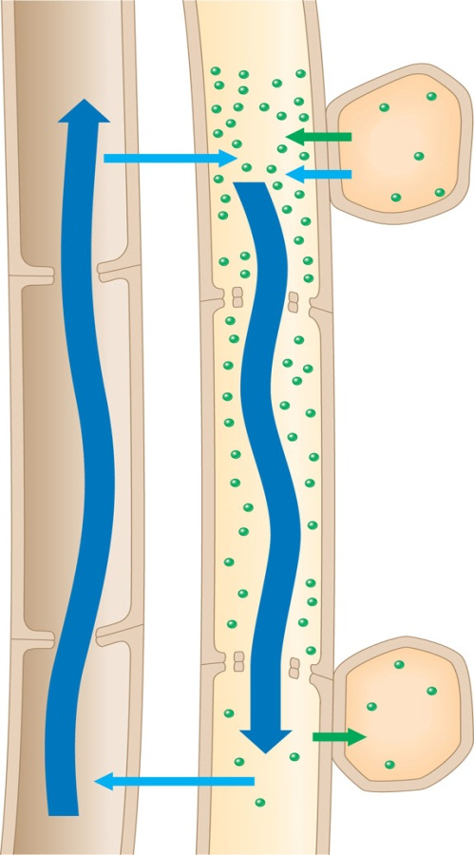
Movement of Phloem Solution
Sugar is produced and pumped into phloem
Water follows the sugar
Builds pressure inside of the cell
Pushes the solution through the
cells to the sink
Vessel
(xylem)
Sieve tube
(phloem)
Source cell
(leaf)
1
Loading of sugar (green dots) into the sieve tube at the source reduces water potential inside the
sieve-tube members. This causes the tube to take up water by osmosis.
H₂O
1
Sucrose
H₂O
2
2
This uptake of water generates a positive pressure that forces the sap to flow along
the tube.
3
The pressure is relieved by the unloading of sugar and the consequent loss of water from the tube at the sink.
Transpiration stream
Pressure flow
4
In the case of leaf-to-root
translocation, xylem recycles water from sink
to source.
Sink cell
(storage
root)
4
3
Sucrose
H₂O

Slide 28
CRASH COURSE

