Slide 1
Nutrient Cycles

Slide 2
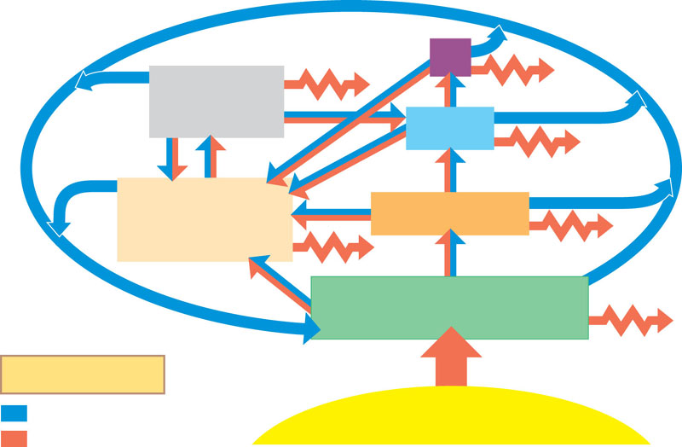
Energy vs Matter
Tertiary consumers
Microorganisms
and other
detritivores
Secondary
consumers
Detritus
Dead stuff
Primary consumers
Primary producers
Key
Heat
Chemical cycling
Sun
Energy flow
Figure 54.2

Slide 3
Energy vs Matter
Energy is always lost
2nd Law of Thermodynamics
Matter can be recycled
Neither can be created or destroyed
- 1st Law of Thermodynamics

Slide 4
Ecological Players
Producers (Autotrophs)
Trap Energy and Fix Matter in Biological Molecules
Photosynthesis
Chemosynthesis

Slide 5
Consumers (Heterotrophs)
Eat producers or other consumers
Completely dependent on what they eat

Slide 6
Decomposers:
Break down biological components into their parts – recycle matter for the producers
Complete the cycles

Slide 7
Water Cycle
Precipitation
Evapotranspiration – water moving up by evaporation or transpiration (through plants)
Percolation – water moving through soil

Slide 8
Carbon Cycle
Photosynthesis – carbon fixation
CO₂ into sugars
Cellular respiration (all organisms)
Produce CO₂
Human Input – burning fossil fuels

Slide 9
Nitrogen Cycle
Atmospheric Nitrogen = N₂
Must be fixed by bacteria
Nitrogen Fixation: N₂ → NH₄+
Nitrification: NH₄+ → NO₃-
Denitrification: NO₃- → N₂
Plants assimilate NH₄+ or NO₃- and make them into amino acids for proteins

Slide 10
Nitrogen Cycle and Humans
Humans add extra nitrogen to the environment by using fertilizer
Enters water from farms and golf courses by run off
Causes excessive algae growth = eutrophication, which can kill fish

Slide 11
Mutualism
Some plants (Legumes) contain bacteria in special structures in their roots called nodules. This is a form of mutualism, a relationship where both parties benefit.
Examples of Legumes:
Beans, clover, alphalpha, Farmers plant these to help restore nitrogen in the soil with the use of fertilizers.
Crop Rotation

Slide 12
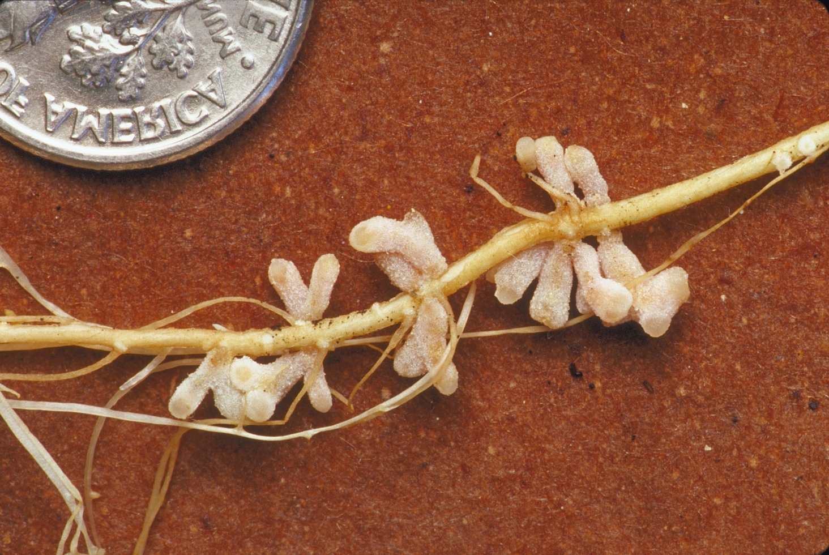
Root Nodules of a Legume

Slide 13
Phosphorus and Sulfur
Exist as phosphate (PO₄³⁻) and Sulfate (SO₄⁻²) in the soil from eroded rocks
Plants assimilate these forms

