Slide 1
Mutations and Genetic Disorders

Slide 2
Mutation: Change in the genetic structure of an organism
Types: 1. Gene mutations – changes to one or a few nucleotides in a gene – alters the expression of the gene’s protein and can affect the cell
2. Chromosomal mutations – changes due to errors in cell division, usually meiosis that alters the structure or number of chromosome in a cell

Slide 3
Gene Mutations
Point Mutations: changes in one nucleotide – typically a replication error
a. Silent Mutations – the change in the nucleotide still brings in the same amino acid so the protein remains unchanged

Slide 4
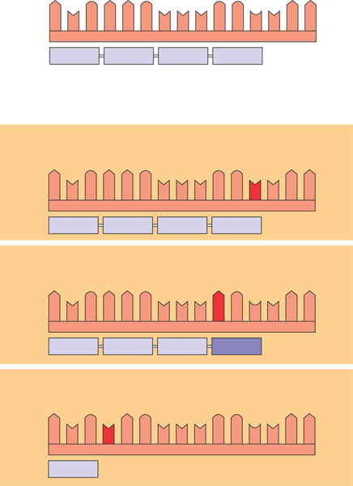
Wild type
A
U
G
A
A
G
U
U
U
G
G
C
U
A
A
mRNA
5′
3′
Protein
Met
Lys
Phe
Gly
Stop
Amino end
Carboxyl end
Base-pair substitution
No effect on amino acid sequence
U instead of C
A
U
G
A
A
G
U
U
U
G
G
U
U
A
A
Met
Lys
Phe
Gly
Stop
Missense
A instead of G
A
U
G
A
A
G
U
U
U
A
G
U
U
A
A
Met
Lys
Phe
Ser
Stop
Nonsense
U instead of A
A
U
G
U
A
G
U
U
U
G
G
C
U
A
A
Met
Stop

Slide 5
b. Missense Mutation – the change in the nucleotide brings in a different amino acid altering the structure of the protein
Ex: Sickle Cell Anemia

Slide 6
Wild type
A
U
G
A
A
G
U
U
U
G
G
C
U
A
A
mRNA
5′
3′
Protein
Met
Lys
Phe
Gly
Stop
Amino end
Carboxyl end
Base-pair substitution
No effect on amino acid sequence
U instead of C
A
U
G
A
A
G
U
U
U
G
G
U
U
A
A
Met
Lys
Phe
Gly
Stop
Missense
A instead of G
A
U
G
A
A
G
U
U
U
A
G
U
U
A
A
Met
Lys
Phe
Ser
Stop
Nonsense
U instead of A
A
U
G
U
A
G
U
U
U
G
G
C
U
A
A
Met
Stop

Slide 7
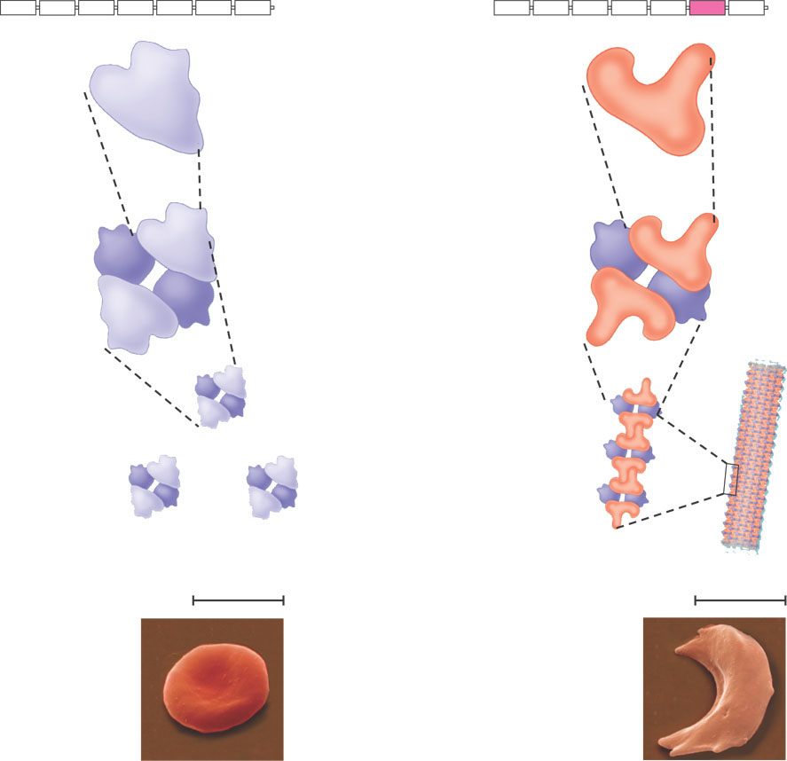
Primary structure
Normal hemoglobin
Sickle-cell hemoglobin
. . .
Primary structure
. . .
Exposed hydrophobic region
Val
His
Leu
Thr
Pro
Glul
Glu
Val
His
Leu
Thr
Pro
Val
Glu
5
6
3
7
5
4
6
7
1
1
2
2
3
4
Secondary and tertiary structures
Secondary and tertiary structures
 subunit
 subunit


Quaternary structure
Hemoglobin A


Quaternary structure
Hemoglobin S




Molecules interact with one another to crystallize into a fiber, capacity to carry oxygen is greatly reduced.
Function
Function
Molecules do not associate with one another, each carries oxygen.
10 m
10 m
Red blood cell shape
Normal cells are full of individual hemoglobin molecules, each carrying oxygen
Red blood cell shape
Figure 5.21

Slide 8
c. Nonsense Mutation – the change in the nucleotide results in a STOP codon being produced too early in the mRNA – causes the protein to stop prematurely.

Slide 9
Wild type
A
U
G
A
A
G
U
U
U
G
G
C
U
A
A
mRNA
5′
3′
Protein
Met
Lys
Phe
Gly
Stop
Amino end
Carboxyl end
Base-pair substitution
No effect on amino acid sequence
U instead of C
A
U
G
A
A
G
U
U
U
G
G
U
U
A
A
Met
Lys
Phe
Gly
Stop
Missense
A instead of G
A
U
G
A
A
G
U
U
U
A
G
U
U
A
A
Met
Lys
Phe
Ser
Stop
Nonsense
U instead of A
A
U
G
U
A
G
U
U
U
G
G
C
U
A
A
Met
Stop

Slide 10
2. Frame shift mutation: the gain or loss of a nucleotide in the DNA results in a shift of the reading frame.
Causes all of the amino acids after the change to be different.
THE CAT ATE THE RAT
Remove the first “E”
THC ATA TET HER AT
Frameshift Animation

Slide 11
Chromosomal mutations
1. Aneuploidy: loss (monosomy) or gain (trisomy) of a chromosome. Due to failure of sister chromatids to separate in meiosis. Results in an uneven distribution of chromosomes in the gametes. Ex: Trisomy 21 or Down’s Syndrome

Slide 12
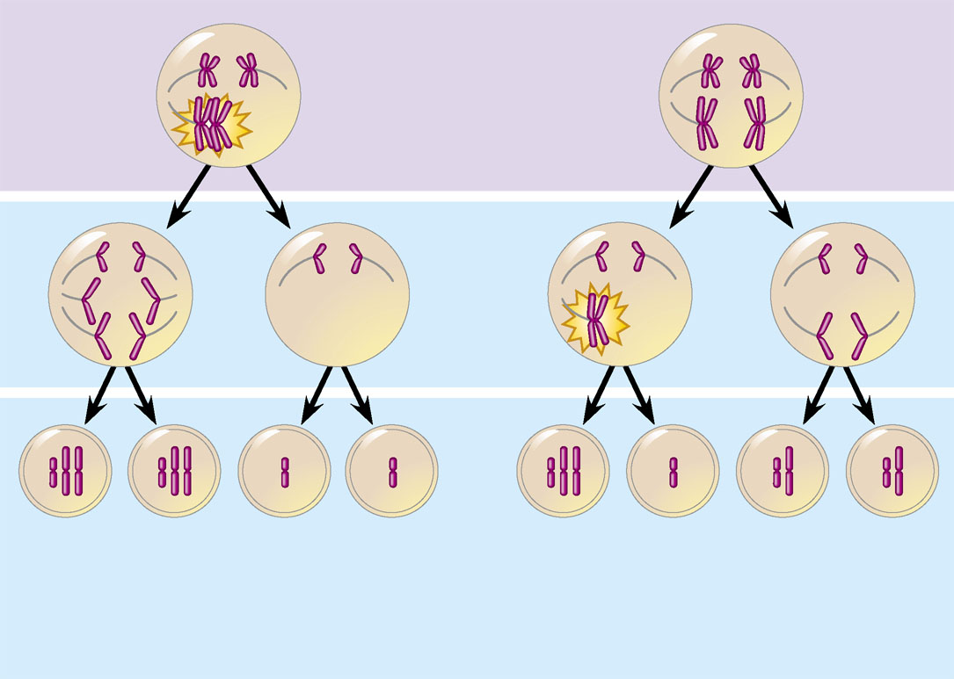
Meiosis I
Nondisjunction
Meiosis II
Nondisjunction
Gametes
n + 1
n + 1
n − 1
n – 1
n + 1
n –1
n
n
Number of chromosomes
(a)
Nondisjunction of homologous
chromosomes in meiosis I
(b)
Nondisjunction of sister
chromatids in meiosis II

Slide 13
2. Polyploidy: Gain of one or more sets of chromosomes in a gamete;
Result is an embryo with three or four times the amount of chromsomes (triploid or tetraploid)
Can benefit plants by making them bigger
Rarer in animals: occurs in simpler animals such as worms, and in insects, fish, and amphibians.

Slide 14
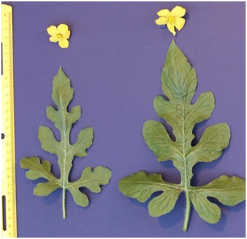
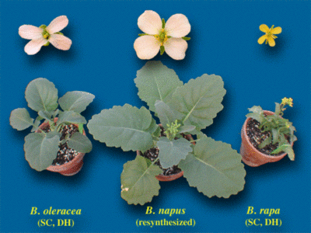
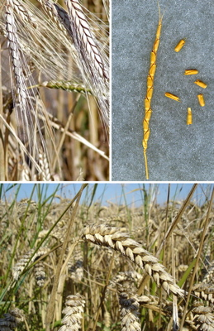
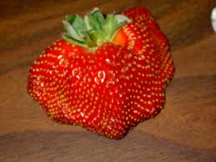

Slide 15
3. Errors resulting from Crossing Over - inversion, deletion, duplication, translocation – results in extra or missing information

Slide 16
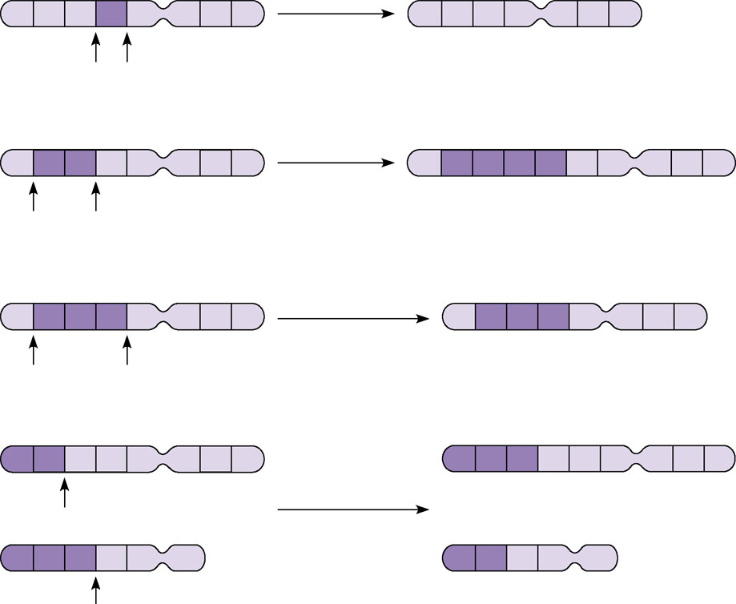
(a) A deletion removes a chromosomal
segment.
A
B
C
D
E
F
G
H
Deletion
A
B
C
E
F
G
H
A
B
C
D
E
F
G
H
Duplication
A
B
C
B
C
D
E
F
G
H
(b) A duplication repeats a segment.
A
B
C
D
E
F
G
H
Inversion
A
D
C
B
E
F
G
H
(c) An inversion reverses a segment within
a chromosome.
(d) A translocation moves a segment from one chromosome to another,
nonhomologous one. In a reciprocal
translocation, the most common type,
nonhomologous chromosomes exchange
fragments. Nonreciprocal translocations
also occur, in which a chromosome
transfers a fragment without receiving a
fragment in return.
A
B
C
D
E
F
G
H
M
N
O
C
D
E
F
G
H
Reciprocal
translocation
M
N
O
P
Q
R
A
B
P
Q
R
Figure 15.14a–d

Slide 17
Problems with Mutations
Changes the DNA
Changes the RNA
Changes the Protein
Leads to a genetic disorder – problem due to the misinformation

Slide 18
Environmental Causes of Mutations:
Mutagens – environmental factors that result in a mutation
Carcinogens – environmental factors that result in a mutation that leads to cancer - change the genetic structure of the cell causing uncontrolled cell growth

Slide 19
Types of Mutagens/Carcinogens:
1. Chemicals – pesticides, asbestos,
2. Cigarette Smoke – over 70 known carcinogens
3. UV light – sunlight and tanning beds (extra concentrated)
4. Radiation – radon gas, nuclear waste
5. Viruses

