Slide 1
Muscle Contraction

Slide 2
Basis of Muscle Contraction = Actin filaments (microfilaments) and Myosin Proteins

Slide 3
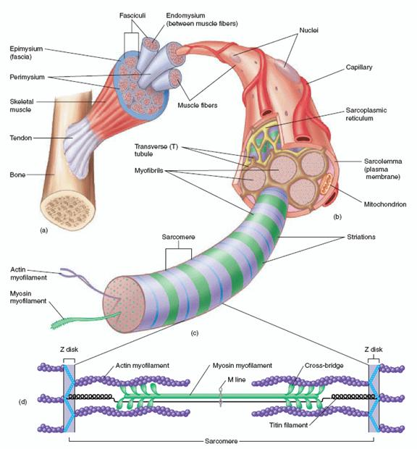

Slide 4
Muscle Structure
Muscle is made of Fascicles.
Fascicles are made of clusters of muscle fibers (Muscle Cells)
Muscle fibers are made of Myofibrils
Myofibrils are made of sarcomeres
Sarcomeres are made of Actin and Myosin

Slide 6
Almost every muscle is attaches to a bone at each end using tendons. Exception: the tongue.
When muscles contract they pull on the tendons which pull on the bones causing the bones to move.

Slide 7
Muscle Contraction
Requirements:
Energy: ATP (Adensosine Triphosphate) Calcium Ions – stored in the smooth E.R. of the Sarcomere
– called the Sarcoplasmic Reticulum Actin and Myosin

Slide 8
Process: 1) A signal is sent from the brain to the muscle by a motor neuron

Slide 9
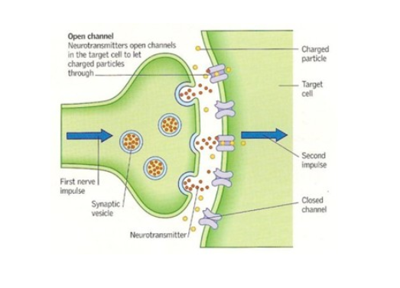
2) The motor neuron releases a chemical called acetylcholine

Slide 10
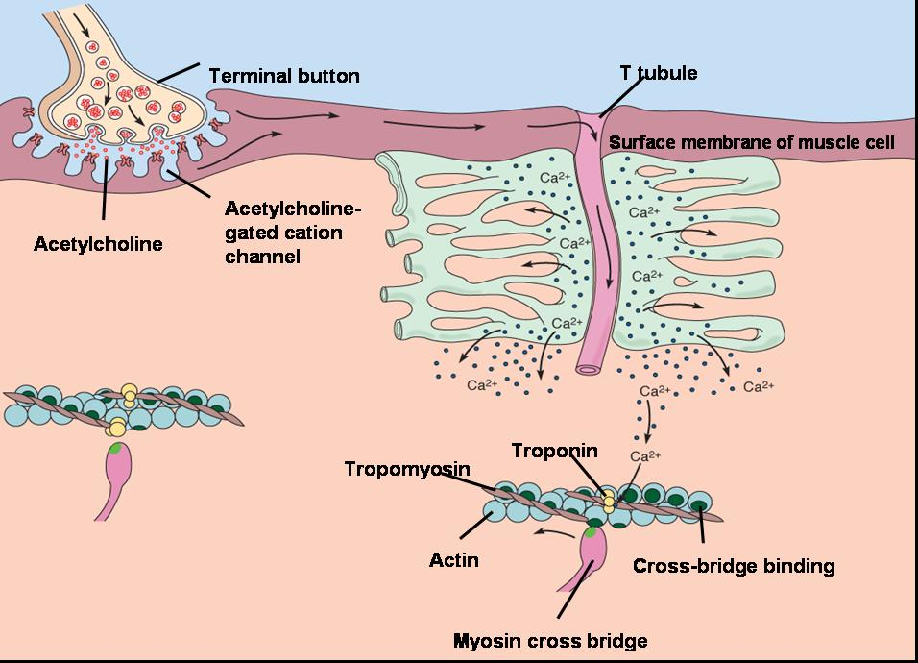
3) Acetylcholine causes the Sarcoplasmic Reticulum to release Calcium Ions

Slide 11
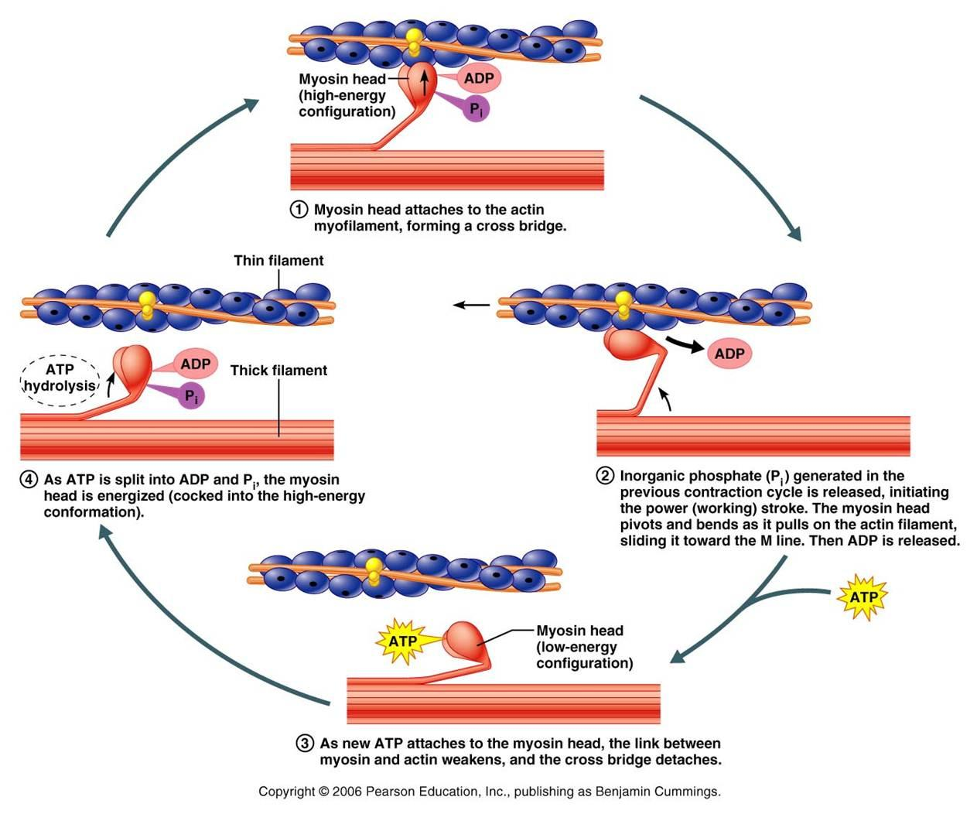
4) Calcium Ions allow myosin to bind to actin and pull the actin filaments closer together

Slide 12
Myosin must first be activated by ATP. ATP binds to Myosin making it ready to bind to the actin
When the myosin binds to the actin, the ATP leaves and the myosin moves the actin forward This repeats until the muscle is fully contracted.

Slide 13
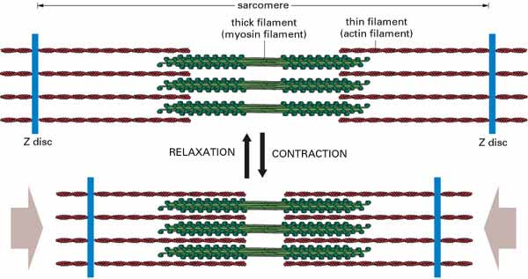

Slide 14
Muscle Relaxation: Calcium ions are pumped back into the Sarcoplasmic Reticulum Myosin can’t bind to the actin anymore so the actin slides back into place.
This is added by Potassium (K+) Ions helping to transmit relaxation signals from the brain

Slide 15
Building Muscle Exercise creates micro tears in the muscle fibers = soreness When the micro tears are repaired the muscle cells get thicker = bigger muscles
Lactic Acid causes the “burning” in your muscles during and shortly after a workout but is gone within hours of the end of the workout.
Video

