Slide 1
Linked Genes and Human Inheritance

Slide 2
Humans have approximately 20,000 – 30,000 genes that code for traits.
However, only have 46 chromosomes. Thus each chromosome must have many genes on them.

Slide 4
Often seen in Sex-Linked Traits:
Genes that are found on the sex chromosomes.
Sex Chromosomes determine gender: Mammals: XX = female XY = male
Autosomes: the other chromosomes that are not sex chromosomes AKA: body chromosomes

Slide 5
Types of Sex Linked Traits X-linked traits: genes found on the X-chromosome Can be passed from Mother to Daughters or Sons Can be passed from Fathers to Daughters

Slide 6
Y-linked traits: genes found on the Y-chromosome Can be passed from Fathers to Sons

Slide 7
Since Males are XY, they only need one copy of a recessive gene to show the trait. This is called hemizygous. (Hemi means half) This is why X-linked recessive traits are seen more often in males.
Examples: color blindness, hemophilia

Slide 8
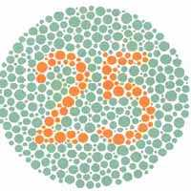
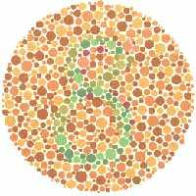
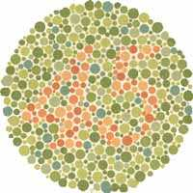
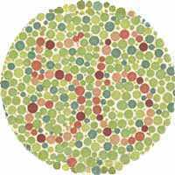
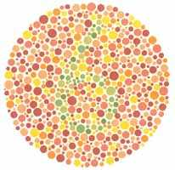
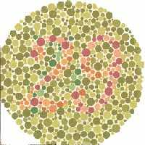

Slide 9
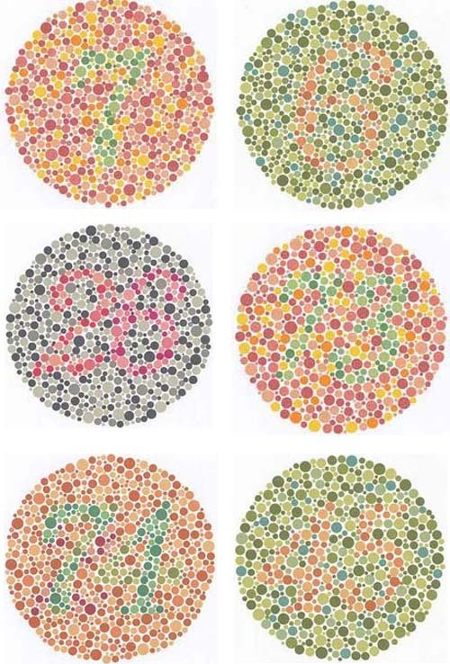

Slide 10
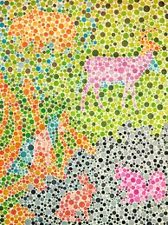

Slide 11
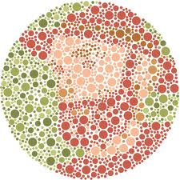

Slide 12
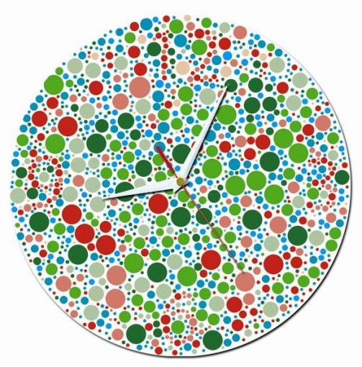

Slide 13
Y linked traits can only be passed to males. Example: SRY gene – this is what makes boys

Slide 14
Example Problem: John Smith is color blind. Melody is not. John and Melody have two daughters who are not color blind. Their first daughter, Martha, marries a man who is not color blind. Donna, their second daughter, marries a man who is color blind. What is the probability that John and Melody’s grandchildren will be color blind? Assume each couple has one boy and one girl.

Slide 15
The inheritance of the Smith family can be drawn as a Pedigree Chart. Pedigree Charts use Circles, Squares, and Lines to show the relationships and inheritance of a particular trait, whether it be sex linked or autosomal.

Slide 17
Pedigree Charts are labeled: Each Line is given a Roman numeral and each individual on the line is given a number.
Draw a pedigree chart for the Smith Family:

Slide 18
Expression of X Chromosomes In Females:
Only one X chromosome is needed per cell. In females, one of the X chromosomes is inactivated by chemicals called methyl groups. The X chromosome shrinks and becomes known as a Barr Body.

Slide 19
RESULT: As the female develops, it is a 50/50 chance that determines which chromosome becomes the Barr Body. Therefore, if the female is heterozygous for a trait on the X chromosome, she can actually express two different traits.

Slide 20
Example: Calico cats. Orange and black fur being expressed. One X is orange and the other is Black. Since the cells only express one of the X chromosomes, the fur will either be orange or black.
Implication: Only female cats can be calico.

Slide 21
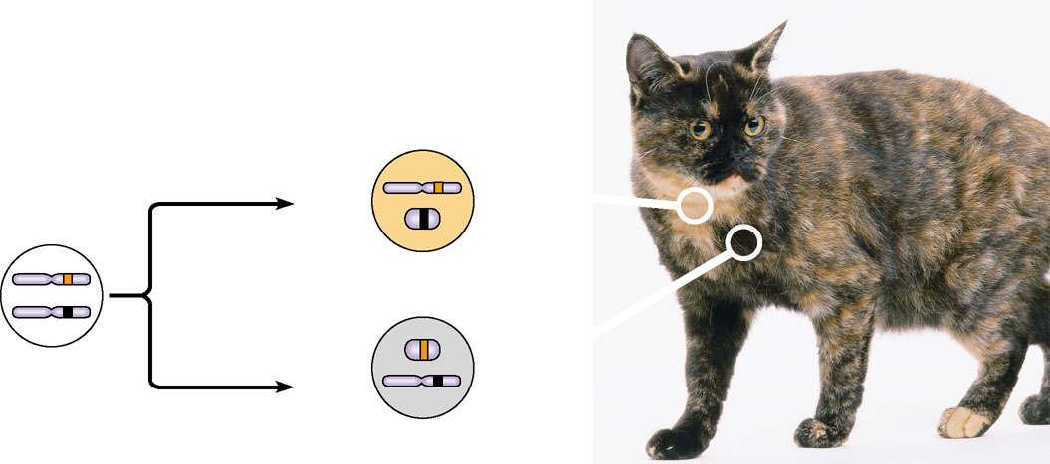
Two cell populations
in adult cat:
Active X
Early embryo:
Orange
fur
X chromosomes
Cell division
and X
chromosome
inactivation
Inactive X
Inactive X
Black
fur
Allele for
black fur
Active X
Figure 15.11

Slide 22
Implications of Linkage for Dihybrid Crosses:
Because genes that are linked are inherited together, they do not independently sort when gametes are formed.

Slide 23
EX: Genes A and B are linked on the same chromosome. An individual is heterozygous for each gene. A
Since the genes are linked, there are only two possible gametes: AB and ab.
A
B
a
b

Slide 24
If the genes were on separate chromosomes, there would be 4 possible gametes:
AB, Ab, aB, ab
A
a
B
b

Slide 25
Example Problem: The human traits for red hair and freckles are closely linked on chromosome 16. Red hair is a recessive trait while having freckles is a dominant trait. If a brown haired, freckled man (whose mother had red hair and no freckles and father had brown hair and freckles) marries a red headed, no freckled woman, what is the probability they will have red headed, freckled, children?

Slide 26
HOWEVER, because of crossing over in prophase I of meiosis, linked genes can change chromosomes. This results in chromosomes that are different from the individual’s parent’s chromosomes and are called recombinant chromosomes.

Slide 27
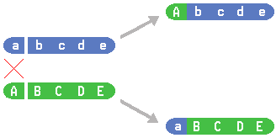

Slide 28
Recombination will only be seen if the individual is heterozygous. If they are homozygous, the cross over will result in the same combination of genes even if crossing over occurs.

Slide 29
Heterozygous Cross
A
B
a
b
a
B
A
b

Slide 30
Homozygous Cross
A
B
A
B
A
B
A
B

Slide 31
IF crossing over does occur, it will only happen a certain percentage of the time. This is called the recombination frequency = how often crossing over occurs between two genes.
The closer two genes are found on the chromosome the LESS often they will cross over.

Slide 32
If two genes are known to cross over at a certain recombination frequency then the number offspring can be calculated based on the percentage of recombination. The percentage of recombination determines the number of different gametes that are formed.

Slide 33
Example 1: NO CROSSING OVER
All gametes formed are AB and ab.
A
B
a
b

Slide 34
Example 2: Crossing over occurs 20% of the time.
80% of the time nothing happens and the gametes are AB and ab.
→ 20% of the time crossing over occurs and the gametes are
aB and Ab.
A
B
a
b
A
B
a
b
a
B
A
b

Slide 35
Therefore 40% of the gametes are AB 40% of the gametes are ab 10% of the gametes are aB 10% of the gametes are Ab

Slide 36
Example 3: If two genes cross over 30% of the time, how often (percent) will each type of gamete form?
A
B
a
b

Slide 37
Using recombination frequencies in dihybrid crosses.
When two genes cross over with a certain recombination frequency, then a dihybrid cross is carried out using a heterozygous individual and a homozygous recessive individual.
The cross is done like a normal dihybrid cross (FOIL) except the gamete percentage is used to calculate the probable number of offspring.

Slide 38
Example: In the purple crested blifflecooter, the purple crest gene is dominant over the green crested gene. The gene for rounded snouts is dominant over the pointed snout gene. Both of these genes (crest and snout) are on the same chromosome and cross over 20% of the time. If a male blifflecooter that is heterozygous for both traits is crossed with a green crested, pointy snouted female, how many of the 20 offspring can be expected to have purple crests and pointy snouts? (It is important to know that the male is descended from a pure bred purple crested, round snout and a pure bred green crested, pointy snout)

