Slide 1
Honors Biology 1st Semester Content Review
Each slide will present information in some form of question or practice. The slide following it will have the answers.

Slide 2
Six Characteristics of Life Match the Following Characteristics
1. Complexity
2. Reproduction 3. Homeostasis 4. Adaptation 5. Uses Energy 6. Grow and Develop
Over time bird beaks get larger to help them eat larger seeds
Sweating
I eat turkey sandwiches
You have about 120 trillion cells in your body
You started out as 1 cell
That cell began when a sperm and egg fused together.

Slide 3
Six Characteristics of Life Match the Following Characteristics
1. Complexity
2. Reproduction 3. Homeostasis 4. Adaptation 5. Uses Energy 6. Grow and Develop
Over time bird beaks get larger to help them eat larger seeds
Sweating
I eat turkey sandwiches
You have about 120 trillion cells in your body
You started out as 1 cell
That cell began when a sperm and egg fused together.

Slide 4
Biomolecules
Type | Elements
Carbohydrate
Lipids
Proteins
Nucleic Acids

Slide 5
Biomolecules
Type | Elements
Carbohydrate | CHO + N (chitin only)
Lipids | CHOP
Proteins | SPONCH
Nucleic Acids | PONCH

Slide 6
Type | Examples
Carbohydrate
Lipids
Proteins
Nucleic Acids

Slide 7
Biomolecules
Type | Examples
Carbohydrate | Sugars (sucrose, glucose, lactose) Starch and Glycogen Cellulose and Chitin
Lipids | Fats and Oils Waxes Hormones Phospholipids
Proteins | Enzymes Antibodies Muscle Transport Proteins Cytoskeleton
Nucleic Acids | DNA and RNA

Slide 8
Type | Function
Carbohydrate
Lipids
Proteins
Nucleic Acids

Slide 9
Biomolecules
Type | Function
Carbohydrate | Energy Energy Storage Structure (Cell Walls)
Lipids | Energy Storage Protection Cell Communication Structure
Proteins | Regulate Metabolism Defense Movement and Storage Cell Transport Cell Structure
Nucleic Acids | Control and Regulate Cell Processes

Slide 10
Type | Site of Digestion
Carbohydrate
Lipids
Proteins
Nucleic Acids

Slide 11
Type | Site of Digestion
Carbohydrate | Mouth (starch) and Small intestine (starch, sugars, NOT cellulose (fiber))
Lipids | Small intestine
Proteins | Stomach and small intestine
Nucleic Acids | Small intestine

Slide 12
Nutrient Cycles Match the Organism to its Ecological Role
Producer
Herbivore
Omnivore
Carnivore
Detrivore
Primary Producer
Primary Consumer Secondary Consumer
Grasshopper
Snake
Grass
Mouse
Fungus

Slide 13
Nutrient Cycles Match the Organism to its Ecological Role
Producer
Herbivore
Omnivore
Carnivore
Detrivore
Primary Producer
Primary Consumer Secondary Consumer
Tertiary Consumer
Grasshopper
Snake
Grass
Mouse
Fungus

Slide 14
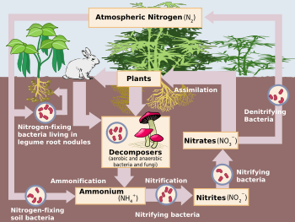
Nitrogen Cycle Use the following terms: Nitrogen fixation, Nitrification, Denitrification, Assimilation, Decomposition

Slide 15
Nitrogen Cycle Use the following terms: Nitrogen fixation, Nitrification, Denitrification, Assimilation, Decomposition
Assimilation
Denitrification
Nitrogen fixation
Decomposition→
Nitrification
Nitrogen fixation

Slide 16
Muscle Contraction Put the following steps in order
Acetylcholine causes the Sarcoplasmic Reticulum to release Calcium Ions
A signal is sent from the brain to the muscle by a motor neuron
The motor neuron releases a chemical called acetylcholine
Myosin must first be activated by ATP.
When the mysosin binds to the actin, the ATP leaves and the myosin moves the actin forward
Calcium Ions allow myosin to bind to actin and pull the actin filaments closer together
ATP binds to Myosin making it ready to bind to the actin
This repeats until the muscle is fully contracted.

Slide 17
Muscle Contraction Put the following steps in order
1) A signal is sent from the brain to the muscle by a motor neuron 2) The motor neuron releases a chemical called acetylcholine 3) Acetylcholine causes the Sarcoplasmic Reticulum to release Calcium Ions 4) Calcium Ions allow myosin to bind to actin and pull the actin filaments closer together
5) Myosin must first be activated by ATP. 6) ATP binds to Myosin making it ready to bind to the actin 7)When the mysosin binds to the actin, the ATP leaves and the myosin moves the actin forward 8) This repeats until the muscle is fully contracted.

Slide 18
Cell Parts Quizzes
Cell Parts Quiz
Cell Membrane Quiz
Cell Organelles Quiz
Cell Parts Matching
If you want to do more of these just Google “Cell Parts Quiz”

Slide 19
Cell Transport Animations
Cell Transport Animations (Don’t click through the “next” button until it changes color or you will skip most of the animation)
Facilitated Diffusion Animation
Osmosis Animation
Bulk Transport

Slide 20
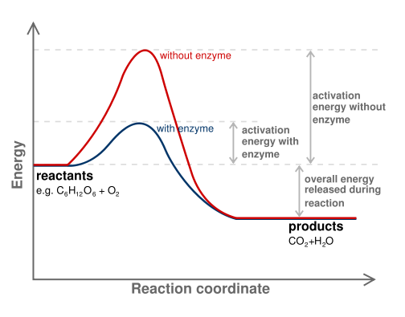
Chemical Reaction Pathway Labels: Path with enzyme, Path without enzyme, activation energy with enzyme, activation energy without enzyme, exothermic energy released, reactants, products

Slide 21
Chemical Reaction Pathway Labels: Path with enzyme, Path without enzyme, activation energy with enzyme, activation energy without enzyme, exothermic energy released, reactants, products

Slide 22
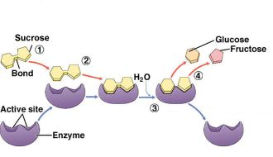
Enzyme Substrate Complex Labels Substrate, Enzyme, Active Site, Products

Slide 23
Enzyme Substrate Complex Labels Substrate, Enzyme, Active Site, Products
Substrate
Products
Active Site
Enzyme

Slide 24
Enzymes
Enzyme Tutorial

Slide 25
Photosynthesis
Light Dependent Reaction Animation
Calvin Cycle Animation

Slide 26
Cellular Respiration
Bad Animation but informative
Good Animation
Electron Transport Chain

Slide 27
Cellular Division
Mitosis Video
Meiosis Video

