Slide 1
Genetics
Inheritance and HEREDITY = Genetics

Slide 2
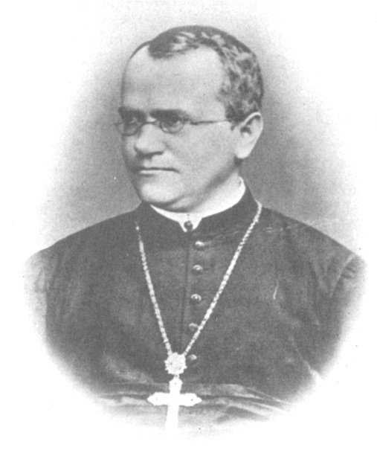
Father of Genetics: Gregor Mendel
Austrian Monk
Grew Peas and studied
their characteristics and their traits
Flower color: characteristic (gene)
Pink or white: Trait (allele)

Slide 3
Mendel’s Work:
Reasons for Studying Peas
Easily distinguished traits
Fast reproduction
Self pollinate: develop true breeding varieties - parents and offspring have the same characteristics from generation to generation

Slide 4
Two types of Studies:
Monohybrid – study of one gene
Dihybrid – study of two genes
Mendel Crossed Two types of Organisms:
Pure bred = Homozygous - two of the same allele
Hybrid = Heterozygous - two different alleles
- typically one dominant and one recessive

Slide 5
Results of Mendel’s Work
Law of Dominance:
Tall pure bred X Short pure bred
found all F1 were Tall
one trait would over shadow the other trait
Against the convention of the time – blending

Slide 6
Law of Segregation:
Took F1 Generation and did a self cross
Tall F1 X Tall F1
found 75% of F2 were Tall and 25% of F2 were short
traits were preserved from one generation to the next and separated from one another during gamete formation

Slide 7
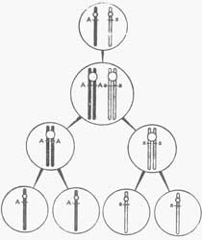
Law of Segregation

Slide 8
Mendel’s Crosses: How to do genetics Problems
Homozygous Tall Pea plant X Homozygous Short Pea plant
STEP 1: Make a Key
Key: T = tall
t = short
one letter for each trait
capital letters for dominant trait
lower case letters for recessive traits

Slide 9
STEP 2: Write the genotypes of the parents
Homozygous Tall = TT
Homozygous Short = tt
TT X tt

Slide 10
STEP 3: Determine the possible gametes formed
TT → T or T
tt → t or t

Slide 11
STEP 4: Draw a Punnett square and fill in the combinations

Slide 12
STEP 5: Write the genotypic and phenotypic ratios
in a monohybrid cross, the ratios should add up to four
in a dihybrid cross, ratios should add up to sixteen

Slide 13
MONOHYBRID CROSS: the Punnett square P generation: TT x tt
Male Genotype
Female Genotype
Possible
Gametes
Possible
Gametes

Slide 14
Male Genotype
TT
Female Genotype
Possible
Gametes
T
T
Possible
Gametes
t
tt
t

Slide 15
Male Genotype
TT
Female Genotype
Possible
Gametes
T
T
Possible
Gametes
t
tt
t

Slide 16
Male Genotype
TT
Female Genotype
Possible
Gametes
T
T
Possible
Gametes
t
Tt
tt
Tt
t
Tt
Tt
Genotypic Ratio:
Phenotypic Ratio:

Slide 17
Male Genotype
TT
Female Genotype
Possible
Gametes
T
T
Possible
Gametes
t
Tt
tt
Tt
t
Tt
Tt
Genotypic Ratio:
4:0
Phenotypic Ratio:
4:0

Slide 18
F1 Generation Cross: Tt X Tt
Male Genotype
Female Genotype
Possible
Gametes
Possible
Gametes

Slide 19
F1 Generation Cross: Tt X Tt
Male Genotype
Tt
Female Genotype
Possible
Gametes
T
t
T
Possible
Gametes
Tt
t

Slide 20
F1 Generation Cross: Tt X Tt
Male Genotype
Tt
Female Genotype
Possible
Gametes
T
t
T
Possible
Gametes
TT
Tt
Tt
t
Tt
tt
Genotypic Ratio:
Phenotypic Ratio:

Slide 21
F1 Generation Cross: Tt X Tt
Male Genotype
Tt
Female Genotype
Possible
Gametes
T
t
T
Possible
Gametes
TT
Tt
Tt
t
Tt
tt
Genotypic Ratio:
1:2:1
Phenotypic Ratio:
3:1

Slide 22
Example Problems
A purple flowered pea plant that is the result of a cross between a purple flowered plant and a white flowered plant is crossed with a white flowered plant. How many of the offspring of this cross will be white and how many will be purple?

Slide 23
In a certain species of fish blue scales is dominant over red scales. If two blue scaled fish mate and produce, 80 blue scaled offspring and 20 red scaled offspring, what are the genotypes of the parents?

Slide 24
A new species of bird was recently discovered that shows two varieties of color, yellow and orange. When two orange birds are crossed, only orange offspring are produced. When two yellow are crossed, the results are either all yellow or yellow and orange. What does this tell you about the pattern of inheritance?

Slide 25
Test Cross
T___ X tt
crossing of a dominant phenotype with an unknown genotype with a homozygous recessive

Slide 26
Possible Outcomes
T ___
t
t
If some of the offspring show the recessive trait =

Slide 27
Possible Outcomes
Must be recessive if tt appears
T t
t
Tt
tt
t
Tt
tt
If some of the offspring show the recessive trait =
If some of the offspring show the recessive trait the unknown genotype has to be recessive

Slide 28
Possible Outcomes
T
__
t
Tt
t
Tt
If no offspring show the recessive =

Slide 29
Possible Outcomes
T
T
t
Tt
Tt
t
Tt
Tt
If no offspring show the recessive = it is most likely that the unknown genotype is homozygous dominant
depends on the number of offspring produced

