Slide 1
Evolution

Slide 2
Basic Definition: change over time
Biological Definition: change in the frequency of a gene in a population over time
- individuals do not evolve -
- changes in the population accumulate and eventually lead to large scale change or speciation (formation of a new species)

Slide 3
Types of Evolution
Microevolution: change in the gene pool (genetic content) of a population based on natural selection
EX: normal variations
Macroevolution: change on a large scale leading to new and different species

Slide 4
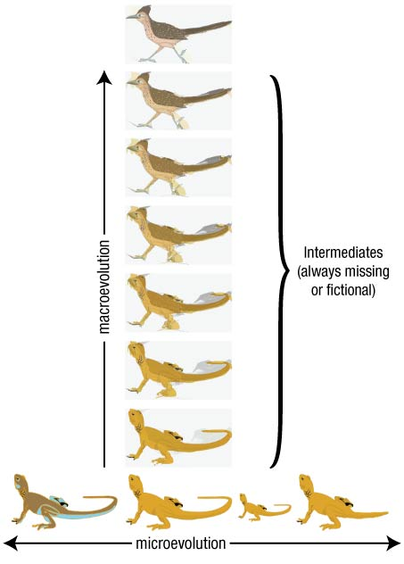

Slide 5
Early Theories Influencing Darwin:
Hutton: gradualism seen in geology
Lyell - geologist - uniformitarianism - geological systems are constant
Lamark: individuals acquired traits would be passed down to the next generation - USE AND DISUSE
EX: giraffe and black smiths

Slide 6
ALL INFLUENCED DARWIN
- HMS Beagle, Galapagos - collected different species
- noticed similarities to other species on other islands and South American species
CONCLUSION: new species could arise from an ancestral form by the gradual accumulation of adaptations to a different environment
→DESCENT WITH MODIFICATION

Slide 7
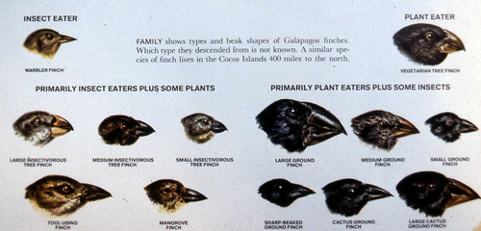

Slide 8
Darwin’s Finches
- big beaks and little beaks
- plants make big seeds in dry season and little seeds in wet seasons
Driving force: Natural Selection and Adaptation (survival of the fittest)
- those that survive get to breed and pass on their traits

Slide 9
Fitness vs Survival - Survival = not dead
- Fitness = survival and reproduction of viable offspring Viable = can also reproduce

Slide 10
Points of Natural Selection
1. great potential for reproduction
2. resources are limited in size
3. variation in population

Slide 11
Results: 1. competition for resources
2. survival dependent on better suited characteristics
3. better characteristics get passed on to next generation

Slide 12
EVIDENCE OF EVOLUTION:
Fossil Record: evidence of past species that are similar to current species
Age of Fossils Determined By Radiometric Dating: - measuring the amount of radioactive atoms in a sample and working backwards to determine the age based on how quickly those radioactive atoms decay into different atoms

Slide 13
Known as the Half life of a sample: Ex: Carbon-14 has a half life of 5730 years – this means if you have a 10 gram sample of C-14, it will take 5730 years for half of it (5 grams) to break down into Nitrogen 14 and another 5730 years to degrade to 2.5 grams and another 5730 years to degrade to 1.25 grams, etc.
Based on the ratio of C-14 and C-12 in the sample, the age can be determined. For really old samples, other radiometric dating like potassium and uranium

Slide 15
Radioactive iodine-131 has a half-life of 8.04 days
1) If you have 8.2 ug (micrograms) of this isotope, what mass remains after 32.2 days?
2) How long will it take for a sample of iodine-131 to decay to 1/8 of its activity?

Slide 16
2. Biogeography
- species of nearby areas populate those around it and then change according to the environmental pressures
EX: South American species are going to be more like North American than Australian

Slide 17
A
Migrate
Evolve
Migrate
B
A
B
Evolve
D
Migrate
Migrate
B
D
F
Evolve
Evolve
C

Slide 18
3. Comparative Anatomy:
-species that evolved from a common ancestor should have similar anatomical structures
Homologous Structures:
- same components but different variations – shaped from a common ancestor into different forms by different selective pressures (environmental conditions)
EX: Whale fin, human arms, bat wing

Slide 20
Analogous Structures:
Different components but same function – shaped by similar environmental conditions
EX: Bat wing, bird wing, butterfly wing

Slide 21
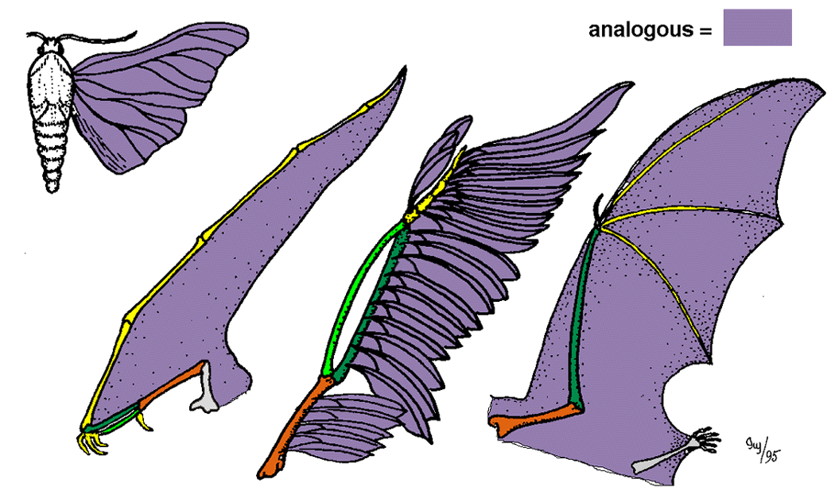

Slide 22
4. Comparative Embryology:
“ontogeny recapitulates phylogeny”
ontogeny = development phylogeny = past history - means as the individual develops embryologically, the embryo shows the past history or evolution of the species
NOT TRUE
Current Understanding: organisms with a common ancestor will show similar traits but will not express the traits of that past ancestor

Slide 23
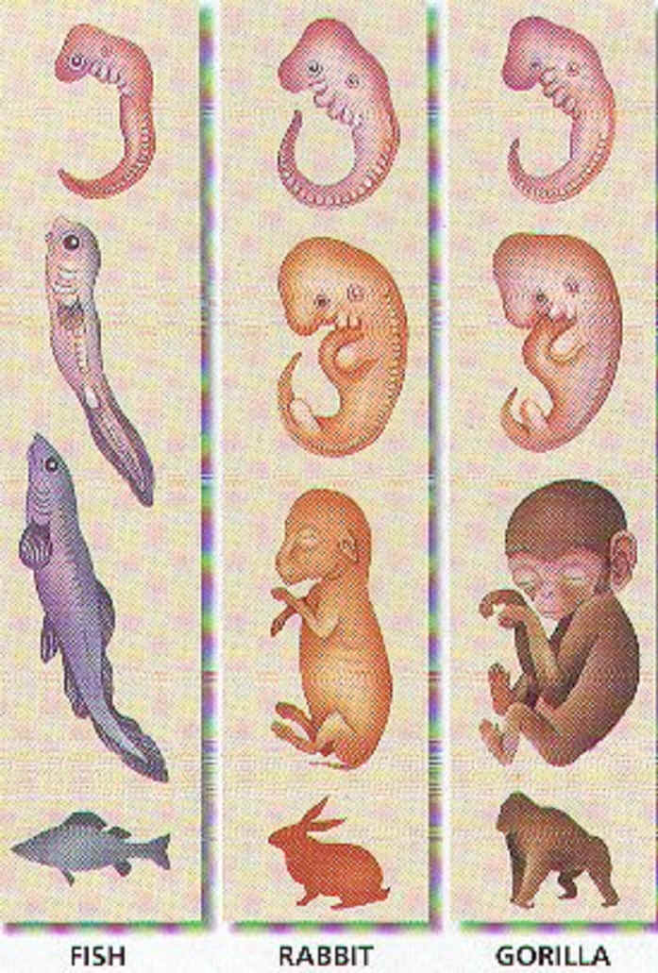

Slide 24
5. Molecular Biology – Homologous Molecules
Current Powerhouse of Evolutionary Research: - look at DNA and Proteins to see how similar they are. The more they have in common, the more closely they are related.
EX: Animals, Mushrooms and Plants

Slide 26
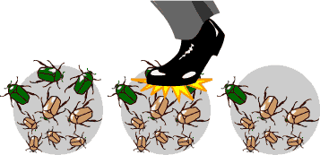
Causes of Microevolution
1. Genetic Drift
- change in the gene pool due to chance
- smaller sample of individuals has less variation

Slide 27
TYPES:
Bottle Neck Effect
- natural catastrophe reduces population to a few individuals
- survivors become parents of resulting population
- can wipe out a certain trait

Slide 29
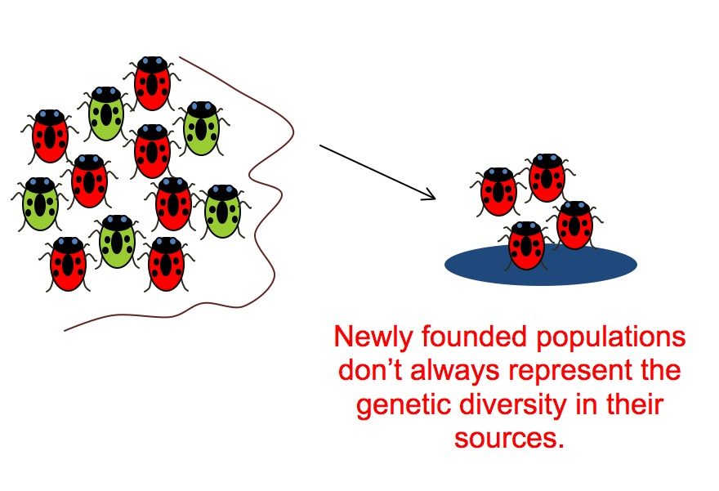
Founder Effect
- a few individuals start the population

Slide 30
2. Gene Flow
- individuals move in or out of the population introducing or removing new alleles
- Immigration and emigration
3. Mutations
- introduce new alleles
- rare - most are fatal or non-effective

Slide 31
4. Non-random mating
- based on some characteristic
- mate choice
- isolates favorable traits - sexual dimorphism

Slide 32
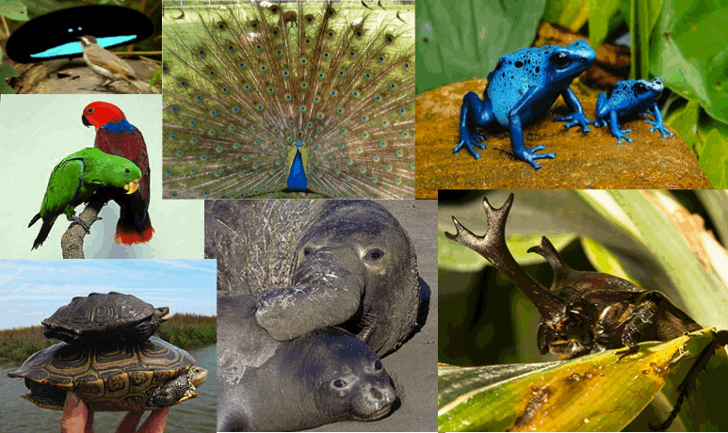
Birds of Paradise

Slide 33
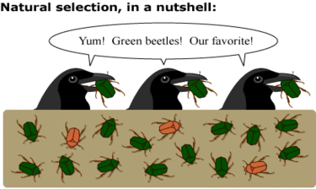
5. Natural Selection
- Selection Pressure by the Environment
- competition, territory, predation, climate,
- best adapted have the greatest fitness

Slide 34
TYPES OF NATURAL SELECTION

Slide 35
1. Stabilizing Selection: favors middle ground
- bird beaks, human birth weight
2. Directional Selection: favors and extreme
- giraffe
3. Diversifying Selection: does not favor middle ground - makes both extremes more frequent
- crabs that are black or white

Slide 36
GENETIC CHANGE CAN LEAD TO SPECIATION
- different environments = natural selection = speciation
HOW MUCH CHANGE IS ENOUGH?
various - depends on what is changed
TEMPO OF CHANGE: how fast
gradualism vs. punctuated equilibrium

Slide 37
gradualism = very small changes over a period of time
- not supported by fossil record
FOSSIL RECORD:
- shows stasis - no change for long periods of time
- then disappear - replaced by something different
- little to no transition

Slide 38
POSSIBLE EXPLANATION: changes that occurred are not seen in the fossils because they were in the soft tissues or were behavioral
- alternate theory: PUNCTUATED EQUILIBRIUM
- stayed same for long periods of time and then underwent periods of rapid change for some reason (presumably change in the environment) -
- does not allow enough time for fossils to be formed so there are none

Slide 39
PREBIOTIC EVOLUTION:
IDEAS and SPECULATION of the ORIGIN of LIFE
Formation of the earth
THE YOUNG EARTH
- little atmospheric oxygen
- high UV
- lightning
- volcanos
- conducive to chemical reactions
- energy
- no oxygen to oxidize products and break them down
Hot mixture of chemicals
- formed amino acids and nucleic acids
- formed proteins and DNA
- formed simple cells (Protobionts)
- formation of heredity
- cells became more complicated

Slide 40
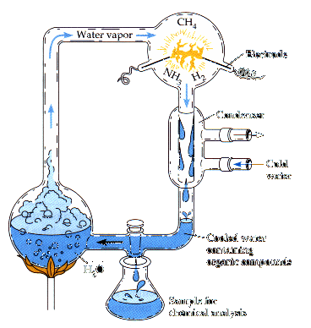
Evidence
Miller/Urey Experiment
- methane, water, ammonia, H₂, and electricity
- excluded, CO, CO₂, N₂ and O₂
FOUND: produced amino acids and nucleotides and ATP

