Slide 1
ENZYMES and Metabolism

Slide 2
Metabolism: sum of all chemical reactions in a cell
Parts of a Chemical Reaction:
Reactants → Products
Examples: 2 H₂ + O₂ → 2 H₂O

Slide 3
Two types of Metabolism:
Catabolism: Reactions that break down molecules and release energy
Called Exothermic or Exergonic Reactions
Example: CH₄ +2 O₂ → CO₂ + 2 H₂O

Slide 4
Anabolism: Reactions that build molecules and store energy
Called Endothermic or Endergonic Reactions
Example: 6 CO₂ + 6 H₂O → C₆H₁₂O₆ + 6 O₂
= photosynthesis

Slide 5
All Chemical Reactions Need Energy to start = Activation Energy
Reactions that have enough energy to start at room temperature are called Spontaneous
Reactions that don’t have enough energy to start at room temperature are call Non-Spontaneous.

Slide 6
Energy Profile of a Chemical Reaction Key: E = amount of Energy t = time Ea = Activation Energy

Slide 9
Role of Enzymes
Enzymes are Protein Catalysts.
Enzymes Lower the Activation energy
Give a short cut for reactions
Reactions happen faster and at a lower temperatures
Example: Glucose burns and releases energy at 177 ºC (350 ºF). Our bodies, because of enzymes burn glucose at 37 ºC (98.6 ºF)

Slide 11
Enzymes are three dimensional structures that bind to chemicals called substrates and cause them to react faster.
Substrates fit specifically into the reaction center of the enzyme called the ACTIVE SITE and cause the enzyme to change shape slightly – called a conformational change or an INDUCED FIT.
EX: Putting your hand in a glove.

Slide 12
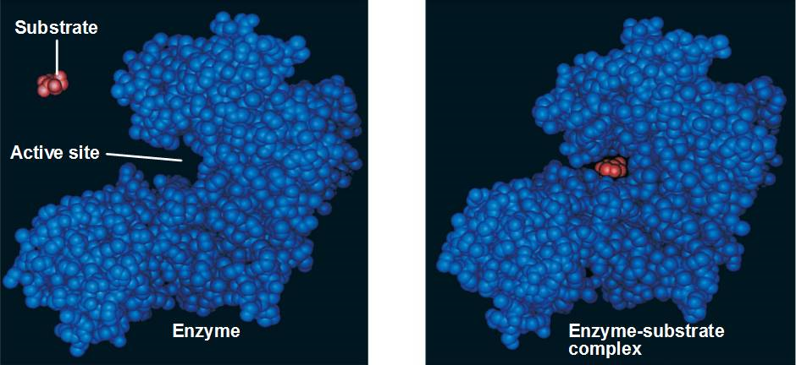

Slide 14
Factors that Affect Enzymes
1) Temperature:
Increase in temperature speeds up a reaction because it provides more energy and makes the molecules collide faster. HOWEVER, if the temperature increases too much, the enzyme DENATURES and no longer functions

Slide 15
Denature: to undo the chemical structure of a molecule – break it down
Ex: Cooking an egg, having a fever

Slide 16
2) pH – all enzymes work best at a specific pH – Optimal pH
Most work best between 6 – 8 .
Some work better in acidic conditions and some in basic.
If the pH is too high or too low the enzyme will denature and stop

Slide 18
3) Enzyme and Substrate Concentrations
If you have lots of substrate and you increase the number of enzymes, the reaction will go faster until the level of substrate gets too low.
If you have lots of enzymes and increase the amount of substrate, the reaction will go faster until you reach the point of Enzyme Saturation and the enzymes are working at full capacity. Adding more substrate will not make the reaction go any faster.
Enzyme Saturation

Slide 20
4) Presence of Co-factors and Co-enzymes
Substances that bind to enzymes and make them work properly Co-factor = metal ions Ex: Iron in hemoglobin Zinc in DNA polymerase (builds new DNA) Co-enzyme = vitamins Ex: Riboflavin (B₂) and Niacin (B₃) for components in cellular respiration = energy production

Slide 21
5) Inhibitors: Substances that bind to the enzyme and stop it functioning.
Types:
1) Competitive Inhibitors: Bind to the active site and COMPETE with the substrate
2) Non-competitive Inhibitors: Bind to another area of the enzyme causing the active site to undergo a conformational change (change in shape) so the substrate can’t bind

Slide 22
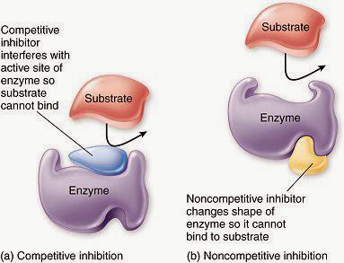
Tutorial

Slide 23
6) Regulatory Feedback
Some enzymes and metabolic pathways (a series of several enzymatic reactions) are regulated by the products of the reaction.
When enough product is made, excess product binds to the enzyme and turns it off.
This keeps the cell from making too much of one product and wasting energy and resources.

Slide 24
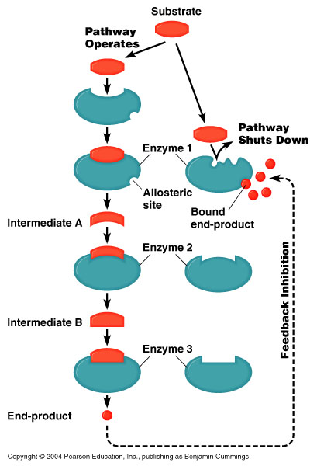

Slide 25
ARE ENZYMES IMPORTANT? !!
!!!YES!!!!!
They control EVERYTHING that happens inside your cells.
No enzymes = No Life.
Enzyme Tutorial

