Slide 1
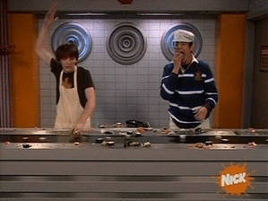
Enzyme Review

Slide 2
Enzyme Vocabulary
Active Site
Substrate
Exothermic
Endothermic Reactants
Products
Activation Energy Spontaneous Non-spontaneous
Chemicals formed in a reaction
Reaction that consumes energy
Component(s) changed by an enzyme
Chemicals consumed in a reaction
Reaction that produces energy
Location of the chemical reaction on the enzyme
Energy needed for a reaction to progress

Slide 3
Enzyme Vocabulary
Active Site
Substrate
Exothermic
Endothermic
Reactants
Products
Activation Energy
Spontaneous
Non-spontaneous
Chemicals formed in a reaction
Reaction that consumes energy
Component(s) changed by an enzyme
Chemicals consumed in a reaction
Reaction that produces energy
Location of the chemical reaction on the enzyme
Energy needed for a reaction to progress

Slide 4
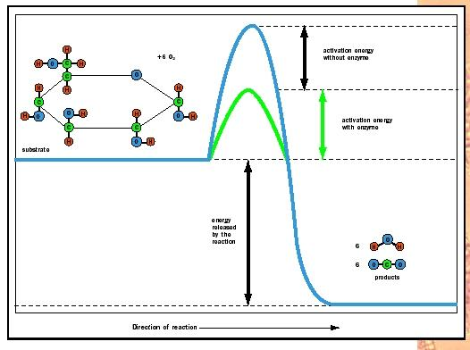
Use the following terms to label the diagram: Substrate, Products, Activation Energy without enzyme, Energy Released By Reaction, Activation Energy with Enzyme

Slide 5
Use the following terms to label the diagram: Substrate, Products, Activation Energy without enzyme, Energy Released By Reaction, Activation Energy with Enzyme

Slide 6
Which of the diagrams below is an Exothermic reaction? Which is an Endothermic reaction? How can you tell?

Slide 7
Which of the diagrams below is an Exothermic reaction? Which is an Endothermic reaction? How can you tell?
The diagram on the left is Exothermic because energy is being released and the energy of the products is below the energy of the reactants. The diagram on the right is Endothermic because energy is absorbed and the products have a higher energy than the reactants.

Slide 8
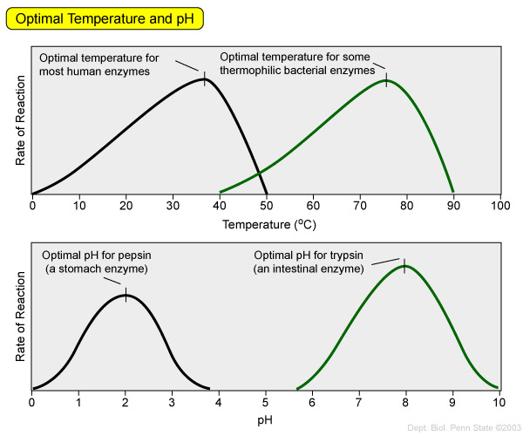
What is the optimal temp for most human enzymes?
What is the optimal temperature for some thermophilic bacteria?
What is the optimal pH for pepsin?
What is the optimal pH for trypsin?

Slide 9
What is the optimal temp for most human enzymes?
about 37 ºC
What is the optimal temperature for some thermophilic bacteria?
About 75 ºC
What is the optimal pH for pepsin?
About 2
What is the optimal pH for trypsin?
About 8

Slide 10
Vocab
Coenzyme
Cofactor
Denaturation
Negative Feedback
Break down of an enzyme due to extreme temperatures or pH
Metal ion that binds to an enzyme allowing it to function
The binding of the product of a reaction to the enzyme that causes the enzyme to stop functioning.
A vitamin that binds to an enzyme allowing it to function

Slide 11
Vocab
Coenzyme
Cofactor
Denaturation
Negative Feedback
Break down of an enzyme due to extreme temperatures or pH
Metal ion that binds to an enzyme allowing it to function
The binding of the product of a reaction to the enzyme that causes the enzyme to stop functioning.
A vitamin that binds to an enzyme allowing it to function

Slide 12
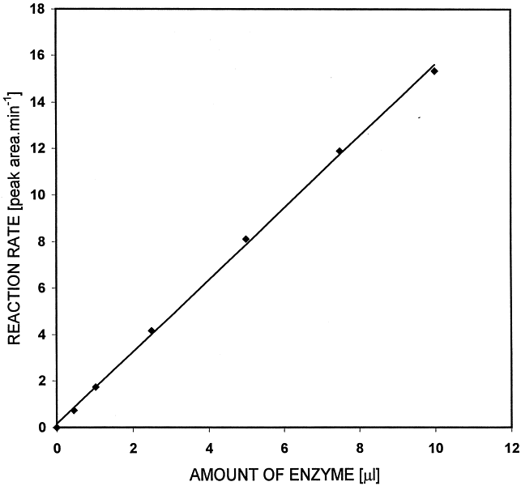
What does this graph indicate about the effect of enzyme concentration on the rate of reaction?

Slide 13
As enzyme concentration increases, reaction rate will increase as well because there are more enzymes to catalyze the reaction. More workers make the work go faster.

Slide 14
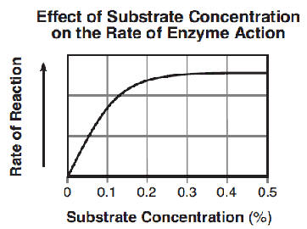
What does the following graph indicate about the effect of substrate concentration on the rate of a reaction?

Slide 15
As the amount of substrate increases, the rate of reaction will increase, but only to a point. Once all the enzymes are working at full capacity, they can only break down a certain amount of substrate. Adding more substrate will not increase the rate. The point where the enzymes are working at full capacity is known as the Enzyme Saturation point.
Enzyme Saturation Video

Slide 16
Enzyme Tutorial Animation
Allow the animation to run until the “Next” button at the bottom of the screen turns yellow.

