Slide 1
DNA Structure

Slide 2
Genetics and Heredity
the study of the inheritance of genes, genotypes, and phenotypes of individuals and populations.

Slide 3
Gene: Section of DNA that controls the expression of a characteristic by directing the manufacture of a protein.
Protein is then used as the materials to build the structure of the cell OR it is an enzyme that regulates how the cell does its job. The expression of these proteins is what determines the specific traits.

Slide 4
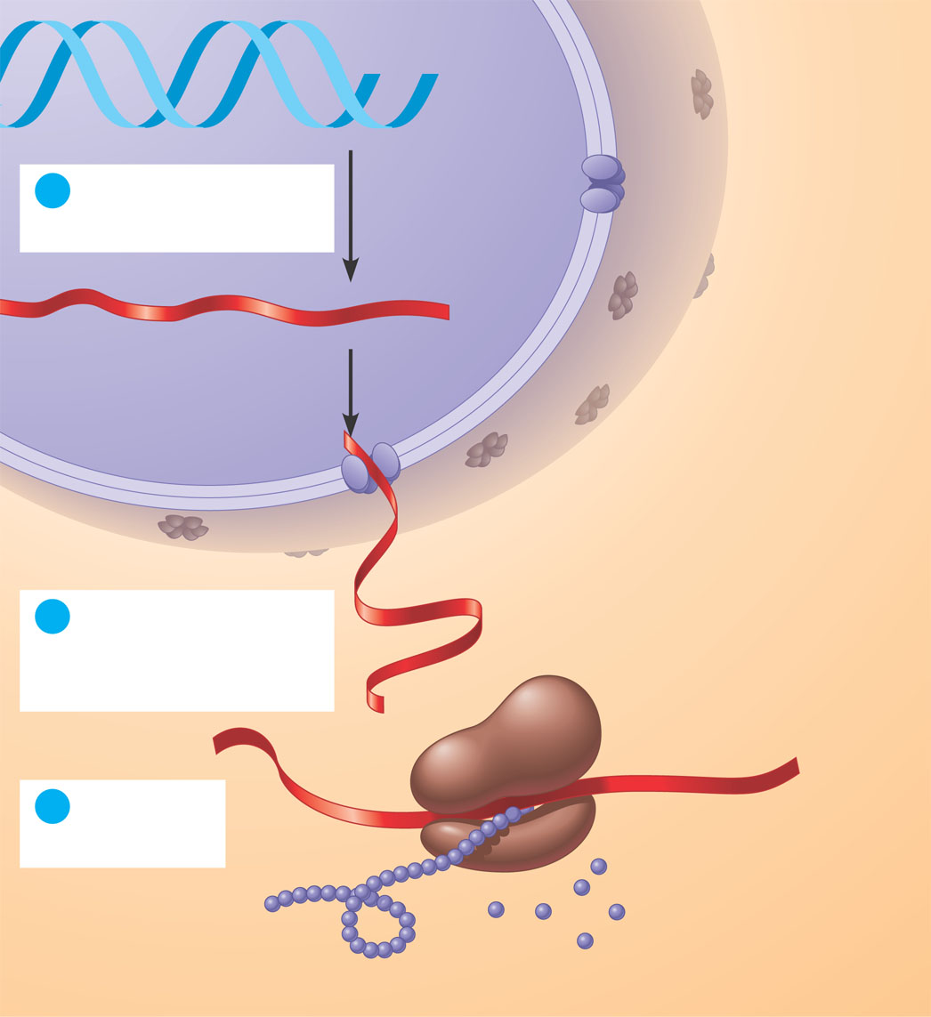
DNA
1
Synthesis of mRNA in the nucleus
mRNA
NUCLEUS
CYTOPLASM
mRNA
2
Movement of
mRNA into cytoplasm
via nuclear pore
Ribosome
3
Synthesis
of protein
Amino acids
Figure 5.25
Polypeptide

Slide 5
EX: Skin color is due to the presence of melanin in the skin. The genes tell the cell how much melanin to make. The more “dark genes” causes more melanin to be produced making the skin darker.
The structure of each gene is based on its DNA sequence.

Slide 6
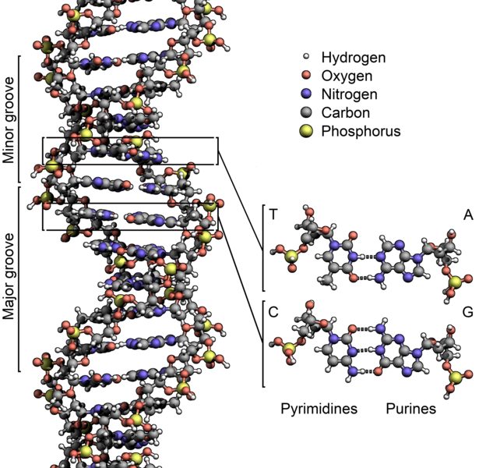
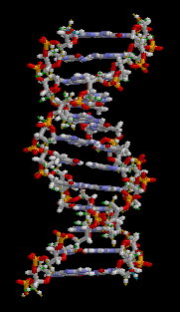
Structure of DNA:
DNA = Deoxyribonucleic Acid
Twisted ladder – a double helix

Slide 7
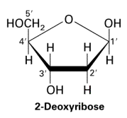
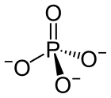
Components of DNA:
Components of DNA:
Composition: 1. Sugar molecule = Deoxyribose 2. Phosphate = PO₄⁻³

Slide 8
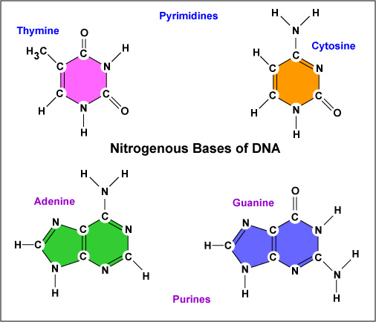
3. Nitrogenous Bases: 4 Types

Slide 9
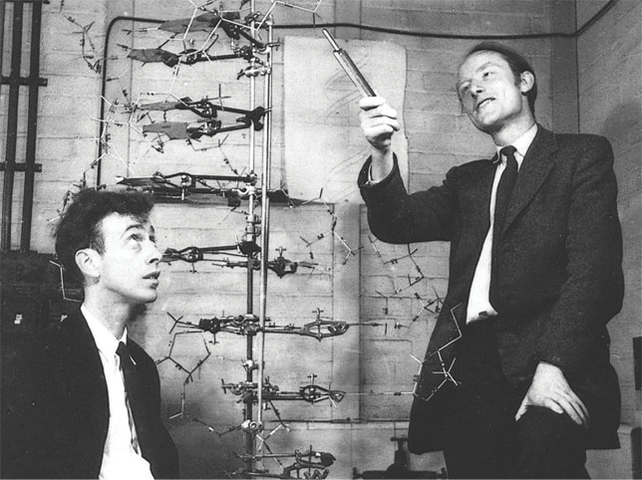
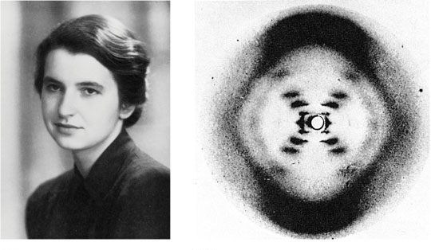
DNA Molecule Structure - Discovered by Watson and Crick using (stealing) the work of Rosalind Franklin
(a) Rosalind Franklin
(b)
Franklin’s X-ray diffraction
Photograph of DNA
Figure 16.1
Figure 16.6 a, b

Slide 10
What they found: Sides of “ladder” are made of deoxyribose and phosphate.
Phosphates bind to the 5’ and 3’ carbons of the deoxyribose.
Steps of the “ladder” are made of the nitrogenous bases branching off the deoxyribose.
Bases link together to form complimentary pairs.
Adenine bonds to Thymine
Guanine bonds to Cytosine
Each side runs Anti-parallel to the other – they run opposite directions

Slide 11
