Slide 1
DNA Replication

Slide 2
Cell Division occurs after DNA has replicated. - occurs in the S phase of Interphase
Occurs so that each daughter cell can have its own copy of the instruction book (DNA)
Occurs in the nucleus

Slide 3
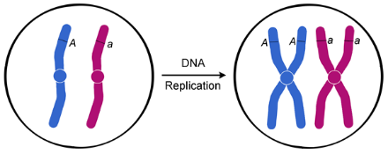

Slide 4
Requires new nucleotides and replication enzymes.
Replication Enzymes:
Gyrase (Topoisomerase)
Helicase
Single Strand Binding Proteins
RNA Primase
DNA Polymerase
Ligase

Slide 5
Process of Replication
1. Gyrase unspools the DNA. DNA is wound around itself in the nucleus. Gyrase straightens it out for helicase to work.
Many drugs operate through interference with the topoisomerases. The broad-spectrum fluoroquinolone antibiotics act by disrupting the function of bacterial type II topoisomerases. These small molecule inhibitors act as efficient anti-bacterial agents by hijacking the natural ability of topoisomerase to create breaks in chromosomal DNA.
Some chemotherapy drugs called topoisomerase inhibitors work by interfering with mammalian-type eukaryotic topoisomerases in cancer cells. This induces breaks in the DNA that ultimately lead to programmed cell death (apoptosis). This DNA-damaging effect, outside of its potential curative properties, may lead to secondary neoplasms in the patient.

Slide 6
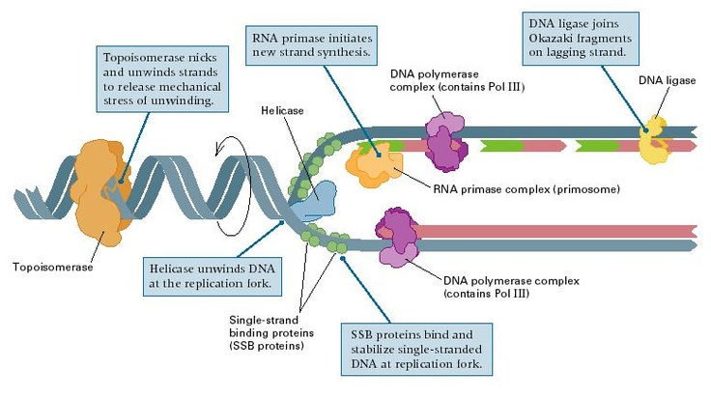
2. Helicase binds to the start point of replication and separates the two strands of DNA by breaking the adenine from the thymine and the guanine from the cytosine.

Slide 7
3. Single Strand Binding Proteins attach to each side of the DNA to keep the strands separated.

Slide 8
4. RNA Primase builds a small section of RNA across from the DNA. This is called an RNA primer and acts as the starting point for DNA to start building. This is like the foundation of a house. You don’t just build the house on the ground, you need something flat and solid to build on.

Slide 9
5. DNA Polymerase adds new nucleotides to the end of the 3’ end of the RNA primer building from in the 5’ to 3’ direction. It can only add new nucleotides to the 3’ end of another nucleotide. Builds unidirectionally. The nucleotides build continuously on this side of the RNA primer and is called the leading strand.

Slide 10
DNA ANIMATION

Slide 11
New DNA is built complementary to the old strand. DNA polymerase matches the DNA nucleotides to the opposite pair. A’s are matched with new T’s, G’s are matched with new C’s, etc.
Parent (original) Strand of DNA: AGTCGATAGC
Complementary Daughter (new) Strand:

Slide 12
New DNA is built complementary to the old strand. DNA polymerase matches the DNA nucleotides to the opposite pair. A’s are matched with new T’s, G’s are matched with new C’s, etc.
Parent (original) Strand of DNA: AGTCGATAGC
Complementary Daughter (new) Strand: TCAGCTATCG

Slide 13
Because DNA can only be built unidirectionally (on the 3’ of the previous nucleotide), new nucleotides cannot be added to the other side of the 5’ end.
Therefore another RNA primer must be added to the DNA “downstream” from the first RNA primer. The DNA polymerase then adds nucleotides to the 3’ end and builds the DNA in a short segment.
As the helicase continues to unwind the DNA, new primers are added building numerous short strands, called Okazaki fragments. This side of the DNA, since it is built in short segments, takes longer to build than the other side. Therefore it is called the lagging strand.
DNA ANIMATION
DNA ANIMATION II

Slide 15
6. Once the DNA has been built, another form of DNA polymerase removes the RNA primers and replaces them with DNA.
7. DNA Ligase binds the Okazaki fragments together.
DNA ANIMATION

Slide 16
Both sides of the DNA strands are replicated at the same time. Since they are anti-parallel (run opposite directions), the leading and lagging strands of each side are opposite of one another.
Each original strand (parent strand) acts as the template for the new strand (daughter strand). Since each of the copies of DNA contains one half parent (original) DNA and one half daughter (new) DNA, DNA replication is said to be SEMI-Conservative.
DNA ANIMATION
A more realistic representation

Slide 18
Problems with Replication
1. Replication Errors: sometimes the wrong nucleotide is put in place (one in a billion) . A third type of DNA polymerase scans the newly replicated DNA for errors and cuts them out and corrects them → DNA spellcheck

Slide 19
2. Shortening of the Chromosomes with each replication. Each lagging strand end loses some DNA with each replication. After the very last RNA primer has been removed, there is no 3’ end to add nucleotides too. So a short section of DNA is not replicated and some information is lost.
To compensate, each chromosome is capped with TELOMERES – sections of non-sense DNA that don’t code for proteins.
Once the telomeres have been worn down, important DNA information begins to get lost. The shortening of telomeres is one of the causes of aging. Cells enter senescence → Don’t divide anymore.

Slide 20
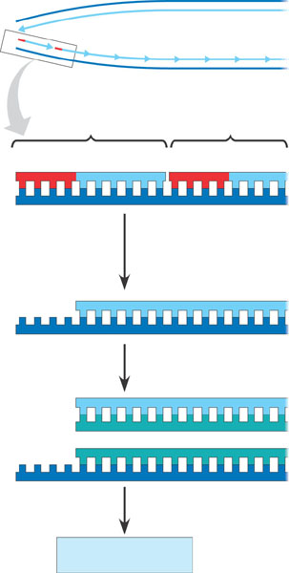
5′
End of parental
DNA strands
Leading strand
Lagging strand
3′
Last fragment
Previous fragment
RNA primer
Lagging strand
5′
3′
Primer removed but
cannot be replaced
with DNA because
no 3′ end available
for DNA polymerase
Removal of primers and
replacement with DNA
where a 3′ end is available
5′
3′
Second round
of replication
5′
New leading strand
3′
New lagging strand 5′
3′
Further rounds
of replication
Figure 16.18
Shorter and shorter
daughter molecules

Slide 21
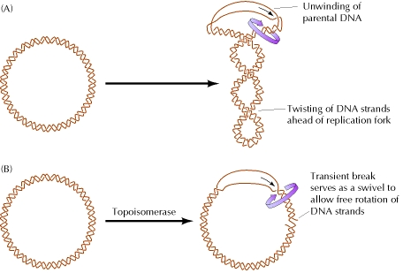
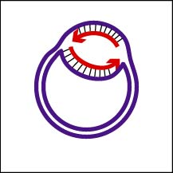
Differences in Prokaryotes and Eukaryotes
Prokaryote chromosomes are circular.
Don’t need telomeres

