Slide 1
DNA and Protein Synthesis
Test Review

Slide 2
DNA Videos
Crash Course – DNA and Replication
Crash Course – Protein Synthesis
Bozeman Science

Slide 3
DNA Basics
What is the base unit of DNA?
What three parts make up the base unit of DNA?
What is different in these parts in RNA?

Slide 4
DNA Basics
What is the base unit of DNA?
Nucleotide
What three parts make up the base unit of DNA?
Nitrogenous bases (A, T, G, C)
Phosphate
Deoxyribose
What is different in these parts in RNA?
Nitrogenous bases (A, U, G, C)
Ribose

Slide 5
DNA Basics
What are the four nitrogenous bases?
Which are purines?
Which are pyrimidines?
How do they pair?

Slide 6
DNA Basics
What are the four nitrogenous bases in DNA?
Adenine, Thymine, Guanine, Cytosine
Which are purines?
Adenine and Guanine
Which are pyrimidines?
Thymine and Cytosine
How do they pair?
A → T
G → C

Slide 7
These are the basic parts of DNA. Use your brain and imagine how they go together to build a strand of four nucleotides. This might be important to be able to draw.
= Phosphate = Deoxyribose
= Guanine = Cytosine
= Adenine = Thymine

Slide 8
You MIGHT want to draw this out a few times and LABEL it correctly.
Why do they go opposite ways? What is this called? How are they labeled?

Slide 9
Why do they go opposite ways?
So the nitrogenous bases can pair together
What is this called?
Anti-parallel
How are they labeled?
The deoxyribose is labeled 5’ and 3’

Slide 10
5’
3’
3’
5’

Slide 11
DNA Replication Enzymes and Proteins
RNA Primase
DNA Polymerase
Ligase
Topoisomerase
RNA Primer
Helicase
Single Strand Binding Proteins
Binds Okazaki fragments together
RNA foundation that allows DNA polymerase to start building
Uncoils the DNA and lessens the tension on the strands
Unzips the DNA
Keeps the DNA strands from re annealing (going back together)
Builds the new DNA in the 5’ to 3’ direction
Builds a small section of RNA

Slide 12
DNA Replication Enzymes and Proteins
RNA Primase
DNA Polymerase
Ligase
Topoisomerase
RNA Primer
Helicase
Single Strand Binding Proteins
Binds Okazaki fragments together
RNA foundation that allows DNA polymerase to start building
Uncoils the DNA and lessens the tension on the strands
Unzips the DNA
Keeps the DNA strands from re-annealing (going back together)
Builds the new DNA in the 5’ to 3’ direction
Builds a small section of RNA

Slide 13
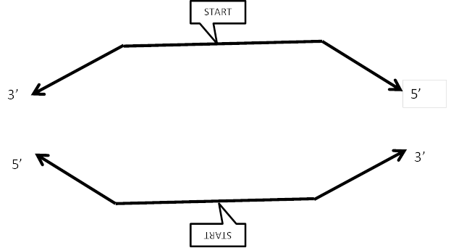
Draw the leading and lagging strands that develop from this strand of replicating DNA. REMEMBER!!!!! The direction of the leading and lagging strand is determined by the 5’ and 3’ direction of the original strand. It builds in the 5’ to 3’ direction complimentary of the 3’ to 5’. Another way to look at it is the leading strand follows the 5’ arrow of the original strand.

Slide 14
Leading Strand
Lagging Strand (Okazaki fragments)

Slide 15
DNA Replication Animation

Slide 16
Vocab
Telomeres
Amino Acids
Peptide Bonds
Code
Codon
Anti-codon
Reading Frame
Chemical bonds holding amino acids together – broken in the process of digestion
Building units of Proteins
Non-coding DNA at the ends of chromosomes that protect the DNA from unraveling
DNA
Three Nucleotide sequence on the t-RNA
Three Nucleotide sequence on the m-RNA

Slide 17
Vocab
Telomeres
Amino Acids
Peptide Bonds
Code
Codon
Anti-codon
Reading Frame
Chemical bonds holding amino acids together – broken in the process of digestion
Building units of Proteins
Non-coding DNA at the ends of chromosomes that protect the DNA from unraveling
DNA
Three Nucleotide sequence on the t-RNA
Three Nucleotide sequence on the m-RNA

Slide 18
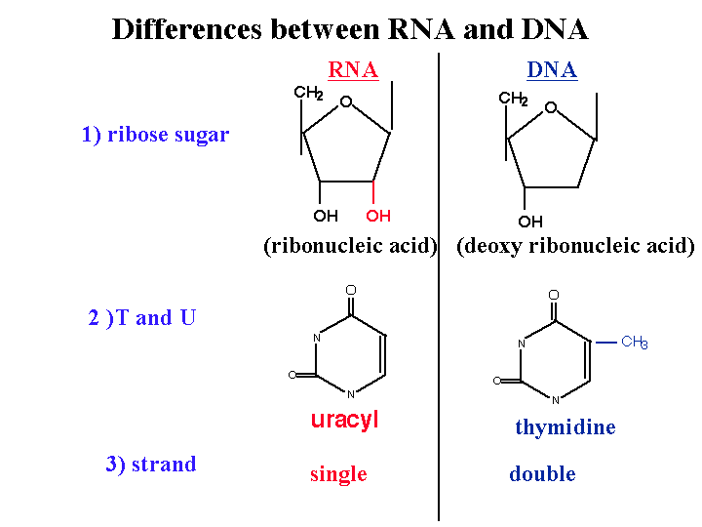

Slide 19
Uracil
Thymine

Slide 20
Transcription, RNA Processing, or Translation
Add a 5’ cap of GTP
Peptide bonds are formed between amino acids
mRNA binds to the Ribsome
RNA Polymerase makes RNA
Uracil Replaces Thymine
Introns are removed and Exons are spliced
The anti-codon matches to the codon
A poly-A tail is added to the 3’ end
t-RNAs shift position in the ribosome
Occurs in the nucleus
Occurs in the cytoplasm
A protein release factor stops the whole process

Slide 21
Transcription, RNA Processing, or Translation
Add a 5’ cap of GTP
Peptide bonds are formed between amino acids
mRNA binds to the Ribosome
RNA Polymerase makes RNA
Uracil Replaces Thymine
Introns are removed and Exons are spliced
The anti-codon matches to the codon
A poly-A tail is added to the 3’ end
t-RNAs shift position in the ribosome
Occurs in the nucleus
Occurs in the cytoplasm
A protein release factor stops the whole process

Slide 22
Steps of Translation – put in order You will have to write this out – 16 point essay!
The first tRNA attaches to the first three nucleotides of the mRNA The first three nucleotides of every mRNA is AUG. This codes for the amino acid Methoinine.
The amino acid on the tRNA in the P site attaches to the amino acid on the tRNA in the A site and forms a peptide bond.
Small subunit of the ribosome binds to the 5’ cap of the mRNA
This process repeats over and over building the amino acid chain until a STOP codon is reached. - STOP codons = UGA, UAG, UAA - bring in a protein called a Release Factor and this causes the amino acid chain (protein) to be freed and the ribosome to detach from the mRNA.
tRNAs attach to the correct amino acid in the cytoplasm – directed by enzymes
The large subunit slides into place so the tRNA is in the middle slot of the ribosome, the P site.
The ribosome shifts down the mRNA causing the tRNAs (which are still attached to the mRNA) to translocate (move) into the adjacent site on the ribosome. - the tRNA in the A site moves to the P site - the tRNA in P site moves to the E site and then leaves
The next tRNA with the appropriate amino acid enters the A site matching to the mRNA codon.

Slide 23
Steps of Translation – put in order You will have to write this out – 16 point essay!
tRNAs attach to the correct amino acid in the cytoplasm – directed by enzymes
Small subunit of the ribosome binds to the 5’ cap of the mRNA
The first tRNA attaches to the first three nucleotides of the mRNA The first three nucleotides of every mRNA is AUG. This codes for the amino acid Methoinine.
The large subunit slides into place so the tRNA is in the middle slot of the ribosome, the P site.
The next tRNA with the appropriate amino acid enters the A site matching to the mRNA codon.
The amino acid on the tRNA in the P site attaches to the amino acid on the tRNA in the A site and forms a peptide bond.
The ribosome shifts down the mRNA causing the tRNAs (which are still attached to the mRNA) to translocate (move) into the adjacent site on the ribosome. - the tRNA in the A site moves to the P site - the tRNA in P site moves to the E site and then leaves
This process (steps 5 – 7) repeats over and over building the amino acid chain until a STOP codon is reached. - STOP codons = UGA, UAG, UAA - bring in a protein called a Release Factor and this causes the amino acid chain (protein) to be freed and the ribosome to detach from the mRNA.

Slide 24
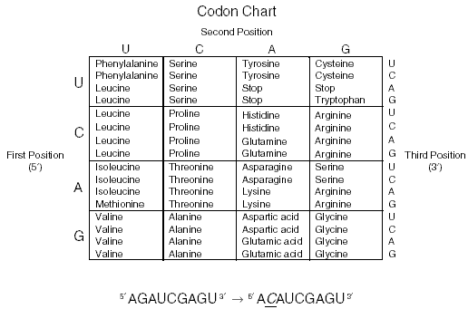
Transcribe and Translate the Following Sequence of DNA
DNA CODE: TAC GCT TTC ATG CGT TGA ACT mRNA CODON: ______ ______ ______ _____ ______ _____ _____ AMINO ACID: ______ ______ ______ _____ ______ _____ _____

Slide 25
Transcribe and Translate the Following Sequence of DNA
DNA CODE: TAC GCT TTC ATG CGT TGA ACT mRNA CODON: AUG CGA AAG UAC GCA ACU UGA AMINO ACID: ______ ______ ______ _____ ______ _____ _____

Slide 26
Transcribe and Translate the Following Sequence of DNA
DNA CODE: TAC GCT TTC ATG CGT TGA ACT mRNA CODON: AUG CGA AAG UAC GCA ACU UGA AMINO ACID: Meth Arg Arg Tyr Ser Thr STOP

Slide 27
Extras
DNA Game
Extra Credit for Test: Print and Make – due day of the test – the video shows you how – the PDF files are listed below the video – if you want to color, there is a non-colored one

