Slide 1
Digestive System

Slide 2
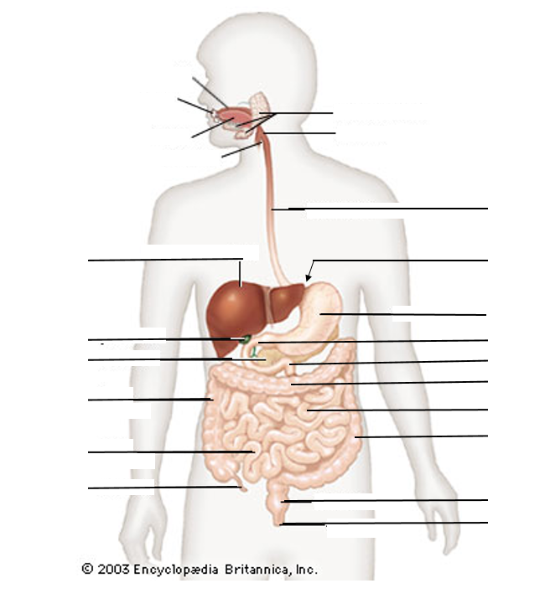

Slide 3
Mouth
Teeth
Salivary Glands
Tongue
Pharynx
Esophagus
Liver
Cardiac Sphincter
Stomach
Gall Bladder
Pyloric Sphincter
Pancreas
Duodenum
Transverse Colon
Ascending Colon
Jejunum
Descending Colon
Ileum
Appendix
Rectum
Anus

Slide 4
Mouth
Teeth
Salivary Glands
Tongue
Pharynx
Esophagus
Liver
Cardiac Sphincter
Stomach
Gall Bladder
Pyloric Sphincter
Pancreas
Duodenum
Transverse Colon
Ascending Colon
Jejunum
Descending Colon
Ileum
Appendix
Rectum
Anus

Slide 5
Mouth
Teeth
Salivary Glands
Tongue
Pharynx
Esophagus
Liver
Cardiac Sphincter
Stomach
Gall Bladder
Pyloric Sphincter
Pancreas
Duodenum
Transverse Colon
Ascending Colon
Jejunum
Descending Colon
Ileum
Appendix
Rectum
Anus

Slide 6
Mouth
Teeth
Salivary Glands
Tongue
Pharynx
Esophagus
Liver
Cardiac Sphincter
Stomach
Gall Bladder
Pyloric Sphincter
Pancreas
Duodenum
Transverse Colon
Ascending Colon
Jejunum
Descending Colon
Ileum
Appendix
Rectum
Anus

Slide 7
Mouth
Teeth
Salivary Glands
Tongue
Pharynx
Esophagus
Liver
Cardiac Sphincter
Stomach
Gall Bladder
Pyloric Sphincter
Pancreas
Duodenum
Transverse Colon
Ascending Colon
Jejunum
Descending Colon
Ileum
Appendix
Rectum
Anus

Slide 8
Mouth
Teeth
Salivary Glands
Tongue
Pharynx
Epiglottis
Esophagus
Liver
Cardiac Sphincter
Stomach
Gall Bladder
Pyloric Sphincter
Pancreas
Duodenum
Transverse Colon
Ascending Colon
Jejunum
Descending Colon
Ileum
Appendix
Rectum
Anus

Slide 9
Mouth
Teeth
Salivary Glands
Tongue
Pharynx
Epiglottis
Esophagus
Esophagus
Liver
Cardiac Sphincter
Stomach
Gall Bladder
Pyloric Sphincter
Pancreas
Duodenum
Transverse Colon
Ascending Colon
Jejunum
Descending Colon
Ileum
Appendix
Rectum
Anus

Slide 10
Mouth
Teeth
Salivary Glands
Tongue
Pharynx
Epiglottis
Esophagus
Esophagus
Liver
Cardiac Sphincter
Cardiac Sphincter
Stomach
Gall Bladder
Pyloric Sphincter
Pancreas
Duodenum
Transverse Colon
Ascending Colon
Jejunum
Descending Colon
Ileum
Appendix
Rectum
Anus

Slide 11
Mouth
Teeth
Salivary Glands
Tongue
Pharynx
Epiglottis
Esophagus
Esophagus
Liver
Cardiac Sphincter
Cardiac Sphincter
Stomach
Stomach
Gall Bladder
Pyloric Sphincter
Pancreas
Duodenum
Transverse Colon
Ascending Colon
Jejunum
Descending Colon
Ileum
Appendix
Rectum
Anus

Slide 12
Mouth
Teeth
Salivary Glands
Tongue
Pharynx
Epiglottis
Esophagus
Esophagus
Liver
Cardiac Sphincter
Cardiac Sphincter
Stomach
Stomach
Gall Bladder
Pyloric Sphincter
Pyloric Sphincter
Pancreas
Duodenum
Transverse Colon
Ascending Colon
Jejunum
Descending Colon
Ileum
Appendix
Rectum
Anus

Slide 13
Mouth
Teeth
Salivary Glands
Tongue
Pharynx
Epiglottis
Esophagus
Esophagus
Liver
Cardiac Sphincter
Cardiac Sphincter
Stomach
Stomach
Gall Bladder
Pyloric Sphincter
Pyloric Sphincter
Pancreas
Duodenum
Duodenum
Transverse Colon
Ascending Colon
Jejunum
Descending Colon
Ileum
Appendix
Rectum
Anus

Slide 14
Mouth
Teeth
Salivary Glands
Tongue
Pharynx
Epiglottis
Esophagus
Esophagus
Liver
Cardiac Sphincter
Cardiac Sphincter
Stomach
Stomach
Gall Bladder
Pyloric Sphincter
Pyloric Sphincter
Pancreas
Duodenum
Duodenum
Transverse Colon
Ascending Colon
Jejunum
Jejunum
Descending Colon
Ileum
Appendix
Rectum
Anus

Slide 15
Mouth
Teeth
Salivary Glands
Tongue
Pharynx
Epiglottis
Esophagus
Esophagus
Liver
Cardiac Sphincter
Cardiac Sphincter
Stomach
Stomach
Gall Bladder
Pyloric Sphincter
Pyloric Sphincter
Pancreas
Duodenum
Duodenum
Transverse Colon
Ascending Colon
Jejunum
Jejunum
Descending Colon
Ileum
Ileum
Appendix
Rectum
Anus

Slide 16
Mouth
Teeth
Salivary Glands
Tongue
Pharynx
Epiglottis
Esophagus
Esophagus
Liver
Cardiac Sphincter
Cardiac Sphincter
Stomach
Stomach
Gall Bladder
Pyloric Sphincter
Pyloric Sphincter
Pancreas
Duodenum
Duodenum
Transverse Colon
Ascending Colon
Ascending Colon
Jejunum
Jejunum
Descending Colon
Ileum
Ileum
Appendix
Rectum
Anus

Slide 17
Mouth
Teeth
Salivary Glands
Tongue
Pharynx
Epiglottis
Esophagus
Esophagus
Liver
Cardiac Sphincter
Cardiac Sphincter
Stomach
Stomach
Gall Bladder
Pyloric Sphincter
Pyloric Sphincter
Pancreas
Duodenum
Duodenum
Transverse Colon
Transverse Colon
Ascending Colon
Ascending Colon
Jejunum
Jejunum
Descending Colon
Ileum
Ileum
Appendix
Rectum
Anus

Slide 18
Mouth
Teeth
Salivary Glands
Tongue
Pharynx
Epiglottis
Esophagus
Esophagus
Liver
Cardiac Sphincter
Cardiac Sphincter
Stomach
Stomach
Gall Bladder
Pyloric Sphincter
Pyloric Sphincter
Pancreas
Duodenum
Duodenum
Transverse Colon
Transverse Colon
Ascending Colon
Ascending Colon
Jejunum
Jejunum
Descending Colon
Descending Colon
Ileum
Ileum
Appendix
Rectum
Anus

Slide 19
Mouth
Teeth
Salivary Glands
Tongue
Pharynx
Epiglottis
Esophagus
Esophagus
Liver
Cardiac Sphincter
Cardiac Sphincter
Stomach
Stomach
Gall Bladder
Pyloric Sphincter
Pyloric Sphincter
Pancreas
Duodenum
Duodenum
Transverse Colon
Transverse Colon
Ascending Colon
Ascending Colon
Jejunum
Jejunum
Descending Colon
Descending Colon
Ileum
Ileum
Appendix
Rectum
Rectum
Anus

Slide 20
Mouth
Teeth
Salivary Glands
Tongue
Pharynx
Epiglottis
Esophagus
Esophagus
Liver
Cardiac Sphincter
Cardiac Sphincter
Stomach
Stomach
Gall Bladder
Pyloric Sphincter
Pyloric Sphincter
Pancreas
Duodenum
Duodenum
Transverse Colon
Transverse Colon
Ascending Colon
Ascending Colon
Jejunum
Jejunum
Descending Colon
Descending Colon
Ileum
Ileum
Appendix
Rectum
Rectum
Anus
Anus

Slide 21
Mouth
Teeth
Salivary Glands
Tongue
Pharynx
Epiglottis
Esophagus
Esophagus
Liver
Cardiac Sphincter
Liver
Cardiac Sphincter
Stomach
Stomach
Gall Bladder
Pyloric Sphincter
Pyloric Sphincter
Pancreas
Duodenum
Duodenum
Transverse Colon
Transverse Colon
Ascending Colon
Ascending Colon
Jejunum
Jejunum
Descending Colon
Descending Colon
Ileum
Ileum
Appendix
Rectum
Rectum
Anus
Anus

Slide 22
Mouth
Teeth
Salivary Glands
Tongue
Pharynx
Epiglottis
Esophagus
Esophagus
Liver
Cardiac Sphincter
Liver
Cardiac Sphincter
Stomach
Stomach
Gall Bladder
Gall Bladder
Pyloric Sphincter
Pyloric Sphincter
Pancreas
Duodenum
Duodenum
Transverse Colon
Transverse Colon
Ascending Colon
Ascending Colon
Jejunum
Jejunum
Descending Colon
Descending Colon
Ileum
Ileum
Appendix
Rectum
Rectum
Anus
Anus

Slide 23
Mouth
Teeth
Salivary Glands
Tongue
Pharynx
Epiglottis
Esophagus
Esophagus
Liver
Cardiac Sphincter
Liver
Cardiac Sphincter
Stomach
Stomach
Gall Bladder
Gall Bladder
Pyloric Sphincter
Pyloric Sphincter
Pancreas
Duodenum
Pancreas
Duodenum
Transverse Colon
Transverse Colon
Ascending Colon
Ascending Colon
Jejunum
Jejunum
Descending Colon
Descending Colon
Ileum
Ileum
Appendix
Rectum
Rectum
Anus
Anus

Slide 24
Mouth
Teeth
Salivary Glands
Tongue
Pharynx
Epiglottis
Esophagus
Esophagus
Liver
Cardiac Sphincter
Liver
Cardiac Sphincter
Stomach
Stomach
Gall Bladder
Gall Bladder
Pyloric Sphincter
Pyloric Sphincter
Pancreas
Duodenum
Pancreas
Duodenum
Transverse Colon
Transverse Colon
Ascending Colon
Ascending Colon
Jejunum
Jejunum
Descending Colon
Descending Colon
Ileum
Ileum
Appendix
Appendix
Rectum
Rectum
Anus
Anus

Slide 25
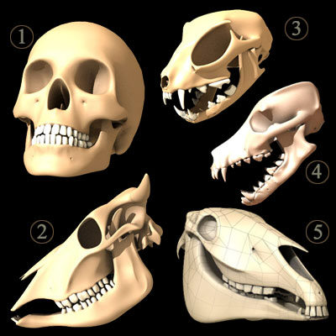
1. Mouth:
- mechanical digestion –

Slide 26
- chemical digestion - salivary amylase - enzyme that breaks down starch
Other functions of saliva:
lubricate and moisten food
antibacterial agents - prevent tooth decay
Bolus: mass of chewed mess
- moved to back of throat by the tongue

Slide 27
2. Pharynx: throat
common opening for respiratory and digestive system
Epiglottis - blocks trachea (windpipe) - prevents food from entering the lungs

Slide 28
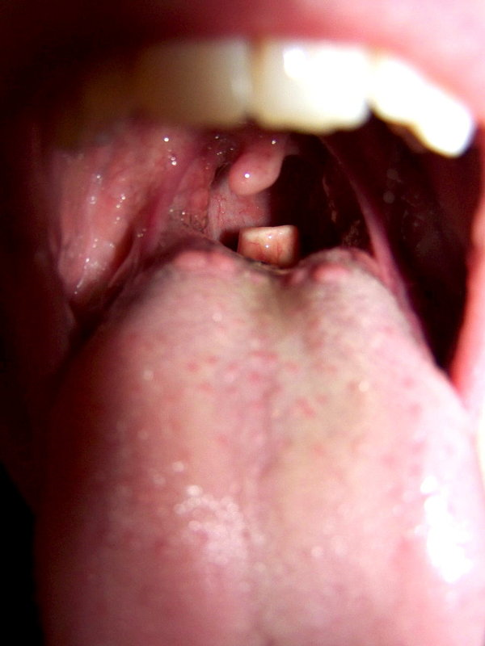
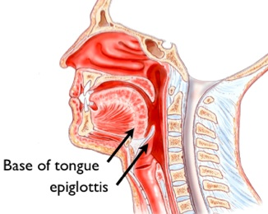

Slide 29
X-Ray of Deglutition
X-Ray of Sword Swallowing

Slide 30
3. Esophagus: pharynx to stomach
moves food to stomach by PERISTALSIS - rhythmic waves of muscle contraction - pushes food down to stomach
4. Cardiac Sphincter
(Sphincter – ring of muscle – acts as a gate)
allows food into the stomach and keeps food inside
Malfunction = heartburn!

Slide 31
5. Stomach: about 2 L capacity - storage of food
Gastric Juice - Pepsin and Hydrochloric Acid (HCl)
HCl
breaks down proteins
kills most bacteria and foreign organisms
PEPSIN - breaks peptide bonds in proteins
Mucus: protects stomach wall from self digestion
Mix of food, enzymes, mucus, and HCl = ACID CHYME

Slide 32
6. Pyloric Sphincter – regulates release of acid chyme into small intestine

Slide 33
7. Small Intestine: Duodenum, Jejunum, Ileum
Duodenum = 1st 25 cm
- secretes enzymes for the digestion of starch, protein, fats and nucleic acids
- Helped by accessory digestive organs
- pancreas, liver, gall bladder

Slide 34
Pancreas secretes digestive enzymes
Liver produces bile (stored in gall bladder) that emulsifies (breaks apart) fat
Jejunum and ileum: 6 meters - function: absorption of nutrients
Increase surface area with villi and microvilli

Slide 35
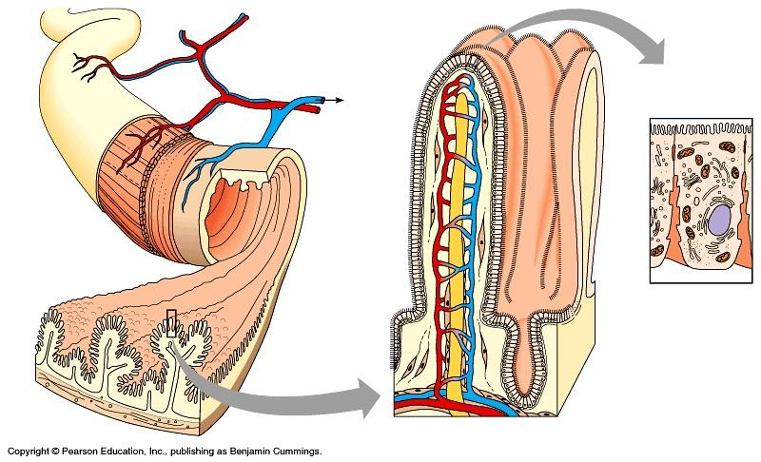
The total surface area of an adult small intestine = a tennis court!

Slide 36
8. Large Intestine: aka Colon : 1.5 meters long
- Absorption of water and minerals
- movement of waste aided by FIBER - stimulates the contraction of the intestine wall
Large Intestine has lots of Bacteria:
Break down many materials in waste and produces vitamins and gas

Slide 37
9. Rectum: storage of feces until eliminated (defecate) through the anus.
The Digestive System Ted Ed
The Digestive System
Cow Digestion

