Slide 1
Classification

Slide 2
Putting things in groups and giving them names.
Father of Modern Taxonomy: Carolus Linneus
Grouped organisms into broad categories and then got more and more specific
Kingdom → Phylum →Class → Order → Family → Genus → Species

Slide 3
The scientific name of an organism is called the specific epithet and is comprised of the Genus and species name where the Genus name is Capitalized and the species name is not but both are either underlined or written in italics. Ex: Canis lupus

Slide 4
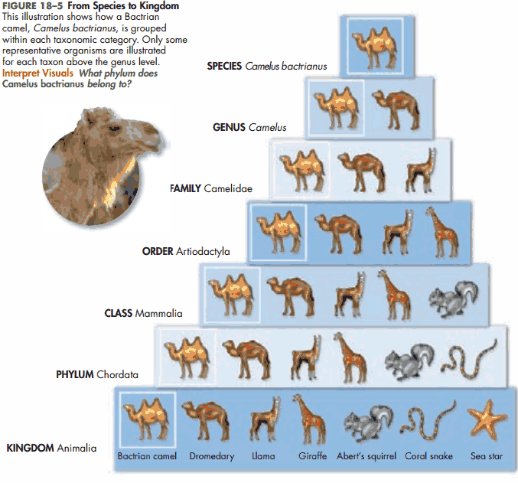

Slide 5
History of Taxonomy:
Time | Names of Kingdoms
1700s | Plantae |  |  |  |  | Animalia
Late 1800s
1950s
1990s

Slide 6
History of Taxonomy:
Time | Names of Kingdoms
1700s | Plantae |  |  |  |  | Animalia
Late 1800s | Protista |  |  | Plantae |  | Animalia
1950s
1990s

Slide 7
History of Taxonomy:
Time | Names of Kingdoms
1700s | Plantae |  |  |  |  | Animalia
Late 1800s | Protista |  |  | Plantae |  | Animalia
1950s | Monera |  | Protista | Fungi | Plantae | Animalia
1990s

Slide 8
History of Taxonomy:
Time | Names of Kingdoms
1700s | Plantae |  |  |  |  | Animalia
Late 1800s | Protista |  |  | Plantae |  | Animalia
1950s | Monera |  | Protista | Fungi | Plantae | Animalia
1990s | Eubacteria | Archae | Protista | Fungi | Plantae | Animalia

Slide 9
Modern Approach: Three Domains
Why? Based on molecular evidence of metabolism and cell structures
Three Domains: Eubacteria, Archae, Eukarya

Slide 10
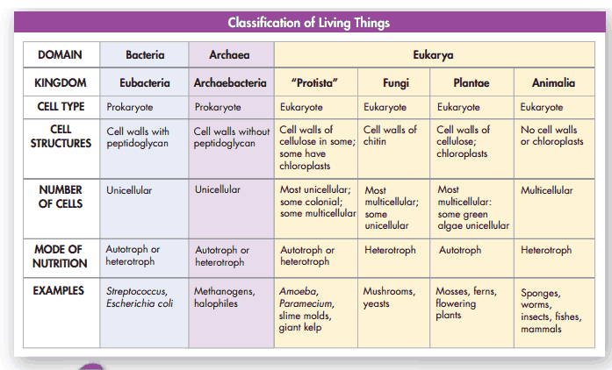

Slide 11
Eubacteria – prokaryotes, cell walls of peptidoglycan (chains of sugar and amino acids)

Slide 12
Archae – prokaryotes, cell walls made of protein scales, live in extreme environments Methanogens – swamps – make methane gas Acidophiles – acid loving bacteria Thermophiles – heat loving bacteria Halophiles – salt loving bacteria

Slide 13
Eukarya – eukaryotes – everything with a nucleus Plants, animals, fungus, Protista (Hodgepodge)

Slide 14
Modern Approach to Classification is based on molecular homologies to differentiate things that look alike, but most classification is done using taxonomic keys.
An ideal taxonomic key presents the classifier with two choices to direct the path of classification.
Because it presents two choices at each branch it is called a DICHOTOMOUS Key.

Slide 15
USING A Dichotomous Key:
Examine the thing being classified
Follow the choices presented in the key until you have identified the sample.
Keys can be a flow chart or they can be a list.

Slide 16
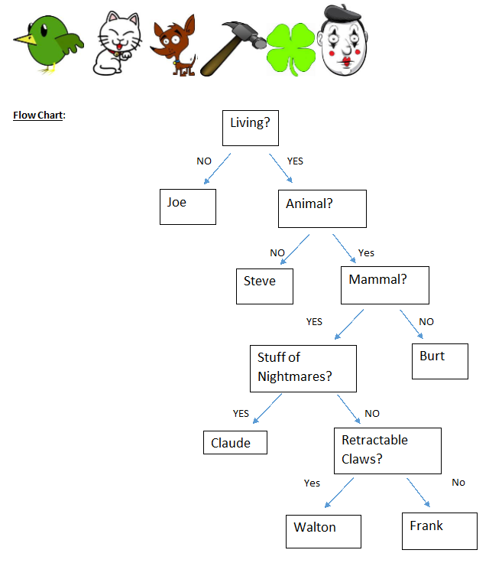
List Form:
1) Is the item living?
a. No →Joe
b. Yes → 2
2) Is the organism an animal?
a. No → Steve
b. Yes → 3
3) Is the organism a mammal?
a. No → Burt
b. Yes → 4
4) Is the organism the stuff of nightmares?
No → 5
Yes → Claude
5) Does the organism have retractable claws?
a. No → Frank
b. Yes → Walton

