Slide 1
Cladograms
Tree of Life

Slide 2
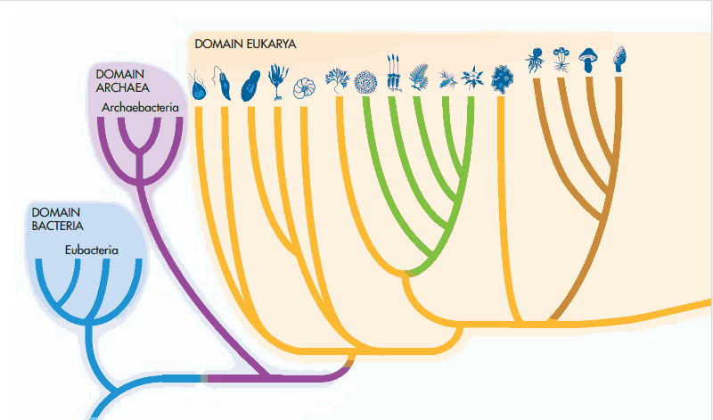
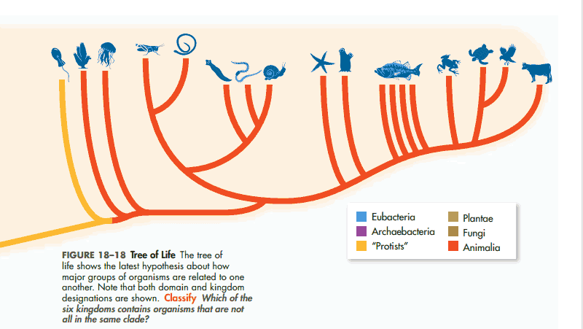

Slide 3
Cladogram
Pictorial representation of the branching patterns of evolution that are reflected in modern taxonomy
Each branch is called a clade and represents a change or changes that lead to the formation of a new species
The point where they split is called a NODE and represents that last point where they had a common ancestor
The closer two species are on a cladogram, the closer they are related to a common ancestor.

Slide 4
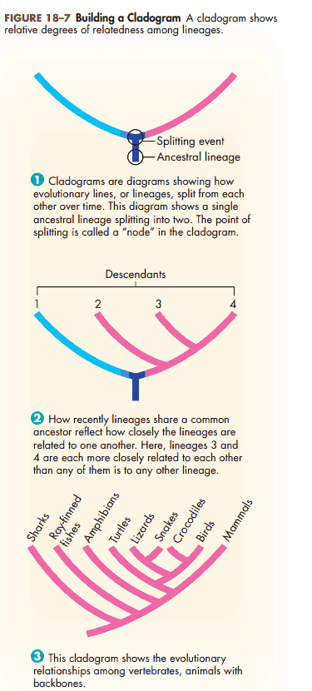
A “splitting” event is some evolutionary change that occurs and results in the divergence of a new species
New characteristics are called DERIVED CHARACTERISTICS.
Characteristics that are common among several branches are called SHARED CHARACTERISTICS

Slide 5
Interpreting a Cladogram
Which species is the outgroup?
After which animals did mammary glands develop?
What animal does not have jaws?
Which animals have lungs?
What is the derived character that separates salamanders and lizards?
What is a shared character between pigeons and lizards?
Based on the cladogram, which shared a common ancestor most recently- a mouse and a lizard, or a mouse and a perch?

Slide 6
Making a Cladogram
1. Gather information about species and make a chart. Make a “+” if they have the trait or a “–“ if they don’t.
Organism | Adults Breath With Lungs | Amniotic Egg (Protected) | Hair | Specialized Teeth for Eating Meat | Retractable Claws
Fish
Frog
Lizard
Kangaroo
Dog
Cat

Slide 7
Making a Cladogram
1. Gather information about species and make a chart. Make a “+” if they have the trait or a “–“ if they don’t.
Organism | Adults Breath With Lungs | Amniotic Egg (Protected) | Hair | Specialized Teeth for Eating Meat | Retractable Claws
Fish | - | - | - | - | -
Frog | + | - | - | - | -
Lizard | + | + | - | - | -
Kangaroo | + | + | + | - | -
Dog | + | + | + | + | -
Cat | + | + | + | + | +

Slide 8
2. Draw a Venn Diagram with the most general organism on the outside. Add concentric circles to the middle indicating the addition of a new trait.

Slide 9
Fish

Slide 10
Fish

Slide 11
Derived Trait: Lungs
Fish

Slide 12
Frog
Fish

Slide 13
Frog
Fish

Slide 14
Derived Trait: Amniotic Egg
Frog
Fish

Slide 15
Lizard
Frog
Fish

Slide 16
Lizard
Frog
Fish

Slide 17
Derived Trait: Hair
Lizard
Frog
Fish

Slide 18
Kangaroo
Lizard
Frog
Fish

Slide 19
Kangaroo
Lizard
Frog
Fish

Slide 20
Derived Trait: Specialized Teeth
Kangaroo
Lizard
Frog
Fish

Slide 21
Dog
Kangaroo
Lizard
Frog
Fish

Slide 22
Derived Trait: Retractable Claws
Dog
Kangaroo
Lizard
Frog
Fish

Slide 23
Cat
Dog
Kangaroo
Lizard
Frog
Fish

Slide 24
3. Draw a Cladogram. Wherever the Venn Diagram gets more specific, draw a NODE (branching point) and label the organism that branches at that point.

Slide 25
