Slide 1
Cellular Structure

Slide 2
Types of Cells
Prokaryotes: No Nucleus, DNA, ribosomes, cell walls, cell membrane
Examples: Bacteria → E.coli, Salmonella
Eukaryotes: True nucleus (DNA inside a nuclear membrane), ribosomes, cell walls (maybe), cell membrane, endoplasmic reticulum, Golgi bodies, Cytoskeleton, Vacuoles, Vesicles, Centrioles (maybe) , Cilia and Flagella, Mitochondria, Chloroplasts (maybe)
Examples: plants, animals, fungus, Protista

Slide 5
Cellular Organelles:
1) Cytoplasm: Everything between the nucleus and the cell membrane
Cytosol: semi-fluid material of the cytoplasm
2) Cell Membrane: Made of phospholipids and proteins
Regulates what goes in and out of the cell

Slide 7
3) Nucleus: Regulates Cell Functions
Contains:
DNA – controls cell process
Nucleolus – center of ribosome production

Slide 8
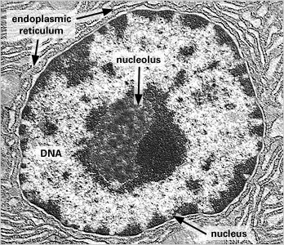

Slide 9
4) Ribosomes: synthesize proteins

Slide 10
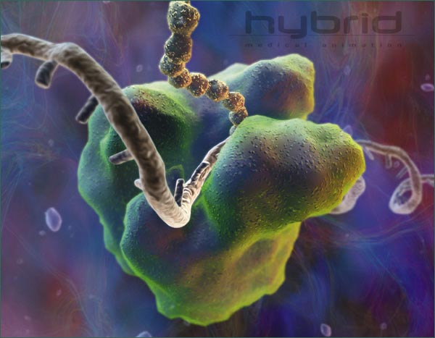

Slide 11
5) Endoplasmic Reticulum: Two Types
Rough ER: Make proteins “rough” because ribosomes are attached to the outside

Slide 12
Smooth ER: 1. Processes carbohydrates 2. Stores Calcium ions 3. Makes lipids 4. Detoxifies poisons
Smooth & Rough ER form vesicles that pinch off and travel to the Golgi bodies.

Slide 13
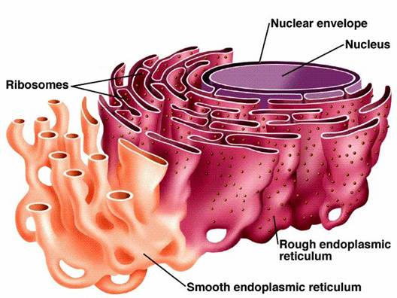

Slide 14
6) Golgi Bodies: Series of flattened membranes - sort and repackage materials from the ER for storage or secretion

Slide 16
7) Lysosome: Digests materials in the cell Digested materials go to mitochondria to generate energy

Slide 17
Lysosomes

Slide 18
ENDOMEMBRANE SYSTEM
ER → Vesicles → Golgi Bodies → Vesicles for storage or secretion
Ex: Digestive Enzymes in Small Intestine

Slide 20
8) Mitochondria: Power house of the cell
Transform food into energy Cellular Energy = ATP – Adenosine Triphosphate

Slide 21
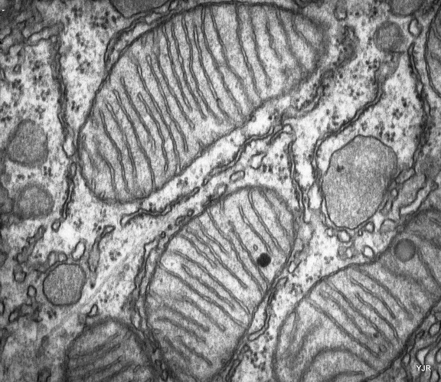

Slide 22
9) Chloroplasts: Site of Photosynthesis

Slide 24
10) Cytoskeleton: System of tubes and filaments that give shape and movement to a cell
TYPES:

Slide 25
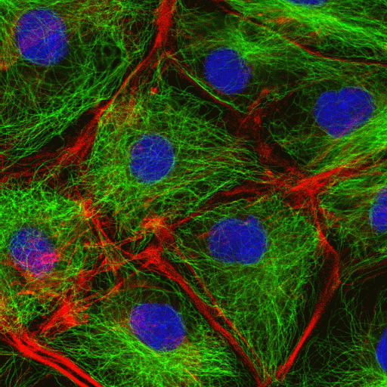
Cytoskeleton

Slide 26
1) Microtubules: tiny tubes used for moving things around inside or outside of a cell Ex: Cilia and Flagella – move cells or things across the surface of a cell

Slide 27
Cilia and Flagella

Slide 28
1) Microtubules: tiny tubes used for moving things around inside or outside of a cell Ex: Cilia and Flagella – move cells or things across the surface of a cell
Spindle Fibers – move chromosomes around in cell division
Centrioles – cluster of short tubes that form spindle fibers in animal cells

Slide 29
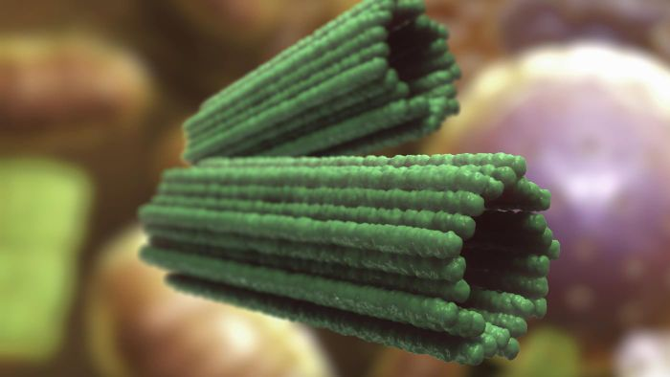
Centrioles

Slide 30
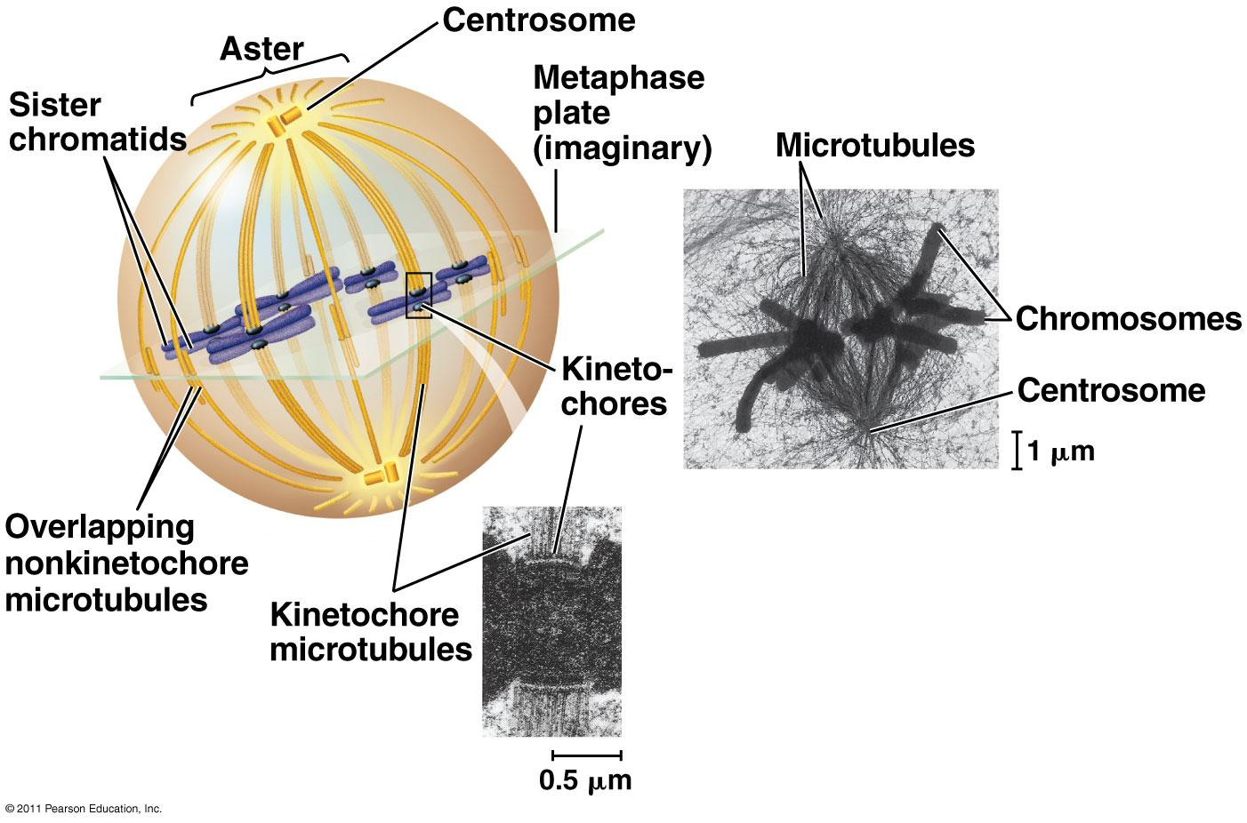
Spindle Fibers and Centrioles

Slide 31
2) Microfilament: tiny filaments used to move things in cells
Ex: Actin filaments in muscles used for contraction with Myosin proteins
3) Intermediate filaments: fibers that give the shape to a cell – the actual real skeleton in a cell

Slide 32
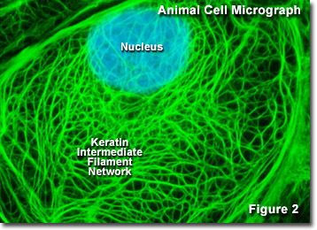

Slide 33
11) Vacuoles: Storage centers of the cell – mainly in plants
Central Vacuole of Plants – like a big water balloon
Stores water, salts, poisons

Slide 34
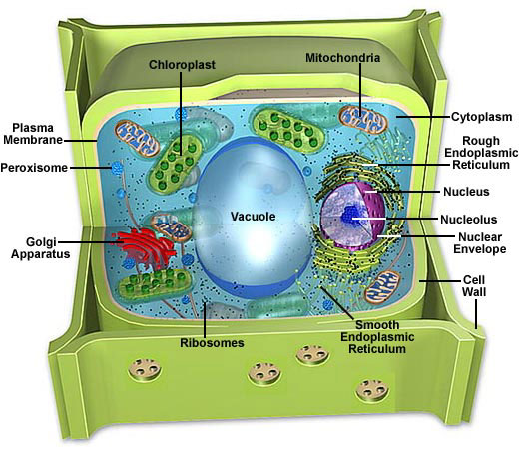

Slide 35
12) Cell Wall: Protective layer that gives support to tissues
Plants: Cellulose Fungi: Chitin Bacteria: Peptidoglycan (proteins and sugars)

Slide 36
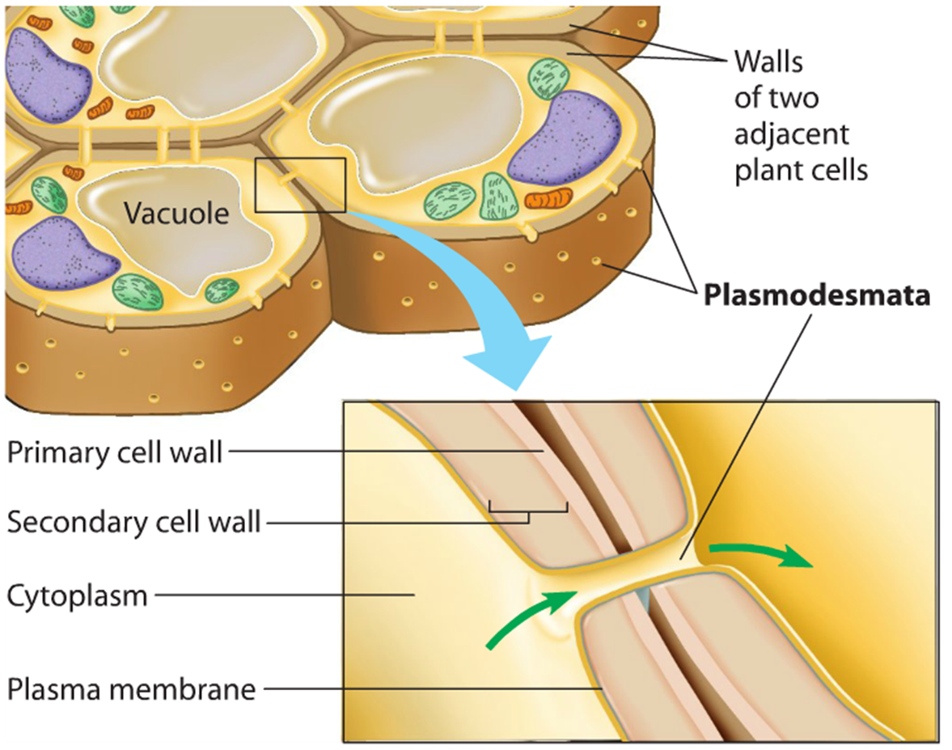

Slide 37
Organelles Specific to Animals: Centrioles
Organelles Specific to Plants: Central Vacuole, Chloroplasts
Animal Cells
Plant Cells
Inner Life of the Cell

