Slide 1
Cellular Structure and Transport Review

Slide 2
Cellular Structure
Nucleus
Mitochondria
Chloroplast
Smooth E.R.
Rough E.R.
Golgi Bodies
Centrioles
Cilia and Flagella
Vacuole
Synthesis of lipids, stores Ca2+, detoxifies
Makes proteins for secretion from cell
Control center
Makes ATP
Site of Photosyntesis
Modifies and sorts proteins for secretion
Makes spindle fibers (microtubules) for cell division – animals only
Move cells or move materials over cells
Site of storage in cells

Slide 3
Cellular Structure
Nucleus
Centrioles
Rough E.R.
Chloroplast
Smooth E.R.
Golgi Bodies
Mitochondria
Cilia and Flagella
Vacuole
Synthesis of lipids, stores Ca2+, detoxifies
Move cells or move materials over cells
Makes proteins for secretion from cell
Control center
Makes ATP
Site of Photosyntesis
Modifies and sorts proteins for secretion
Makes spindle fibers (microtubules) for cell division – animals only
Site of storage in cells

Slide 4
Cellular Structure
Microtubules
Microfilaments
Intermediate Filaments
Cell Membrane
Cytoplasm
Cytosol
Cell Wall
Lysosome
Ribosome
Medium sized filaments made of keratin – give shape to the cells
Fluid in the cell
Everything between the nucleus and the cell membrane
Made of phospholipids and proteins
Small filaments made of actin – muscle contraction
Small tubes used for moving things around inside the cell
Protective layer outside of the cell membrane
Manufactures proteins
Site of cell digestion

Slide 5
Cellular Structure
Microtubules
Microfilaments
Intermediate Filaments
Cell Membrane
Cytoplasm
Cytosol
Cell Wall
Lysosome
Ribosome
Medium sized filaments made of keratin – give shape to the cells
Fluid in the cell
Everything between the nucleus and the cell membrane
Made of phospholipids and proteins
Small filaments made of actin – muscle contraction
Small tubes used for moving things around inside the cell
Protective layer outside of the cell membrane
Manufactures proteins
Site of cell digestion

Slide 6
Plant or Animal Cell or Both
Cell Wall
Centrioles
Central Vacuole
Mitochondria
Chloroplasts
Ribosomes
Nucleus

Slide 7
Plant or Animal Cell or Both
Cell Wall
Centrioles
Central Vacuole
Mitochondria
Chloroplasts
Ribosomes
Nucleus

Slide 8
Cell Wall Components
Plant
Fungus
Bacteria
Animal
None
Cellulose
Peptidoglycan
Chitin

Slide 9
Cell Wall Components
Plant
Fungus
Bacteria
Animal
None
Cellulose
Peptidoglycan
Chitin

Slide 10
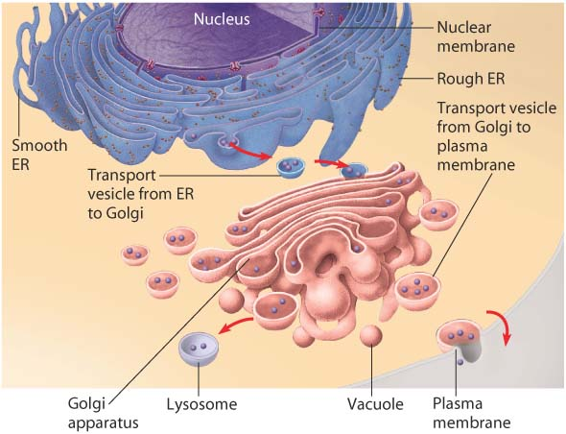
Endomembrane System - Look at the picture and how the proteins flow from one organelle to the next. On the next slide place the organelles in order from the beginning of the endomembrane system to the end (if you remember the picture, you will remember the order)

Slide 11
Endomembrane System
Golgi Bodies
Rough Endoplasmic Reticulum
Exocytosis
Vesicle to Golgi
Vesicle from Golgi
Vesicle from Rough E.R.

Slide 12
Endomembrane System
Rough Endoplasmic Reticulum
Vesicle from Rough E.R.
Vesicle to Golgi
Golgi Bodies
Vesicle from Golgi
Exocytosis

Slide 13
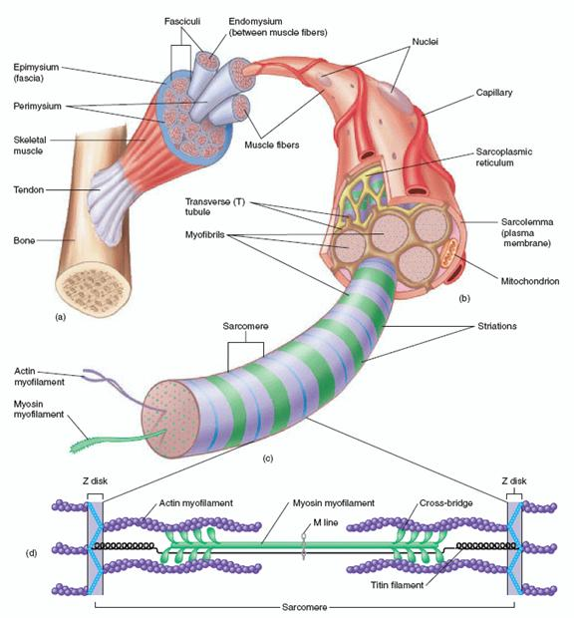
Muscle Structure - Look at the diagram – on the next page you will place the muscle structures in order from largest to smallest

Slide 14
Muscle Structure
Sarcomere
Fascicle
Muscle
Actin and Myosin
Muscle Fiber
Myofibril

Slide 15
Muscle Structure
Muscle
Fascicle
Muscle Fiber
Myofibril
Sarcomere
Actin and Myosin

Slide 16
Muscle Contraction Process: Put the following steps in order. On the test you will have to write them from Memory! PRACTICE! Correct order on next Slide.
Calcium Ions bind to the Actin Filament.
Myosin is reactivated by ATP and contraction continues until the Calcium Ions are pumped back into the Sarcoplasmic Reticulum (Relaxation)
Acetylcholein causes calcium ions to be released from the Sarcoplasmic Reticulum.
Brain sends signal to the muscle through a motor neuron.
ATP activated Myosin bind to the Actin Filament.
Myosin releases the ATP and pulls the Actin forward (Contraction).
Motor neuron releases acetylcholein.

Slide 17
Muscle Contraction Process: Put the following steps in order. On the test you will have to write them from Memory! PRACTICE!
Brain sends signal to the muscle through a motor neuron.
Motor neuron releases acetylcholein.
Acetylcholein causes calcium ions to be released from the Sarcoplasmic Reticulum.
Calcium Ions bind to the Actin Filament.
ATP activated Myosin bind to the Actin Filament.
Myosin releases the ATP and pulls the Actin forward (Contraction).
Myosin is reactivated by ATP and contraction continues until the Calcium Ions are pumped back into the Sarcoplasmic Reticulum (Relaxation)

Slide 18
Cell Transport
Passive
Active
Diffusion
Osmosis
Facilitated Diffusion
Endocytosis
Exocytosis
Phagocytosis
Pinocytosis
Transport Requiring Energy
Transport from High to Low Concentration using a protein
Moving stuff out of the cell
Transport Not Requiring Energy
Movement of large amounts of fluid into the cell
Movement of stuff out of the cell
Cell engulfing food particles
Movement of Materials from high to low concentration
Movement of water towards a solute (salt or sugar)

Slide 19
Cell Transport
Passive
Active
Diffusion
Osmosis
Facilitated Diffusion
Endocytosis
Exocytosis
Phagocytosis
Pinocytosis
Transport Requiring Energy
Transport from High to Low Concentration using a protein
Moving stuff out of the cell
Transport Not Requiring Energy
Movement of large amounts of fluid into the cell
Movement of stuff into the cell
Cell engulfing food particles
Movement of Materials from high to low concentration
Movement of water towards a solute (salt or sugar)

Slide 20
Plant Cells In Various Solutions
Solution
Hypertonic
Isotonic
Hypotonic
Result
Equal exchange of water. Plant cell becomes flaccid (wilts)
Cell gains water and becomes turgid (firm)
Cell loses water and plasmolyses.

Slide 21
Plant Cells In Various Solutions
Solution
Hypertonic
Isotonic
Hypotonic
Result
Equal exchange of water. Plant cell becomes flaccid (wilts)
Cell gains water and becomes turgid (firm)
Cell loses water and plasmolyses.

Slide 22
Animal Cells In Various Solutions
Solution
Hypotonic
Isotonic
Hypertonic
Result
Cell loses water shrivels (crenates)
Equal exchange of water. Cell is in good condition.
Cell gains water and can explode (lyse)

