Slide 1
Cellular Respiration Review

Slide 2
Overall Reaction:Reactants, products, when in the process, where in the cell
+ → +

Slide 3
Overall Reaction:Reactants, products, when in the process, where in the cell
C₆H₁₂O₆ + 6 O₂ → 6 H₂O + 6 CO₂
Glycolysis ETC ETC Krebs
Cytoplasm INNER MEMBRANE Matrix

Slide 4
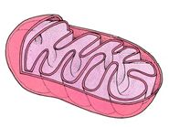
Label and Identify where the reactions occur

Slide 5
Label and Identify where the reactions occur
Outer membrane
Inner membrane (ETC)
Intermembranous space
Matrix (Krebs Cycle)
Cristae
Cytoplasm (Glycolysis)

Slide 6
Energy Yields
Glycolysis
Krebs
ETC
Total

Slide 7
Energy Yields
Glycolysis = 2 ATP – It requires 2 ATP to split the glucose and generates 4 ATP as a result, so we only count a total of 2
Krebs = 2 ATP
ETC = 34 ATP
Each NADH provides enough energy to generate 3 ATP and Each FADH₂ provides enough energy to generate 2 ATP
10 NADH = 30 and 2 FADH₂ = 4
Total = 38 ATP

Slide 8
Glycolysis
Reactants | Products

Slide 9
Glycolysis
Reactants | Products
Glucose 2 ATP 2 NAD+ | 2 Pyruvate – go to Krebs Cycle 4 ATP (Net of 2) 2 NADH – go to ETC

Slide 10
Kreb’s Cycle
Reactants | Products

Slide 11
Kreb’s Cycle
Reactants | Products
2 Pyruvate 8 NAD+ 2 FAD 2 ADP 2 Phosphates | 6 CO₂ 8 NADH 2 FADH₂ 2 ATP

Slide 12
ETC
Reactants | Products

Slide 13
ETC
Reactants | Products
10 NADH 2 FADH₂ 34 ADP + Phosphate 6 Oxygen | 10 NAD+ 2 FAD 34 ATP 6 H₂O

Slide 14
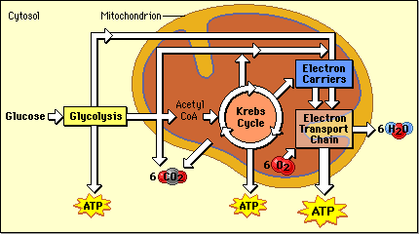

Slide 16
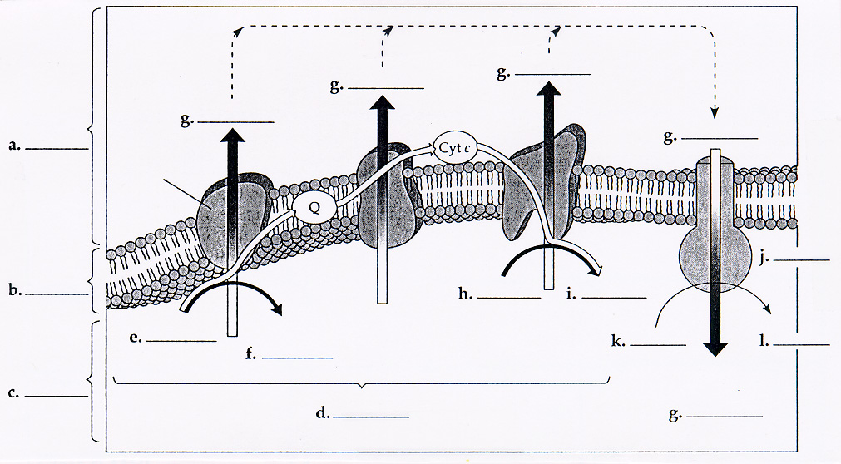

Slide 17
a. Intermembranous Space b. Inner Membrane c. Matrix d. ETC e. NADH f. NAD+ g. H+ h. O2 i. H2O j. ATP Synthase k. ADP + P l. ATP

Slide 18
Types of Fermentation
Type | Location -type of cell | Reactants | Products | When | Why | Energy Yield

Slide 19
Types of Fermentation
Type | Location -type of cell | Reactants | Products | When | Why | Energy Yield
Alcoholic | Yeast | Pyruvate + NADH | Ethanol + CO₂ + NAD⁺ | When Oxygen is not available for ETC | To Restore NAD⁺ for Glycolysis - Allows Glycolysis to generate ATP | NONE
Lactic Acid | Muscle | Pyruvate + NADH | Lactic acid + NAD⁺

Slide 20
Path of a Red Blood Cell Through The Body

Slide 21
Vena Cava → Right Atrium → Atrioventricular Valve → Right Ventrical → Semilunar Valve → Pulmonary artery → lungs → pulmonary vein → Left Atrium → Atrioventricular valve → Left Ventrical → Semilunar Valve → Aorta → Arteries → Atertioles → Capillaries → Venules → Veins → Vena Cava

Slide 22
Control of Respiration
Contraction of Diaphragm and Intercostal muscles
CO₂ concentrations increase forming carbonic acid pH of blood decreases Higher external pressure forces air into lungs Enlargement of Rib Cage
Diaphragm and intercostal muscles relax expelling air
Lower pressure inside lungs Chemosensors in medulla oblongata and carotid artery signal diaphragm to contract harder and more often to increase the flow of air into and out of lungs

Slide 23
CO₂ concentrations increase forming carbonic acid pH of blood decreases Chemosensors in medulla oblongata and carotid artery signal diaphragm to contract harder and more often to increase the flow of air into and out of lungs
Contraction of Diaphragm and Intercostal muscles
Enlargement of Rib Cage Lower pressure inside lungs Higher external pressure forces air into lungs Diaphragm and intercostal muscles relax expelling air

Slide 25
Pulmonary
Artery
Aorta
Vena Cava
Pulmonary Vein
Semilunar Valve
R. Atrium
Semilunar Valve
L. Atrium
R. Ventricle
L. Ventricle
Atrioventricular Valve
Atrioventricular Valve

Slide 26
Bad Animation but informative
Good Animation
Electron Transport Chain
The Heart

