Slide 1
Cellular Respiration

Slide 2
Respiration = to breathe Breathing at the cellular level
Purpose: to generate ATP for cellular work by transferring the energy trapped in food molecules

Slide 3
HOW: Food molecules are broken down and the energy released as energyized electrons is captured and transferred to make ATP

Slide 4
Uses Hydrogen Acceptors:
NAD+ – nicotinamide adenine dinucleotide
FAD – flavin adenine dinucleotide

Slide 5
Types of Cellular Respiration:
1)Aerobic – uses oxygen and requires mitochondria – in Eukaryotic cells
2)Anaerobic – does not use oxygen and occurs in the cytoplasm – in Prokaryotes and Eukaryotes

Slide 6
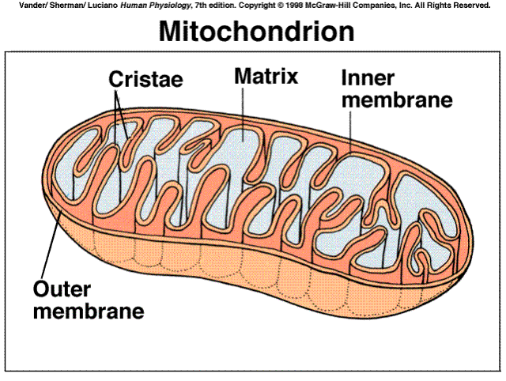
Structure of the Mitochondria

Slide 7
Cellular Respiration Equation:
C₆H₁₂O₆ + 6 O₂ → 6 H₂O + 6 CO₂

Slide 8
Steps of Cellular Respiration:
1. Glycolysis: Glucose is split in half – same as anaerobic respiration
- occurs in cytoplasm

Slide 9
2. Krebs Cycle:
- products of glycolysis are broken down releasing CO₂ and transferring electrons and hydrogens to NAD+ and FAD
- occurs in matrix of mitochondria

Slide 10
3. Oxidative Phosphorylation (Electron Transport Chain): - energized electrons are used to make a hydrogen gradient to make ATP
- occurs in the inner membrane and intermembranous space of the mitochondria

Slide 11
Glycolysis: The Details
Two Parts: 1) Energy Investment Stage:
2 ATP molecules are used to energize a glucose molecule
This makes it unstable and it breaks apart into two, 3 Carbon molecules.

Slide 12
2) Energy Payoff Stage: The phosphates from the 3 carbon molecules are used to make 4 ATP.
Two NAD+ gain electrons and hydrogens to make 2 NADH.
The end products are 2, 3 Carbon molecules called Pyruvate.

Slide 13
Reactants | Products
Glucose 2 ATP 2 NAD+ | 2 Pyruvate – go to Krebs Cycle 4 ATP (Net of 2) 2 NADH – go to ETC

Slide 14
Krebs Cycle (Citric Acid Cycle)
Occurs in the Matrix of the Mitochondria
Everything in the Krebs Cycle happens twice because there are two pyruvates from glycolysis.

Slide 15
1) Pyruvate enters the mitochondria and immediately loses a CO₂ and makes a NADH forming acetic acid which binds to an enzyme called Co-enzyme A.

Slide 16
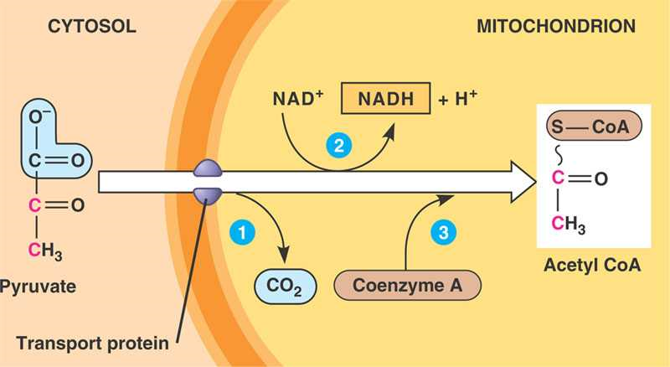

Slide 17
2) Acetic CoA bonds with a 4 carbon compound called oxaloacetate to make Citric Acid (Krebs is also called the Citric Acid Cycle)

Slide 18
3) Citric undergoes many changes and releases 2 CO₂ molecules, 1 ATP, and 3 NADHs and 1 FADH₂.
4) At the end the 4 carbon compound, oxaloacetate, is remade = cycle.

Slide 19
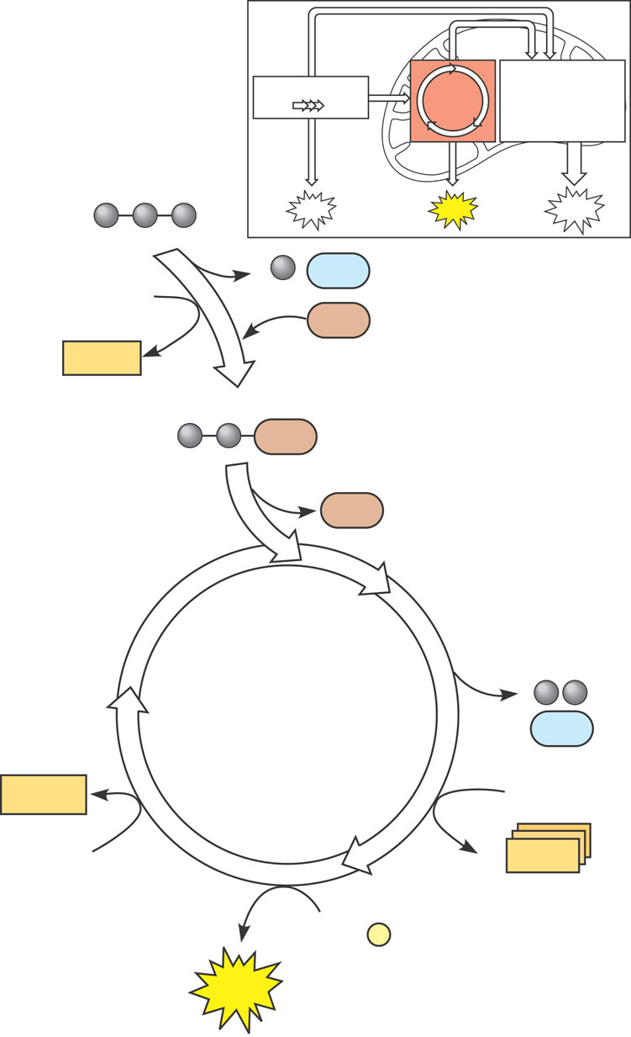
Pyruvate (from glycolysis, 2 molecules per glucose)
Glycolysis
Citric acid cycle
Oxidative phosphorylation
ATP
ATP
ATP
CO₂
CoA
NADH
+ 3 H⁺
Acetyle CoA
CoA
CoA
Citric acid cycle
2 CO₂
FADH₂
3 NAD⁺
FAD
3 NADH
+ 3 H⁺
ADP + P _{i}
ATP

Slide 20
Reactants | Products
2 Pyruvate 8 NAD+ 2 FAD 2 ADP 2 Phosphates | 6 CO₂ 8 NADH 2 FADH₂ 2 ATP

Slide 21
Electron Transport Chain
Where: Inner membrane, Matrix, and Intermembranous Space

Slide 22
What Happens: 1) Energized electrons from NADH and FADH2 enter the ETC and pump Hydrogen ions into the intermembranous space.

Slide 23
2) Hydrogen ions pass through ATP Synthase to make ATP.
Electrons pass from the ETC to Oxygen which then combines with Hydrogen ions to make water.

Slide 24
The whole process is called Chemiosmotic Phosphorylation.
Chemiosmosis = osmosis of chemicals Phosphorylation = adding phosphates

Slide 25
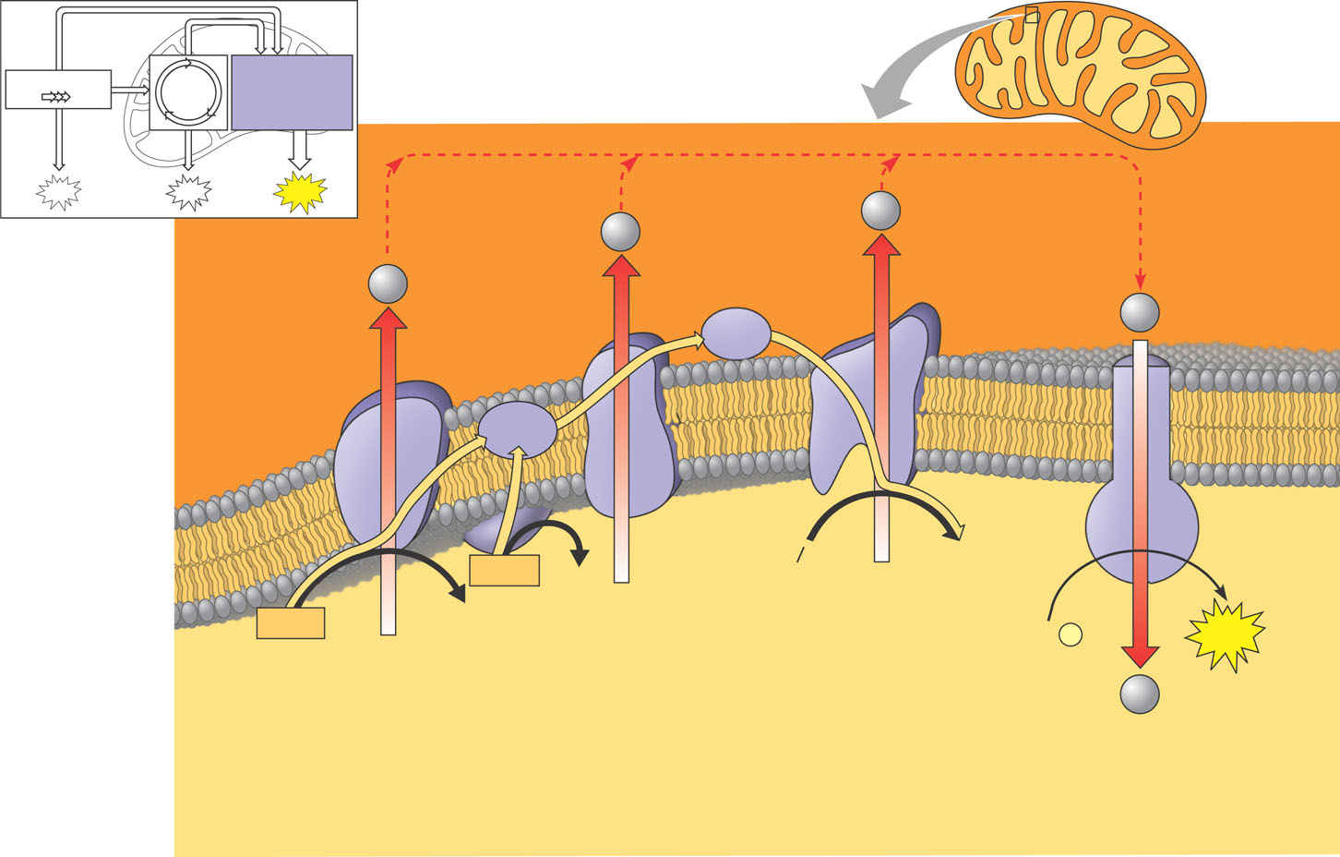
Inner
Mitochondrial
membrane
Glycolysis
Oxidative
phosphorylation.
electron transport
and chemiosmosis
ATP
ATP
ATP
H⁺
H⁺
H⁺
Cyt c
H⁺
Intermembrane
space
Protein complex
of electron
carners
Q
IV
I
III
Inner
mitochondrial
membrane
ATP
synthase
II
FADH₂
H₂O
FAD⁺
2 H⁺ + ¹/₂ O₂
NADH
NAD⁺
ADP +
P _{i}
ATP
(Carrying electrons
from, food)
H⁺
Mitochondrial
matrix
Electron transport chain
Electron transport and pumping of protons (H⁺),
which create an H⁺ gradient across the membrane
Chemiosmosis
ATP synthesis powered by the flow
Of H⁺ back across the membrane
Oxidative phosphorylation

Slide 26
ATP Yields
Each NADH = 3 ATP
Each FADH2 = 2 ATP
Totals: 10 NADH x 3 = 30 ATP 2 FADH2 x2 = 4 ATP
Total = 34 ATP

Slide 27
Reactants | Products
10 NADH 2 FADH₂ ADP + Phosphate Oxygen Hydrogen Ions | 10 NAD+ 2 FAD 34 ATP H₂O

Slide 28
Total Energy Yield for 1 Glucose:
Glycolysis = 2 ATP
Krebs Cycle = 2 ATP
ETC = 34 ATP
Total = 38 ATP

Slide 29
Anaerobic Respiration
Prokaryotes just use glycolysis. Each glucose yields 2 ATP.
Eukaryotes use Aerobic Respiration unless the cells become starved of oxygen.
Lack of oxygen shifts metabolism from aerobic respiration to fermentation (anaerobic).
This is done to keep the cell alive until oxygen is restored.

Slide 30
Types of Fermentation
Alcoholic Fermentation: Yeast cells
Cells take pyruvate and remove a CO₂ molecule making acetic anhydride.
NADH is used to convert the acetic acid into ethyl alcohol and NAD+.
The NAD+ can be used in glycolysis to make ATP keeping the cell alive.

Slide 31
Reactants | Products
Pyruvate NADH | Ethanol NAD+ CO₂

Slide 32
Lactic Acid Fermentation: Muscle Cells
Pyruvate uses NADH to make lactic acid and NAD+
NAD+ is used in glycolysis to make ATP.
Lactic acid causes the muscles to burn, slowing you down, allowing more oxygen to get to the cells.

Slide 33
Reactants | Products
Pyruvate NADH | Lactic Acid NAD+

