Slide 1
Cellular Division
Mitosis and Meiosis

Slide 2
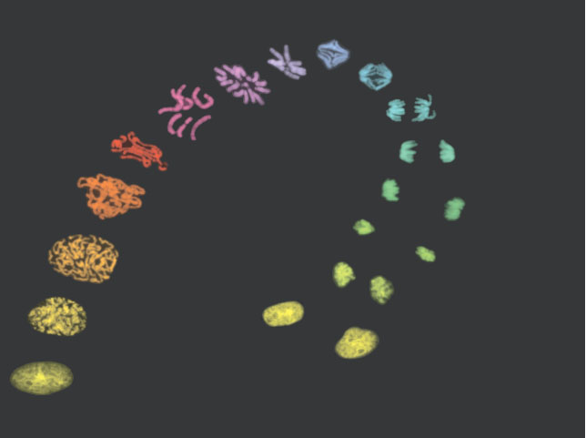

Slide 3
Cell Division: basis for the continuity of life
Functions:
1. Reproduction - making of new individuals (asexual)
- generation of gametes (sexual)
2. Growth - more cells - bigger organism
3. Repair - new cells to fix old or damaged

Slide 4
Focus of Cellular Division is KARYOKINESIS (division of the nuclear material)
followed by CYTOKINESIS (division of the cytoplasm - cytosol and organelles)

Slide 5
Mitosis:
- each new cell (daughter cell) receives and identical set of genetic material from the old cell (parent cell) -forms SOMATIC CELLS (body cells)
Meiosis:
- daughter cells receive half the amount of genetic material from the parent cell - forms GAMETES (sex cells)

Slide 6
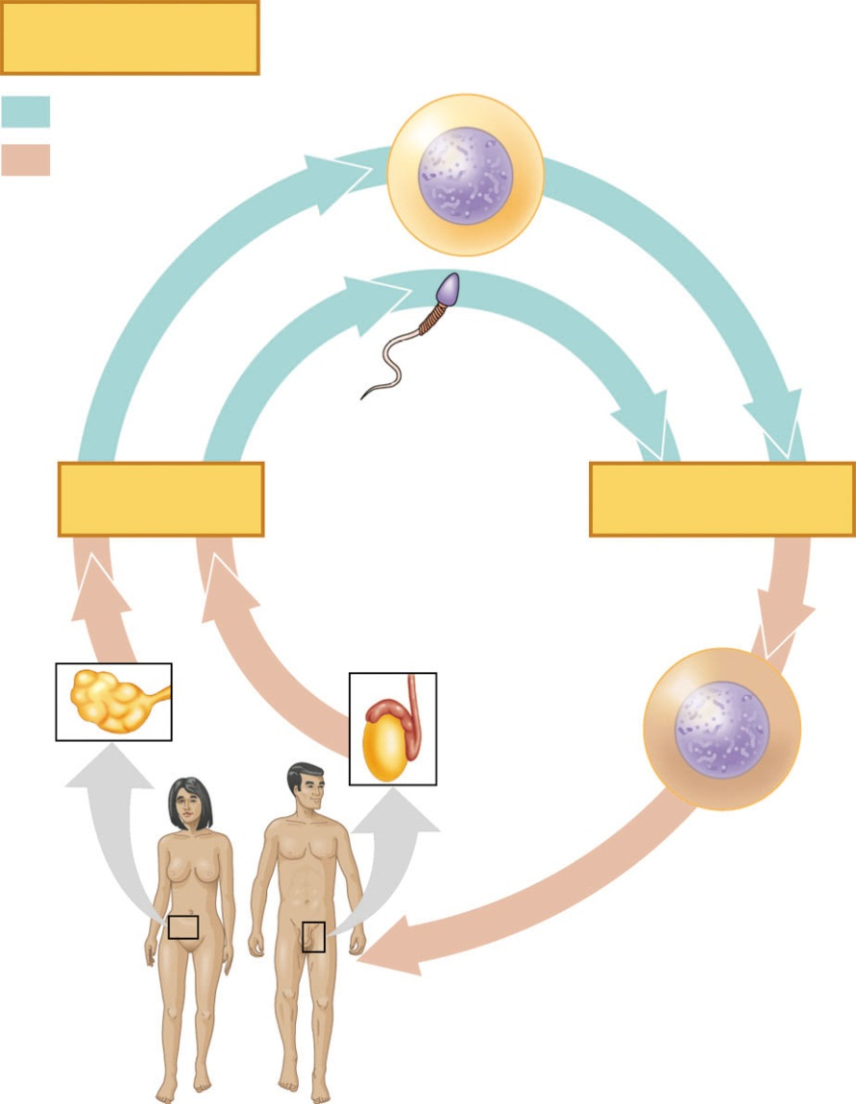
Key
Haploid gametes (n = 23)
Haploid (n)
Ovum (n)
Diploid (2n)
Sperm
Cell (n)
MEIOSIS
FERTILIZATION
Ovary
Testis
Diploid
zygote
(2n = 46)
Mitosis and
development
Multicellular diploid
adults (2n = 46)

Slide 7
Division of the nuclear material involves the separation of condensed DNA chromatin -
CHROMOSOMES: “colored bodies” – condensed chromatin
- each species has a particular number
SOMATIC Cells: 2 sets of each chromosome (2N) – diploid
GAMETES: 1 set of each chromosome (N) - haploid

Slide 8
Structure of Chromosomes
Chromosome contains two sets of the same genetic material
- each set → set of sister chromatids
- linked by centromere - narrow waste - helps identify different chromosomes
Karyotype

Slide 9
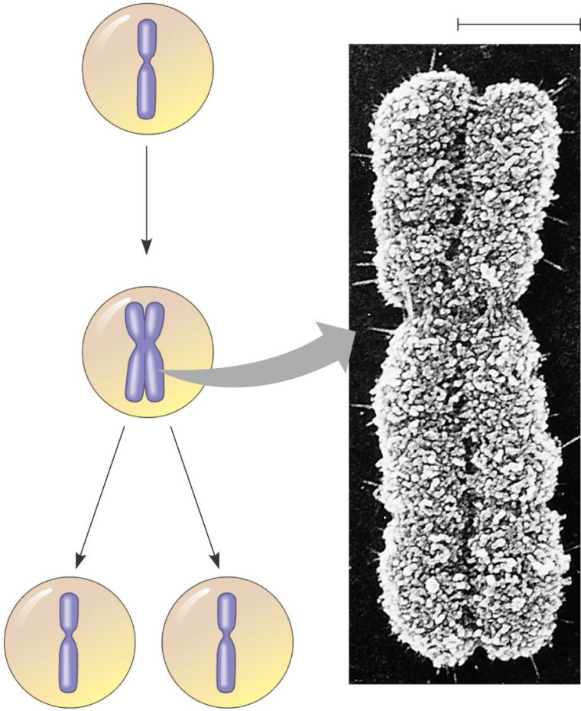
0.5 µm
A eukaryotic cell has multiple chromosomes, one of which is represented here. Before duplication, each chromosome has a single DNA molecule.
Chromosome duplication (including DNA synthesis)
Once duplicated, a chromosome consists of two sister chromatids connected at the centromere. Each chromatid contains a copy of the DNA molecule.
Centromere
Sister chromatids
Separation of sister chromatids
Mechanical processes separate the sister chromatids into two chromosomes and distribute them to two daughter cells.
Centromeres
Sister chromatids

Slide 10
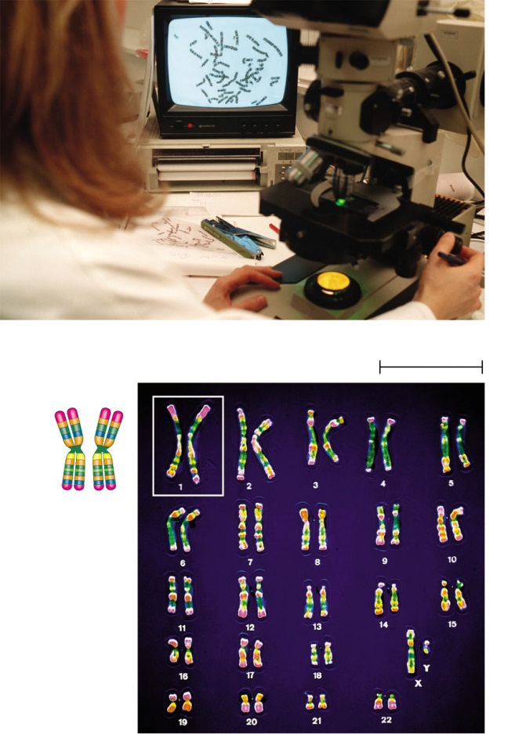
Karyotype
Pair of homologous
chromosomes
5 µm
Centromere
Sister
chromatids
Figure 13.3

Slide 11
MITOTIC CELL CYCLE
separtion of chromosomes into identical daughter cells
Two phases:
Interphase: 90% of cell cycle
Mitotic Phase: division of nuclear material and cytokinesis

Slide 12
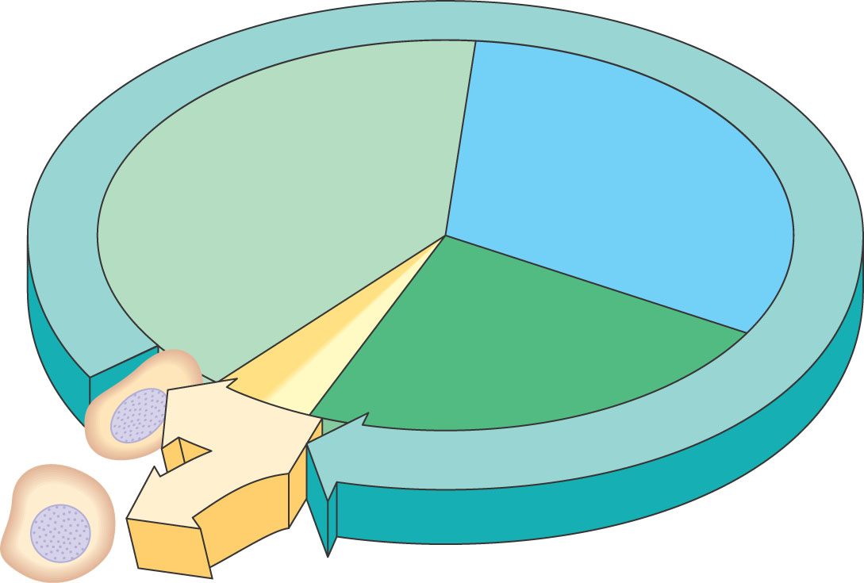
INTERPHASE
S (DNA synthesis)
G₁
Cytokinesis Mitosis
G₂
MITOTIC (M) PHASE

Slide 13
INTERPHASE:
made up of three distinct sub-phases
1) G1 - Gap 1
2) S - Synthesis
3) G2 - Gap 2

Slide 14
Gap 1: growth of cell after cytokinesis: Synthesis: DNA is copied (DNA replication) forming sister chromatid
Gap 2: growth and development: preparation for mitosis

Slide 15
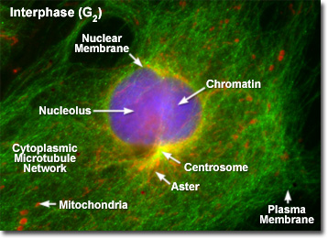

Slide 17
Mitosis (Karyokinesis)
1) Prophase:
chromatin condenses forming chromosomes
nuclear envelope breaks down
nucleolus dissolves
centrioles (in animals) begin to migrate toward the ends of cells
Microtubules (spindle fibers) begin to form and attach to the centromere

Slide 18
2) Metaphase:
"meta" means "middle"
- chromosomes are lined up in the middle of the cell equidistant from the centroile pairs (centrosome)
- metaphase plate – central line in the cell where the chromosomes move due to interactions of the microtubules

Slide 19
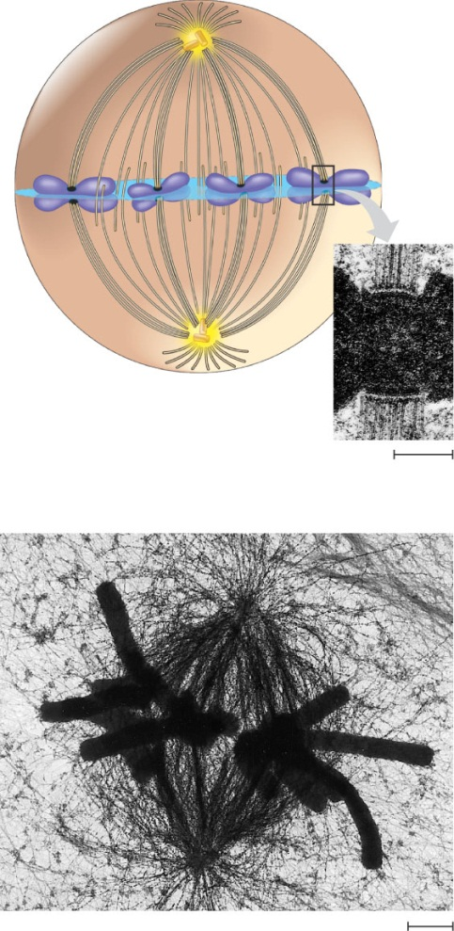
Aster
Centrosome
Sister chromatids
Metaphase Plate
Kinetochores
Overlapping nonkinetochore microtubules
Kinetochores microtubules
Microtubules
0.5 µm
Chromosomes
Figure 12.7
Centrosome
1 µm

Slide 20
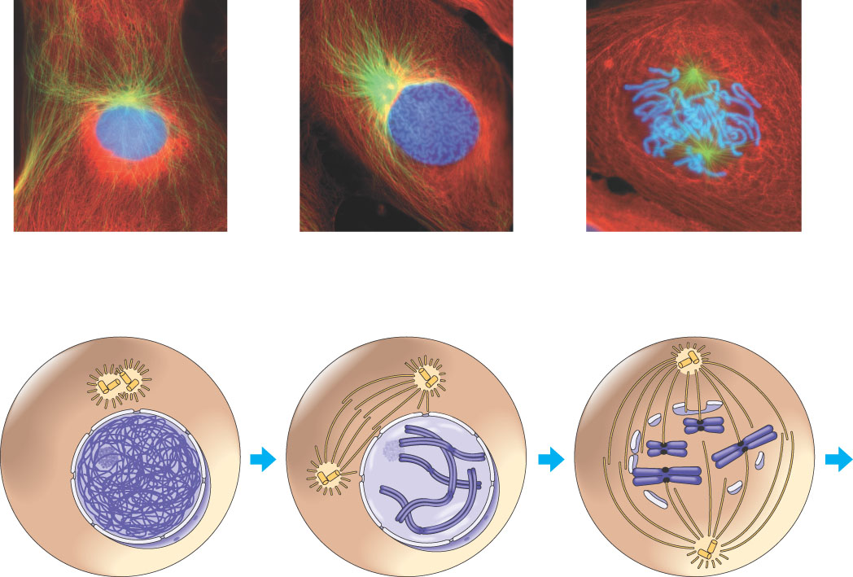
G₂ OF INTERPHASE
PROPHASE
PROMETAPHASE
Centrosomes (with centriole pairs)
Early mitotic spindle
Aster
Fragments of nuclear envelope
Kinetochore
Chromatin (duplicated)
Centromere
Nonkinetochore microtubules
Nucleolus
Nuclear envelope
Plasma membrane
Chromosome, consisting of two sister chromatids
Kinetochore microtubule

Slide 21
3) Anaphase:
separation of sister chromatids via the shortening of microtubules
each chromatid now considered a separate chromosome (each has the same genetic information as the other chromatid)
Cells are genetically identical

Slide 22
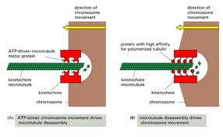

Slide 23
EXPERIMENT
1 The microtubules of a cell in early anaphase were labeled with a fluorescent dye that glows in the microscope (yellow).
Kinetochore
Spindle pole
Figure 12.8

Slide 24
4) Telophase:
daughter nuclei begin to reform
each cell has identical sets of genetic information
nuclear envelope begins to reform
chromosomes unwind
nucleoli reform
beginning of cytokinesis

Slide 25
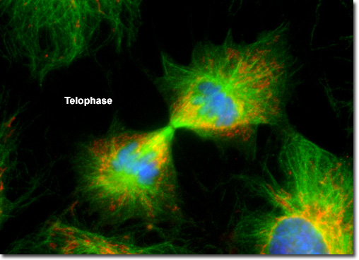

Slide 26
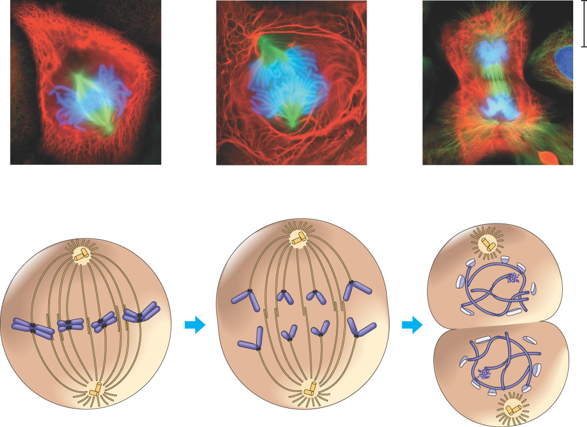
METAPHASE
ANAPHASE
TELOPHASE AND CYTOKINESIS
Metaphase plate
Cleavage furrow
Nucleolus forming
Nuclear envelope forming
Spindle
Centrosome at one spindle pole
Daughter chromosomes

Slide 27
MAKING SENSE OF CHROMOSOME NUMBERS
Ex: 10 Chromosomes
just divided daughter cell - 10 chromosomes
synthesis of DNA
10 Chromosomes of duplicated DNA in sister chromatids
separate into 2 sets of 10

Slide 28
CYTOKINESIS
division of the cytoplasm
Animal cells: use of cleavage furrow
contractile ring of actin filaments and myosin
contract and pull the the cell membrane in - like a draw string
Ex: clay and string

Slide 29
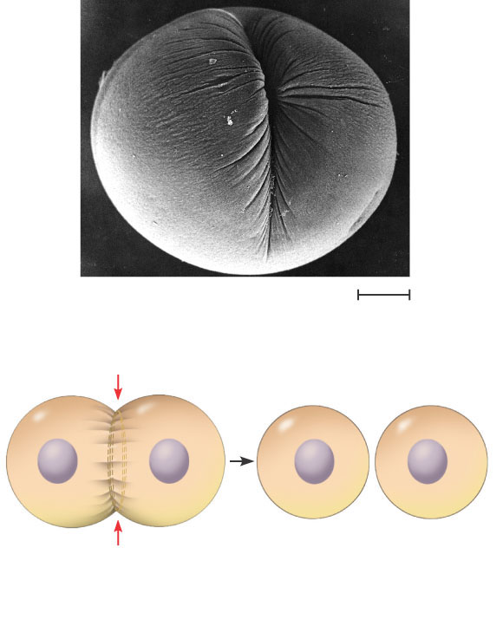
Cleavage furrow
100 µm
Contractile ring of microfilaments
Daughter cells
Figure 12.9 A
(a) Cleavage of an animal cell (SEM)

Slide 30
Plant Cells: use of cell plate
vesicles from the golgi fuse at the metaphase plate
build new cell wall
Ex: dividing a room with a wall

Slide 31
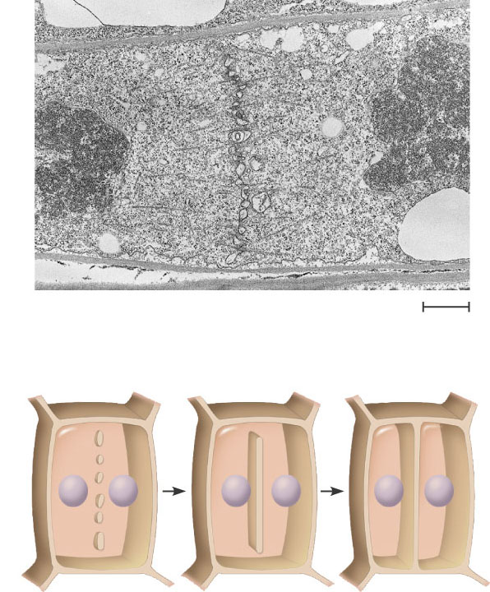
Vesicles forming cell plate
Wall of patent cell
1 µm
Cell plate
New cell wall
Daughter cells
Figure 12.9 B
(b) Cell plate formation in a plant cell (SEM)

Slide 32
Nucleus
Chromatine condensing
Chromosome
Nucleolus
Prophase. The chromatin is condensing. The nucleolus is beginning to disappear. Although not yet visible in the micrograph, the mitotic spindle is staring to from.
2
Prometaphase. We now see discrete chromosomes; each consists of two identical sister chromatids. Later in prometaphase, the nuclear envelop will fragment.
Metaphase. The spindle is complete, and the chromosomes, attached to microtubules at their kinetochores, are all at the metaphase plate.
Anaphase. The chromatids of each chromosome have separated, and the daughter chromosomes are moving to the ends of cell as their kinetochore microtubles shorten.
Telophase. Daughter nuclei are forming. Meanwhile, cytokinesis has started: The cell plate, which will divided the cytoplasm in two, is growing toward the perimeter of the parent cell.
1
3
4
5
Figure 12.10

Slide 33
Mitosis Video
Mitosis Video
Mitosis Video

Slide 34
MEIOSIS
Meiotic Cell Cycle: reduction of chromosomes
Major Processes
Replication of Chromosomes
Pairing of Homologous Chromosomes (Synapsis)
Crossing Over
Separation of Homologous Chromosomes
Separation of Sister Chromatids

Slide 35
2 Phases of Meiosis: Meiosis I and Meiosis II
Meiosis I: Separation of Homologous Chromosomes
each chromosome has one sister chromosome
Chomosomes that carry the same basic genetic content
Humans: 46 chromosomes: 22 homologous pairs and the Sex Chromosomes – X and Y
Interphase I: Like mitosis: Replication of DNA - forms sister chromatids

Slide 36
Prophase I:
Like mitosis except
1. Longer: 90% of meiosis
2. Synapsis: Pairing of homologous chromosomes
- each made of two sister chromatids
- makes tetrad - four chromatids)
non-sister chromatids of homologous pairs cross one another
leads to crossing over - chromatids break and exchange genes

Slide 37
Metaphase I:
Like mitosis except homologous pairs line up along metaphase plate and microtubules only attach to one side of centromere
Anaphase I:
Separation of homologous pairs: sister chromatids remain attached
Telophase I and Cytokinesis:
may or may not reform nucleus and nucleolus
cell divides and forms haploid cells (only a half set)

Slide 38
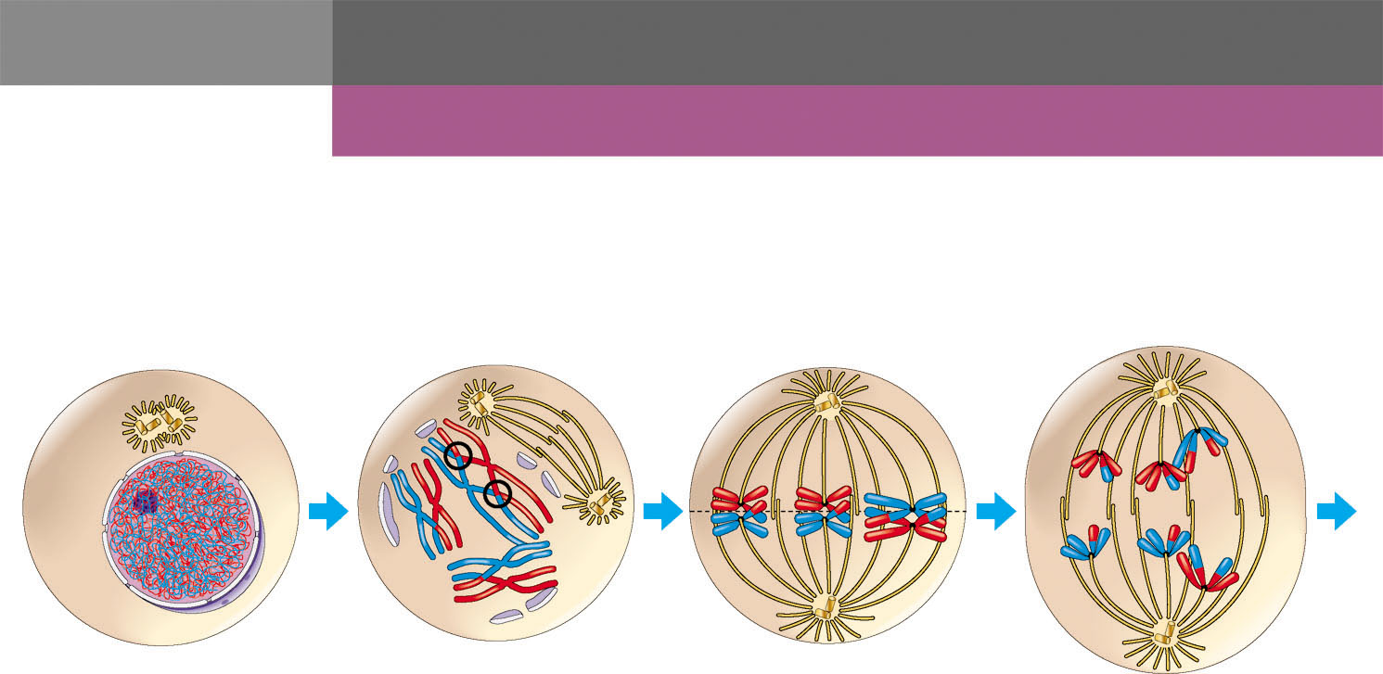
INTERPHASE
MEIOSIS I: Separates homologous chromosomes
PROPHASE I
METAPHASE I
ANAPHASE I
Centrosomes
(with centriole pairs)
Centromere
(with kinetochore)
Sister chromatids
remain attached
Sister
chromatids
Chiasmata
Metaphase
plate
Spindle
Nuclear
envelope
Microtubule
attached to
kinetochore
Homologous
chromosomes
separate
Chromatin
Tetrad
Chromosomes duplicate
Tertads line up
Pairs of homologous
chromosomes split up
Homologous chromosomes
(red and blue) pair and exchange
segments; 2n = 6 in this example

Slide 39
Prophase II:
spindle reforms
Metaphase II:
line up along metaphase plate just like mitosis
Anaphase II:
separation of sister chromatids
Telophase II/Cytokinesis:
nuclei form and cells divide

Slide 40
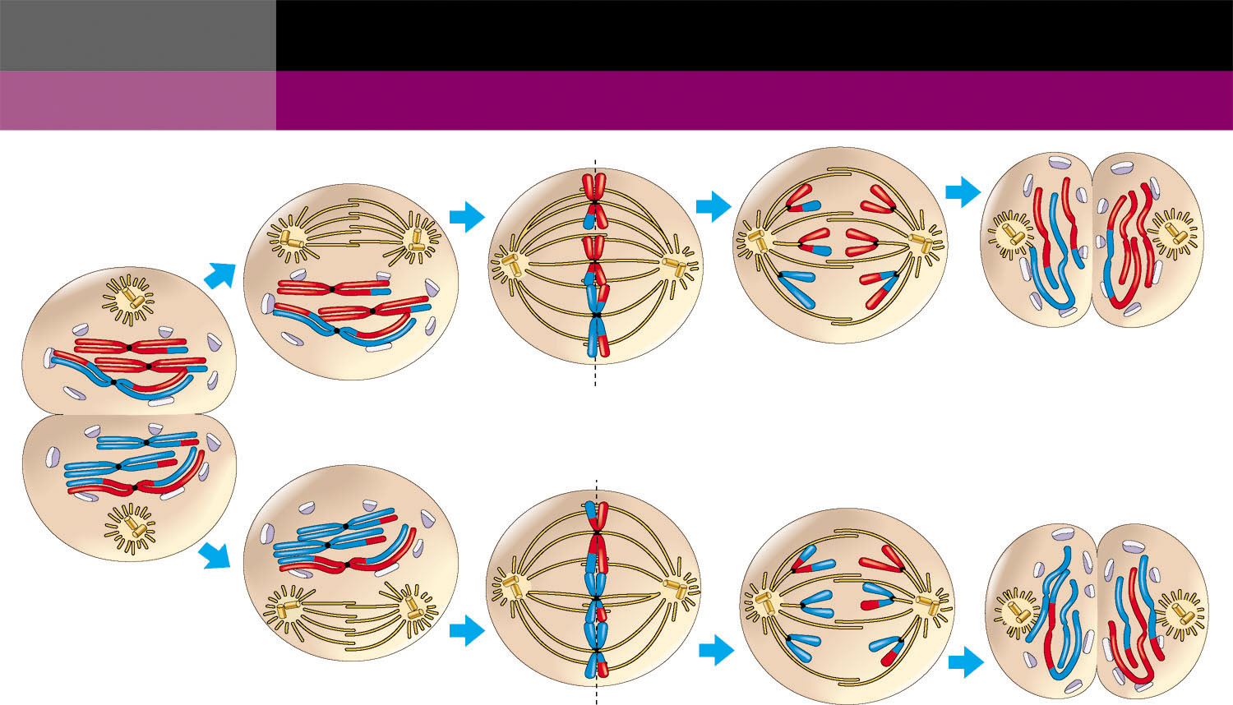
MEIOSIS II: Separates sister chromatids
TELOPHASE I AND
CYTOKINESIS
PROPHASE II
METAPHASE II
ANAPHASE II
TELOPHASE II AND
CYTOKINESIS
Cleavage
furrow
Haploid daughter cells
forming
Sister chromatids
separate
Two haploid cells
form; chromosomes
are still double
During another round of cell division, the sister chromatids finally separate;
four haploid daughter cells result, containing single chromosomes

Slide 41
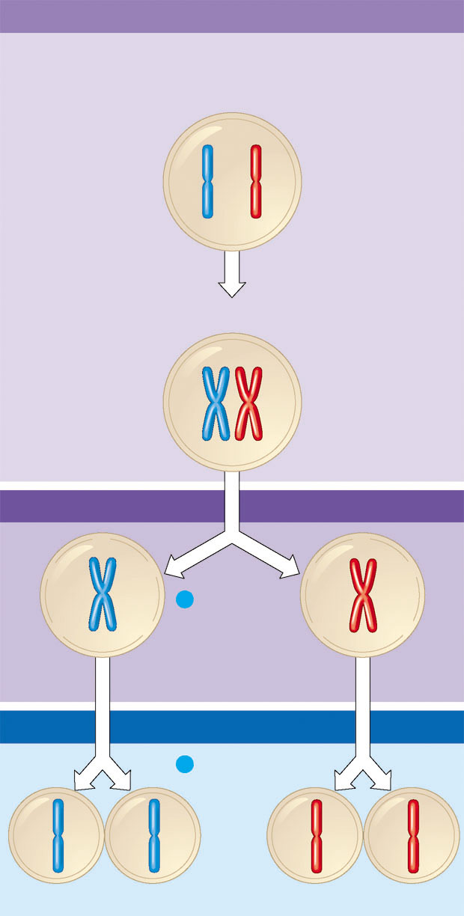
Interphase
Homologous pair
of chromosomes
in diploid parent cell
Chromosomes
replicate
Homologous pair of replicated chromosomes
Sister
chromatids
Diploid cell with
replicated
chromosomes
Meiosis I
1
Homologous
chromosomes
separate
Haploid cells with
replicated chromosomes
Meiosis II
2
Sister chromatids
separate
Haploid cells with unreplicated chromosomes

Slide 42
Meiosis Video

Slide 43
COMPARISON OF MITOSIS AND MEIOSIS
Mitosis: one phase: 2 daughter cells: Diploid
Meiosis: two phases: 4 daughter cells: Haploid

Slide 44
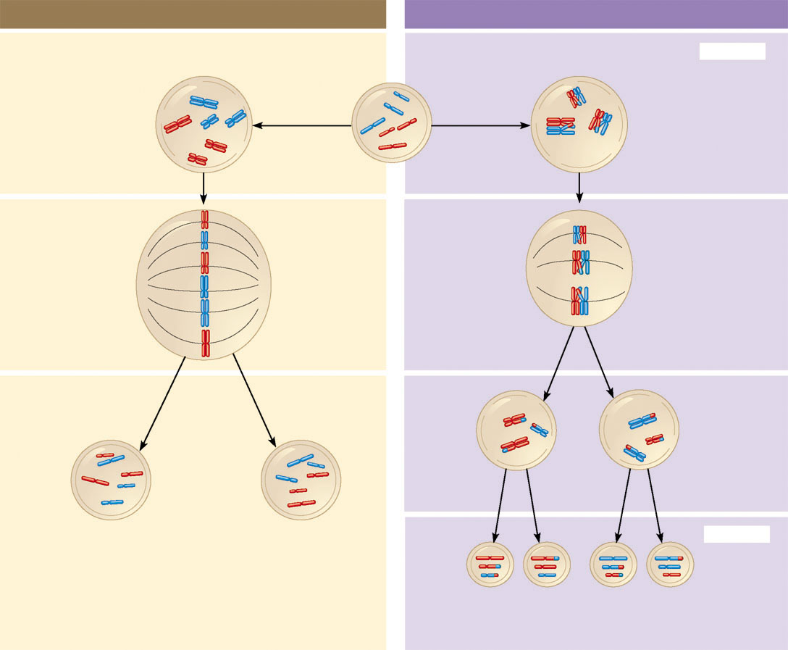
MITOSIS
MEIOSIS
Parent cell
(before chromosome replication)
Chiasma (site of
crossing over)
MEIOSIS I
Prophase
Prophase I
Chromosome
replication
Chromosome
replication
Duplicated chromosome
(two sister chromatids)
Tetrad formed by
synapsis of homologous
chromosomes
2n = 6
Chromosomes
positioned at the
metaphase plate
Tetrads
positioned at the
metaphase plate
Metaphase I
Metaphase
Anaphase
Telophase
Sister chromatids
separate during
anaphase
Homologues
separate
during
anaphase I;
sister
chromatids
remain together
Anaphase I
Telophase I
Haploid
n = 3
Daughter
cells of
meiosis I
2n
Daughter cells
of mitosis
2n
MEIOSIS II
n
n
n
n
Daughter cells of meiosis II
Sister chromatids separate during anaphase II

Slide 45
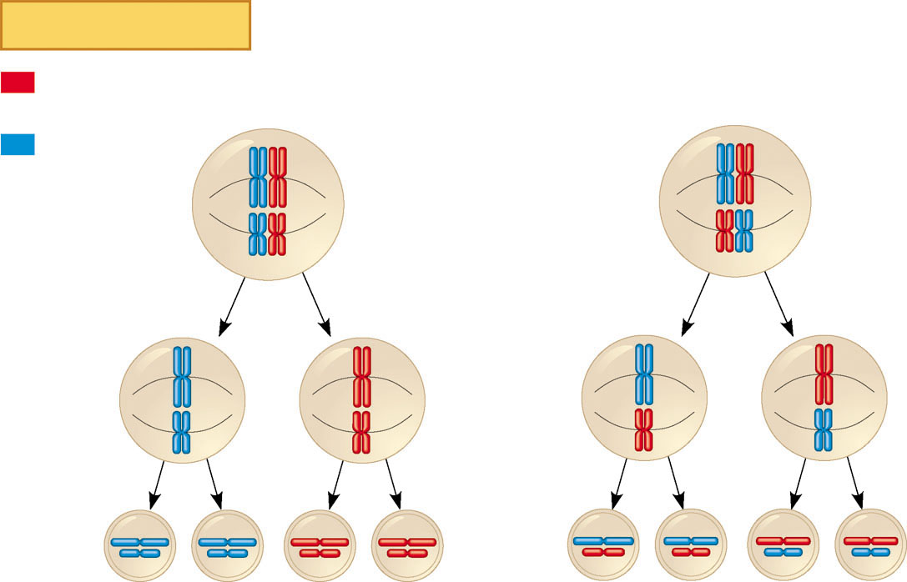
Key
Maternal set of
chromosomes
Paternal set of
chromosomes
Possibility 1
Possibility 2
Two equally probable
arrangements of
chromosomes at
metaphase I
Metaphase II
Daughter
cells
Combination 1
Combination 2
Combination 3
Combination 4

Slide 46
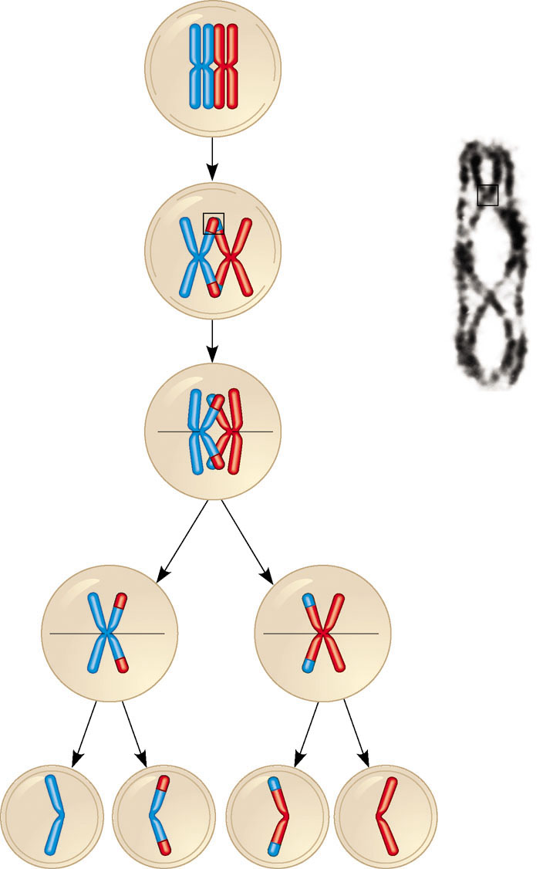
Prophase I
of meiosis
Nonsister
chromatids
Tetrad
Chiasma,
site of
crossing
over
Metaphase I
Metaphase II
Daughter
cells
Recombinant
chromosomes

