Slide 1
Cell Transport

Slide 2
Role of Cell Membrane: Regulate what goes in and out of cell
Cell Membrane Composition:
Fluid Mosaic of phospholipids and proteins
Combination of Different Properties
Moves around

Slide 3
Phospholipids: Phospholipids are amphipathic – two natures
Hydrophyllic Heads Hydrophobic Tails
“Hydro” = Water “Phyllic” = Loves “Phobic” = Fears
Hydrophyllic Head
Hydrophobic Tails

Slide 4
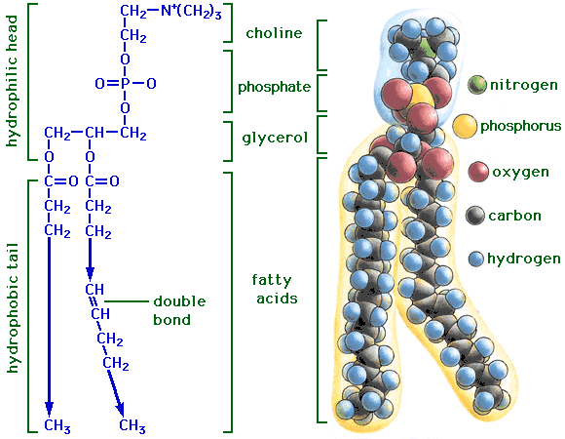
Molecular Structure of a Phospholipid

Slide 5
Causes them to form a bilayer – two layers
Heads of both layers on the outside of the cells and the inside of the cytoplasm
Tails face interior.
Water outside of cell
Water in Cytoplasm

Slide 6
Tails regulate what can enter the cell

Slide 7
Things that move across the cell membrane easily
1. Oxygen
2. Carbon Dioxide
3. Water (assisted by aquaporins)
Protein channels that transport water

Slide 8
Things that move with Difficulty
1. Ions (charged atoms)
2. Large molecules like glucose

Slide 9
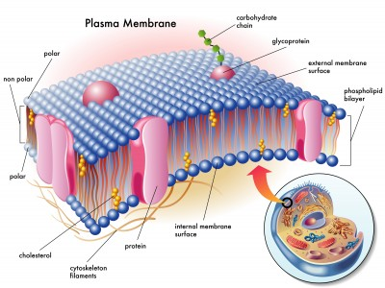
Proteins: Act as tunnels to move things across the membrane that don’t move through the phospholipids

Slide 10
Types of Transport
1. Passive – does not require energy
– substances move from a higher concentration (where there is more of it) to lower concentrations (where there is less of it) until the levels of the substance are even (equilibrium)
Passive Transport Animation

Slide 11
2. Active – requires energy
– substances move from areas of lower concentration to higher concentration
– this builds a larger difference across the membrane and makes the concentrations more uneven (Chemical gradient)

Slide 12
Types of Passive Transport
1. Diffusion: movement of any material from an area of high concentration to low concentration
Ex: Tea from a tea bag
Diffusion Animation

Slide 13
2. Facilitated Diffusion: Movement of a substance with the aid of a membrane protein – protein creates a tunnel for the substance to move through
Ex: Movement of Glucose from the small intestine to the blood
Facilitated Diffusion Animation

Slide 14
3. Osmosis: movement of water Based on the amount of solute in the solution Hypertonic: higher levels of solute
Isotonic: equal amounts of solute
Hypotonic: lower levels of solute
Water moves from an area that is hypotonic to hypertonic until they are isotonic
WATER FOLLOWS THE SALT
Osmosis Animation –

Slide 15
Cells WithOUT Walls
HYPOTONIC Solution | ISOTONIC Solution | HYPERTONIC Solution

Slide 16
Cells WithOUT Walls
HYPOTONIC Solution | ISOTONIC Solution | HYPERTONIC Solution
Cell Gains Water
H₂O
H₂O

Slide 17
Cells WithOUT Walls
HYPOTONIC Solution | ISOTONIC Solution | HYPERTONIC Solution
Cell Gains Water
Cell May Lyse (break)
H₂O
H₂O

Slide 18
Cells WithOUT Walls
HYPOTONIC Solution | ISOTONIC Solution | HYPERTONIC Solution
Cell Gains Water | Nothing Happens
Cell May Lyse (break)
H₂O
H₂O

Slide 19
Cells WithOUT Walls
HYPOTONIC Solution | ISOTONIC Solution | HYPERTONIC Solution
Cell Gains Water | Nothing Happens
Cell May Lyse (break) | Cell is Balanced
H₂O
H₂O

Slide 20
Cells WithOUT Walls
HYPOTONIC Solution | ISOTONIC Solution | HYPERTONIC Solution
Cell Gains Water | Nothing Happens | Cell Loses Water
Cell May Lyse (break) | Cell is Balanced
H₂O

Slide 21
Cells WithOUT Walls
HYPOTONIC Solution | ISOTONIC Solution | HYPERTONIC Solution
Cell Gains Water | Nothing Happens | Cell Loses Water
Cell May Lyse (break) | Cell is Balanced | Cell Shrivels (Crenate)
H₂O

Slide 22
Cells With Walls
HYPOTONIC Solution | ISOTONIC Solution | HYPERTONIC Solution

Slide 23
Cells With Walls
HYPOTONIC Solution | ISOTONIC Solution | HYPERTONIC Solution
Cell Gains Water and Swells Vacuole pushes on cell wall
H₂O
H₂O

Slide 24
Cells With Walls
HYPOTONIC Solution | ISOTONIC Solution | HYPERTONIC Solution
Cell Gains Water and Swells Vacuole pushes on cell wall
Cell Becomes Turgid (firm) Supports Plant tissues
H₂O
H₂O

Slide 25
Cells With Walls
HYPOTONIC Solution | ISOTONIC Solution | HYPERTONIC Solution
Cell Gains Water and Swells Vacuole pushes on cell wall | Nothing Happens
Cell Becomes Turgid (firm) Supports Plant tissues
H₂O
H₂O

Slide 26
Cells With Walls
HYPOTONIC Solution | ISOTONIC Solution | HYPERTONIC Solution
Cell Gains Water and Swells Vacuole pushes on cell wall | Nothing Happens
Cell Becomes Turgid (firm) Supports Plant tissues | Cell is Flaccid (limp) Plants wilt
H₂O
H₂O

Slide 27
Cells With Walls
HYPOTONIC Solution | ISOTONIC Solution | HYPERTONIC Solution
Cell Gains Water and Swells Vacuole pushes on cell wall | Nothing Happens | Cell Loses Water
Cell Becomes Turgid (firm) Supports Plant tissues | Cell is Flaccid (limp) Plants wilt
H₂O

Slide 28
Cells With Walls
HYPOTONIC Solution | ISOTONIC Solution | HYPERTONIC Solution
Cell Gains Water and Swells Vacuole pushes on cell wall | Nothing Happens | Cell Loses Water
Cell Becomes Turgid (firm) Supports Plant tissues | Cell is Flaccid (limp) Plants wilt | Cell Membrane Pulls Away from the Cell Wall (Plasmolysed) Cell May Die
H₂O

Slide 29
Effect of Osmosis on Cells

Slide 30
ACTIVE TRANSPORT
Requires Energy
Types:
1. Building a Chemical Gradient to do work
Like climbing the sliding board to slide down
Gradient: difference in concentration – making one side of the membrane more hypertonic and the other more hypotonic
Ex: Cellular Respiration: Making ATP
Transmitting a nerve signal
Active Transport Animation

Slide 31
2. Bulk Transport – Using energy to change the shape of the cell membrane to move large amounts of substances

Slide 32
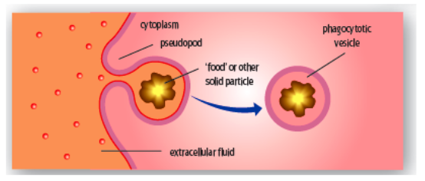
Phagocytosis: Cell eating
– White blood cells eating bacteria
Amoeba eating paramecium

Slide 33
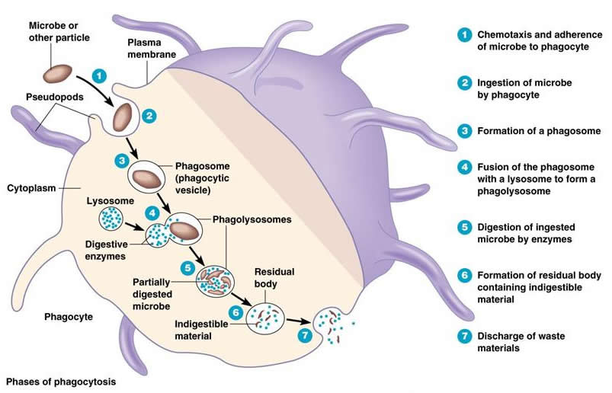
Phagocytosis Video
#2

Slide 34
Pinocytosis: Cell taking in fluids
Bulk Transport Animation

Slide 35
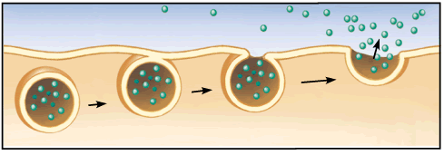
Exocytosis: Shipping out proteins from the cell
Vesicles fuse with the cell membrane and dump the contents of the vesicle outside of the cell (end products of the endomembrane system)
Exocytosis Animation

