Slide 1
Cardiopulmonary System
Cardio – heart
Pulmonary - lungs

Slide 2
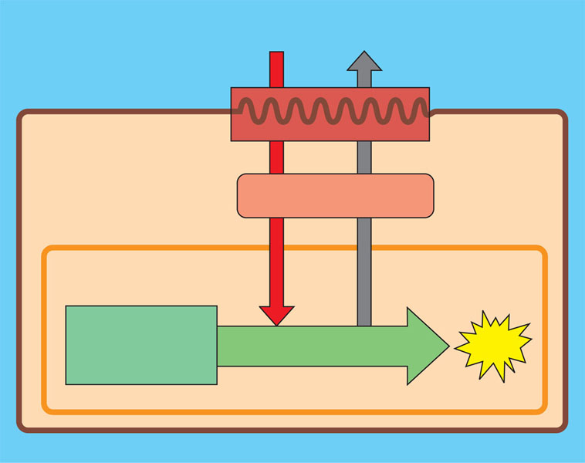
Respiratory medium (air of water)
O₂
CO₂
Respiratory surface
Organismal level
Circulatory system
Cellular level
Energy-rich molecules from food
ATP
Cellular respiration

Slide 3
Gas Exchange in Humans
1. Mouth/Nose/Nasal Cavity, Pharynx, Larynx:
air entrance
Epiglottis open - allows air into trachea
Larynx: Voice Box - air passing over vocal chords causes vibration
http://www.youtube.com/watch?v=Kvr9LFzOo50

Slide 4
2. Trachea: Wind Pipe - in front of esophagus
Cartilage rings - reinforcement
3. Bronchi:
Trachea splits into bronchi
Each bronchus splits further into more bronchioles

Slide 5
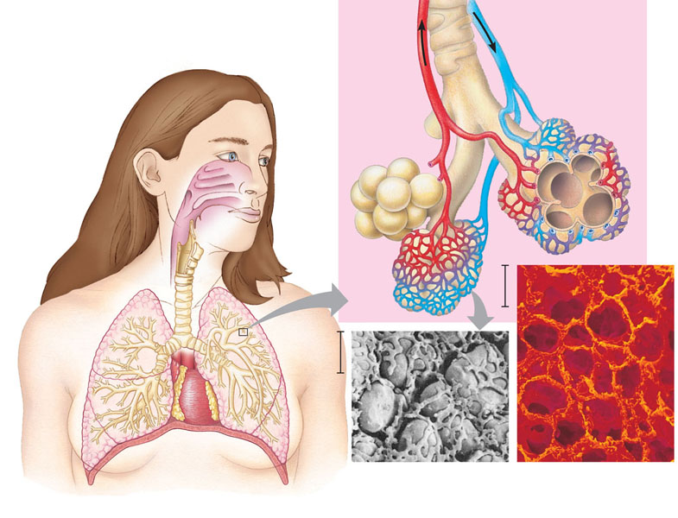

Slide 6
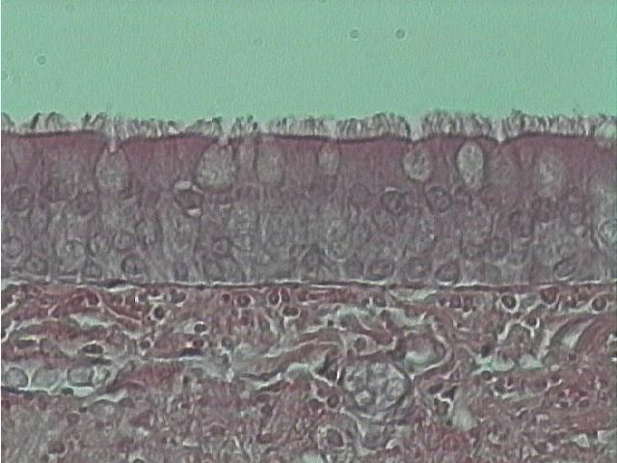
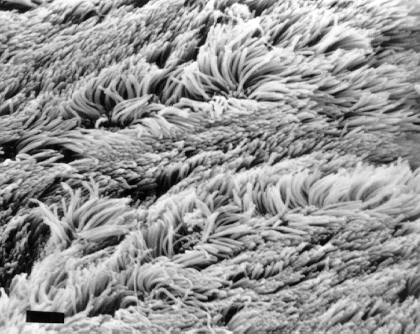

Slide 7
4. Alveolus: air sac
- located at the end of bronchioles
- enveloped by capillaries for gas exchange
5. Diffusion of Gases
Inhale: lots of oxygen - diffuses across membrane into blood - fixed by hemoglobin - binds to the iron at the center of the hemoglobin subunit
- oxygen binds less well in acid environments (control mechanism)
Blood has lots of CO₂ - diffuses out of RBC into alveoli

Slide 8
Circulation: RBC move throughout body and O₂ diffuses with concentration gradient to cells via the interstitial fluid
- CO₂ diffuses opposite direction

Slide 9
RESPIRATION CONTROL
1. Bulk Flow: moving air in and out of lungs
Negative Pressure: mammals, birds and reptiles
- generated by diaphragm (muscle separating the pulmonary and abdominal cavities) and intercostal muscles (muscles between ribs)
- diaphragm contracts and moves downward
Result: decreases the pressure in lungs (more volume)
- air rushes in
- diaphragm relaxes and moves up - air expelled

Slide 10
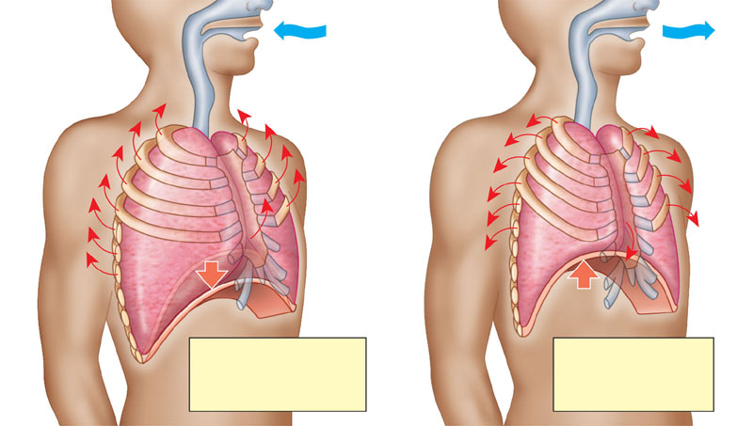
Rib cage expands as rib muscles contract
Rib cage gets smaller as rib muscles relax
Air inhaled
Air exhaled
Lung
Diaphragm
INHALATION Diaphragm contracts (moves down)
EXHALATION Diaphragm relaxes (moves up)
Figure 42.24

Slide 11
2. Breathing Rate:
Balance of pH
- chemoreceptors in carotid artery and medulla oblongata monitor pH
- when pH drops (excess CO₂) a signal is sent to the breathing control center (medulla oblongata) in the brain which signals the diaphragm to contract more often – CO₂ out/O₂ in/pH rises

Slide 12
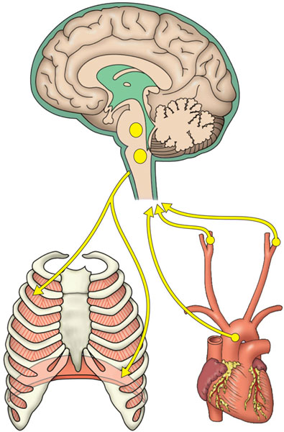
Cerebrospinal fluid
1
The medulla’s control center
also helps regulate blood CO₂ level.
Sensors in the medulla detect changes
in the pH (reflecting CO₂ concentration)
of the blood and cerebrospinal fluid
bathing the surface of the brain.
The control center in the
medulla sets the basic rhythm, and a control center in the pons moderates it, smoothing out the transitions between
inhalations and exhalations.
5
Nerve impulses relay changes in CO₂ and O₂ concentrations. Other sensors in the walls of the aorta and carotid arteries in the neck detect changes in blood pH and send nerve impulses to the medulla. In response, the medulla’s breathing control center alters the rate and depth of breathing, increasing both to dispose of excess CO₂ or decreasing both if CO₂ levels are depressed.
Breathing control centers
Pons
Nerve impulses trigger muscle contraction. Nerves from a breathing control center in the medulla oblongata of the brain send impulses to the diaphragm and rib muscles, stimulating them to contract and causing inhalation.
2
Medulla oblongata
Carotid arteries
In a person at rest, these nerve impulses result in about 10 to 14 inhalations per minute. Between inhalations, the muscles relax and the person exhales.
Aorta
The sensors in the aorta and carotid arteries also detect changes in O₂ levels in the blood and signal the medulla to increase the breathing rate when levels become very low.
6
Figure 42.26
Diaphragm
Rib muscles

Slide 13
Circulatory System
Function: distribute nutrients and oxygen
transport waste products for removal
immune system

Slide 14
Structures of Circulatory Systems
Vessels:
Arteries Veins
move blood away from heart blood to heart
thick layer of smooth muscle thin layer of smooth muscle
Branch into arterioles Formed from converging venules

Slide 15
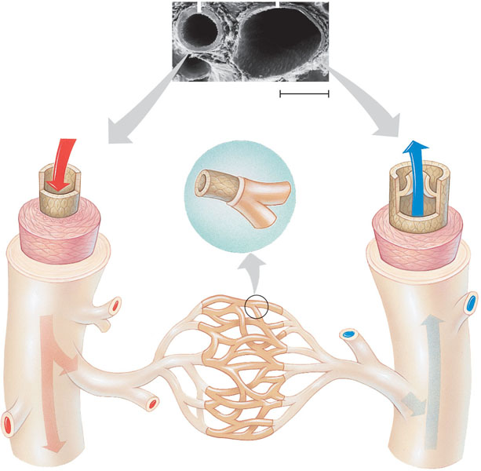
Artery
Vein
Basement membrane
Endothelium
100 µm
Valve
Endothelium
Endothelium
Smooth muscle
Smooth muscle
Capillary
Connective tissue
Connective tissue
Artery
Vein
Venule
Arteriole

Slide 16
Capillaries: smallest blood vessels - transfer of nutrients and waste
Heart: Pumping mechanism: cardiac muscle tissue
Compartments:
Atria: receive blood from veins pump blood to ventricles
Ventricles: typically larger chamber with thicker wall - pump blood into arteries

Slide 17
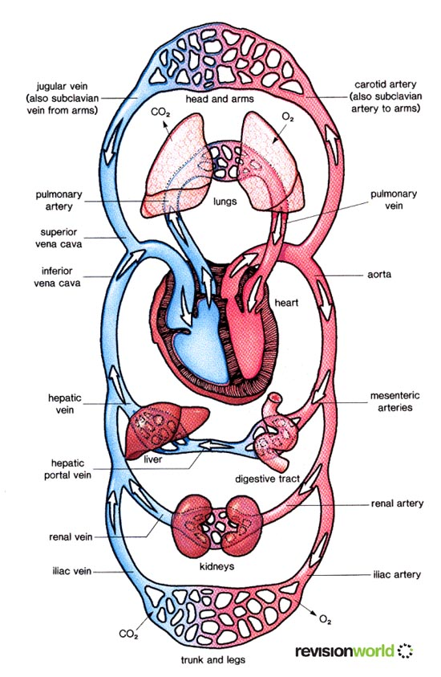

Slide 18
Human Circulatory Systems
Parts/Pathway:
1. Vena Cava- largest veins: Superior (anterior) - head and forelimbs and Inferior (posterior) - torso and legs
2. Right Atrium (RA)- receives blood from vena cavas
3. Atrioventricular Valve (AV valve): tricuspid valve
- passes blood to RV - separates the right chambers
- prevents backflow of blood from RV so blood only moves forward

Slide 19
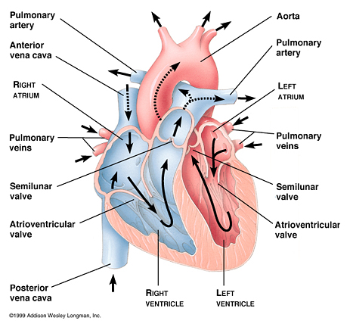

Slide 20
4. Right Ventricle (RV)- thicker wall- pumps blood to Pulmonary Artery
5. Pulmonary Semi-lunar Valve: gateway to pulmonary artery - prevents blood from flowing into the RV
6. Pulmonary Artery: carries blood to lungs for oxygen - NOTE: blood is leaving the heart through an artery but is O₂ Poor
- in lungs the arteries branch into arterioles and then into a capillary net around the alveoli allowing for gas exchange

Slide 22
7. Pulmonary Veins: from lungs to LA - carries O₂ rich blood
8. Left Atrium (LA): receives O₂ rich blood and pumps it into the LV
9. Left Atrioventricular Valve - aka mitral valve or bicuspid valve
- prevents backflow from LV

Slide 24
10. Left Ventricle (LV) : pumps blood into Aorta
11.Left Semilunar Valve : prevents blood from flowing back into LV
12. Aorta: main artery - branches
- sends blood to body systems
13. Arteries:
- branch into arterioles and then into capillaries
14. Capillaries/Capillary Nets:
- gas and nutrient exchange
15. Venules and veins: capillaries merging into larger vessels like streams into rivers

Slide 26
THE HEART
In 1 year, the average human heart circulates from 770,000 to 1.6 million gallons of blood through the body. This is enough fluid to fill 200 tank cars, each with a capacity of 8,000 gallons
Beating Heart/Heart Surgery

Slide 27
Blood Pressure: 120/80
Systole: blood being forced into the arteries
- larger pressure because of the stronger contraction of the ventricles
Diastole: relaxing of the ventricles
Sphygmomanometer

Slide 28
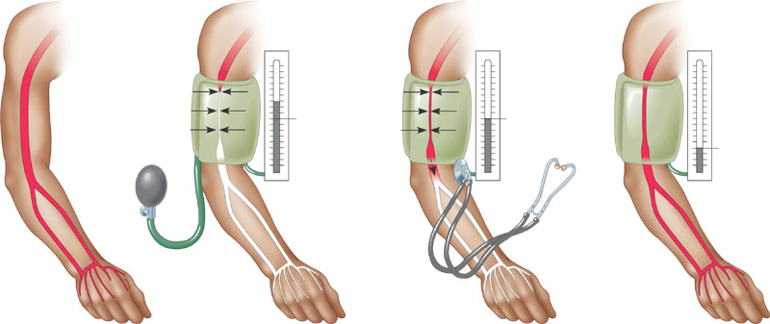
1
A typical blood pressure reading for a 20-year-old is 120/70. The units for these numbers are mm of mercury (Hg); a blood pressure of 120 is a force that can support a column of mercury 120 mm high.
4
The cuff is loosened further until the blood flows freely through the artery and the sounds below the cuff disappear. The pressure at this point is the diastolic pressure remaining in the artery when the heart is relaxed.
Blood pressure
reading: 120/70
Pressure in cuff above 120
Pressure in cuff below 120
Pressure in cuff below 70
Rubber cuff inflated with air
120
120
70
Sounds stop
Sounds audible in stethoscope
Artery
Artery closed
2
3
A sphygmomanometer, an inflatable cuff attached to a pressure gauge, measures blood pressure in an artery. The cuff is wrapped around the upper arm and inflated until the pressure closes the artery, so that no blood flows past the cuff. When this occurs, the pressure exerted by the cuff exceeds the pressure in the artery.
A stethoscope is used to listen for sounds of blood flow below the cuff. If the artery is closed, there is no pulse below the cuff. The cuff is gradually deflated until blood begins to flow into the forearm, and sounds from blood pulsing into the artery below the cuff can be heard with the stethoscope. This occurs when the blood pressure is greater than the pressure exerted by the cuff. The pressure at this point is the systolic pressure.
Figure 42.12

Slide 29
Increased blood pressure:
- higher amounts of water in the blood due to increased solute content
- sugar or salt
- decreased diameter of blood vessels – atherosclerosis and arteriosclerosis

Slide 30
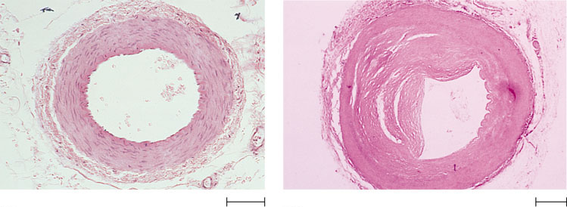
Atherosclerosis/Arteriosclerosis
Connective tissue
Smooth muscle
Plaque
Endothelium
(a) Normal artery
(b) Partly clogged artery
50 µm
250 µm
Figure 42.18a, b

Slide 31
Capillary Exchange:
- nutrient rich blood from arteries enters capillaries
- water, food and gases leave blood to cells
- metabolic wastes enter blood and nearly all of the fluid that left the capillary

Slide 32
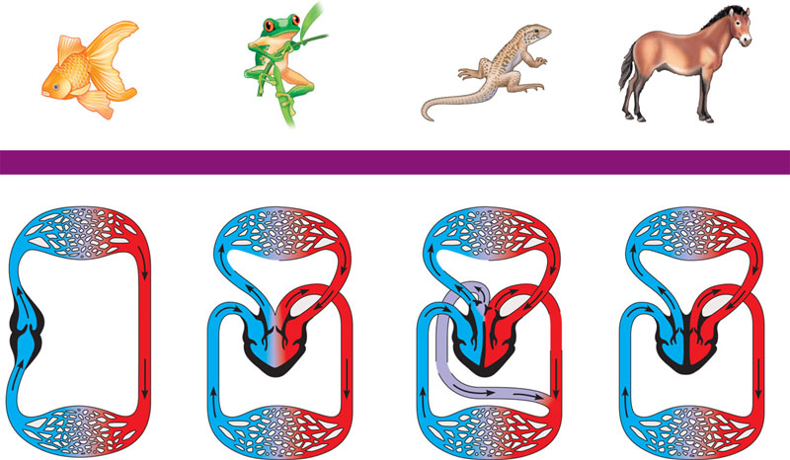
FISHES
AMPHIBIANS
REPTILES (EXCEPT BIRDS)
MAMMALS AND BIRDS
Gill capillaries
Lung and skin capillaries
Lung capillaries
Lung capillaries
Artery
Pulmocutaneous circuit
Right systemic aorta
Pulmonary circuit
Pulmonary circuit
Gill circulation
Heart: ventricle (V)
Left
Systemic aorta
A
A
A
A
A
A
Atrium (A)
V
V
V
V
V
Right
Left
Right
Left
Right
Left
Systemic circulation
Systemic circuit
Systemic circuit
Vein
Systemic capillaries
Systemic capillaries
Systemic capillaries
Systemic capillaries
Figure 42.4

