Slide 1
Biology
An Introduction

Slide 2
Biology
Bio = life
Logy = the study of
Bio+Logy = The study of life

Slide 3
Life??????
What is life? At least biologically
Characteristics of Life
1. Organization: complex in structure
- Specifically made of one or more cells
Unicellular – one cell
Ex: bacteria, amoeba
Multicellular – more than one cell
Ex: plants, animals

Slide 4
2. Utilizes Energy and Matter:
- must gain energy and matter from some source
1st Law of Thermodynamics: Energy cannot be created or destroyed
Autotroph – self feeders – make their own food
Photoautotrophs – use light
Ex: Plants, algae
Chemoautotrophs – use energy from chemicals
Ex: Chemosynthetic bacteria
Heterotroph – other feeder – take in food from outside of themselves
Herbivore
Carnivore
Omnivore
Detrivore

Slide 5
3. Grow and develop
Overtime, groups will change = evolution
4. Reproduction
Asexual: offspring come from one parent – genetically identical (clones)
Sexual: offspring come from two parents – genetic recombination

Slide 6
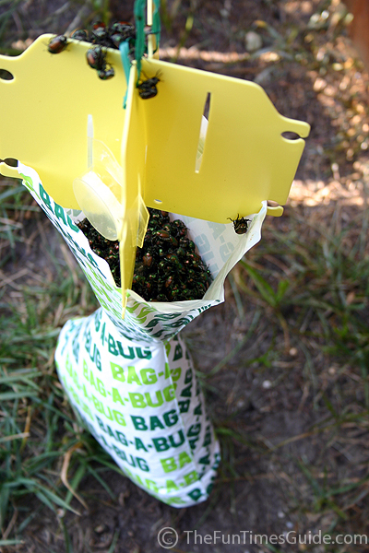
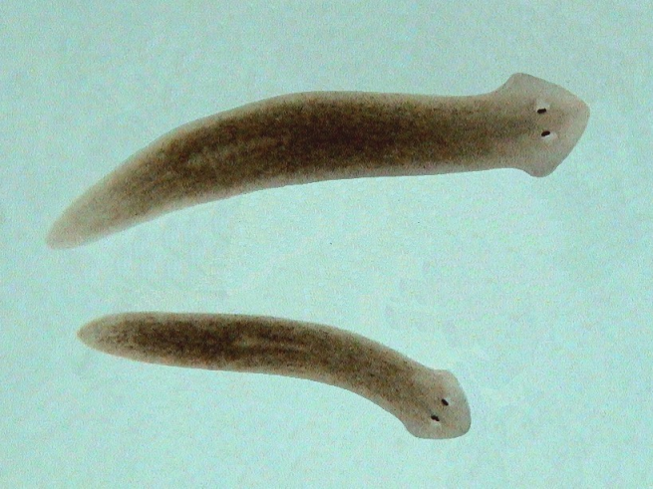
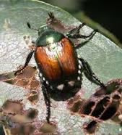
5. Respond to the Environment:
Taxis – directed movement
Chemotaxis
Phototaxis
Thermotaxis

Slide 7
6. Homeostasis:
- maintain a stable INTERNAL environment – fight death
Ex: Thermoregulation
Osmoregulation – salt and water balance

Slide 8
Biological Hierarchy
Atoms → Molecules → Organelles → Cells → Tissues → Organs → Organ Systems → Organism → Population → Community → Ecosystem (Biome) → Biosphere

