Slide 1
Alternate Patterns of Inheritance

Slide 2
Extensions Of Mendel’s Ideas
Not everything in genetics is as clear cut as Mendel’s idea of dominance. Many traits are controlled by several other types of inheritance patterns.

Slide 3
Incomplete Dominance
Blending
neither trait is dominant so both are partially expressed
Red flower X White flower = pink
Different Rules:
Key: Use a capital Letter to represent the characteristic
Use a capital letter superscript to represent the trait
C^{R} = Red
C^{W} = White

Slide 4
Red X white
Genotypic:
Phenotypic:

Slide 5
Red X white
Genotypic: 4:0
Phenotypic: 4:0
C^{R}
C^{R}
C^{W}
C^{R}C^{W}
C^{R}C^{W}
C^{W}
C^{R}C^{W}
C^{R}C^{W}

Slide 6
Cross Pink with Pink
Genotypic:
Phenotypic:

Slide 7
Cross Pink with Pink
Genotypic: 1:2:1
Phenotypic: 1:2:1
C^{R}
C^{W}
C^{R}C^{R}
C^{R}C^{W}
C^{R}
C^{R}C^{W}
C^{W}C^{W}
C^{W}

Slide 8
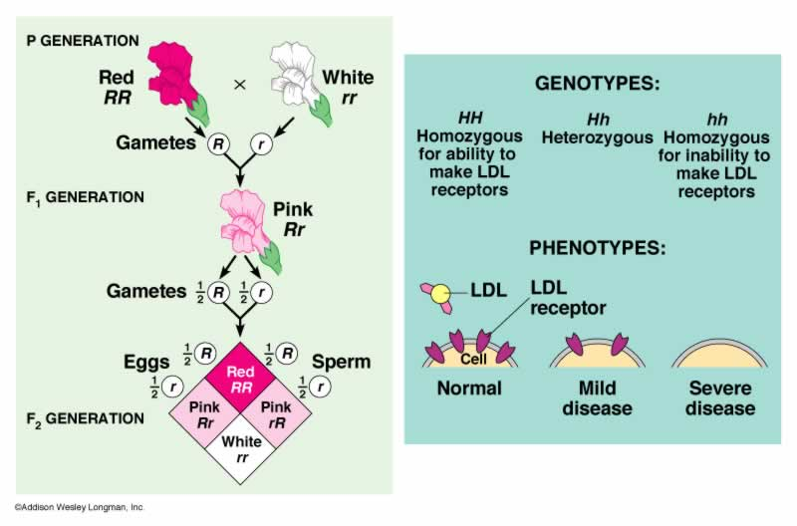

Slide 9
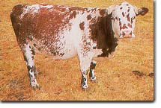
Codominance
Both traits are equally expressed and DISTINGUISHABLE
Ex: Roan Cattle
Red Bull x White Cow
ROAN Offspring
looking closely at the fur = #’s of red hairs and white hairs
KEY:
Function the same way as incomplete dominance
C^{R} = red
C^{W} = white

Slide 10
Codominance Crosses
Crosses
Red with White
Genotypic:
Phenotypic:

Slide 11
Codominance Crosses
Crosses
Red with White
Genotypic: 4:0
Phenotypic: 4:0
C^{R}
C^{R}
C^{W}
C^{R}C^{W}
C^{R}C^{W}
C^{W}
C^{R}C^{W}
C^{R}C^{W}

Slide 12
Codominance Crosses
Crosses
Roan with Roan
Genotypic:
Phenotypic:

Slide 13
Codominance Crosses
Crosses
Roan with Roan
Genotypic: 1:2:1
Phenotypic: 1:2:1
C^{R}
C^{W}
C^{R}
C^{R}C^{R}
C^{R}C^{W}
C^{W}
C^{R}C^{W}
C^{W}C^{W}

Slide 14
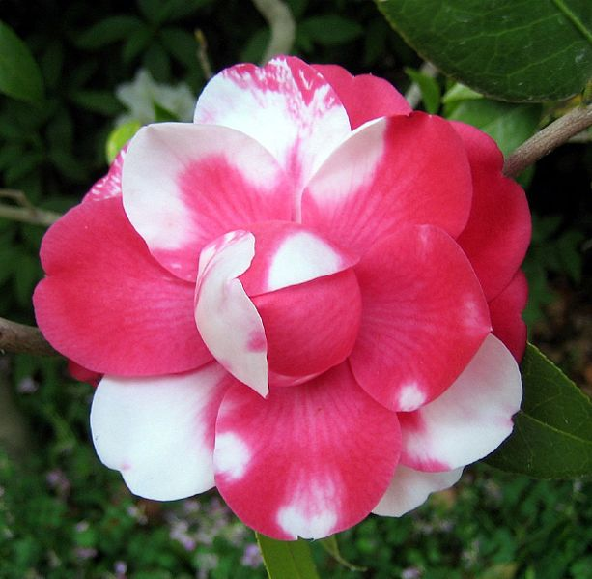

Slide 15
Multiple Alleles
instead of just two possibilities, there are more
gives multiple factors to consider:
which alleles are dominant?
which are codominant?
which are incomplete?

Slide 16
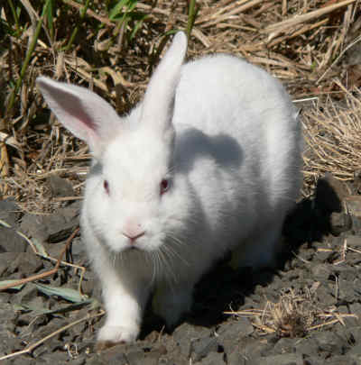
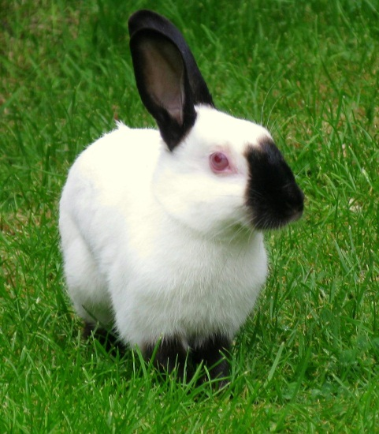
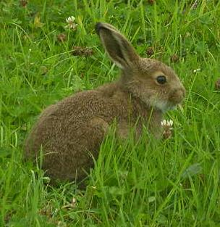
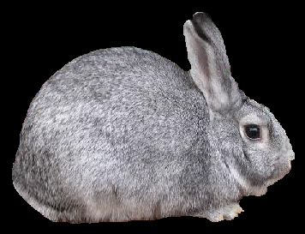
Ex: Rabbit Fur – one of four genes
Full color dominant over chinchilla
Chinchilla dominant over Himalayan
Himalayan dominant over Albino

Slide 17
Key for Multiple Allele Problems
Large Letter for characteristic
Superscript for traits - only lower case is the most recessive
Full color - C^{F}
Chinchilla - C^{Ch}
Himalayan - C^{H}
Albino - c

Slide 18
Cross a heterozygous full/chinchilla with a heterozygous Himalayan/albino
Genotypic:
Phenotypic:

Slide 19
Cross a heterozygous full/chinchilla with a heterozygous Himalayan/albino
C^{F}C^{Ch} x C^{H}c
C^{F}
C^{Ch}
C^{H}
C^{F}C^{H}
C^{Ch}C^{H}
C^{F} c
C^{Ch} c
c
Genotypic: 1:1:1:1
Phenotypic: 2:2

Slide 20
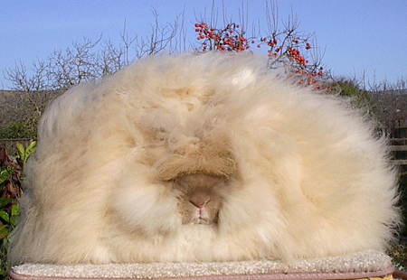
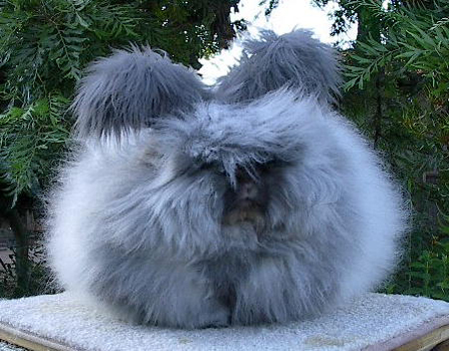
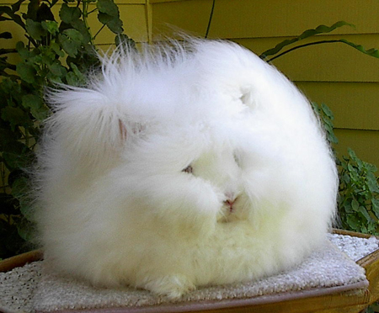
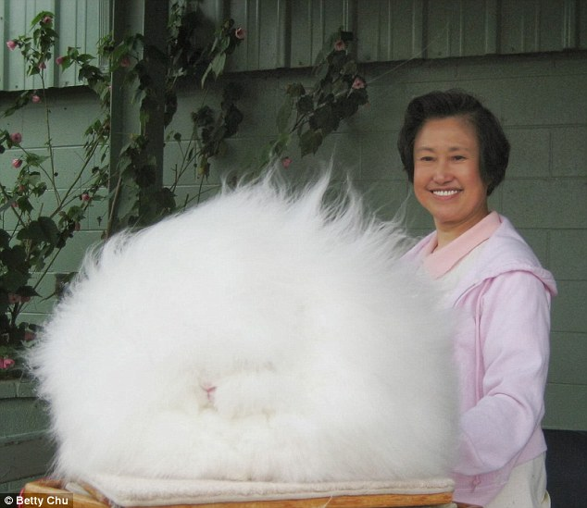
Rabbit Fur Mutations

Slide 21
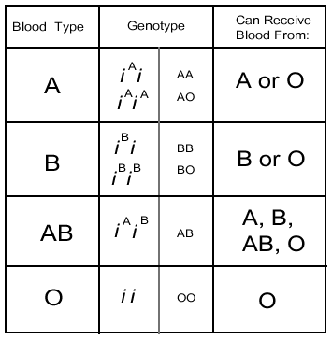
HUMAN BLOOD TYPE
Multiple Alleles and Codominance
Importance: Matching Donors and Recipients - Immunoglobin Responses
I^{A}i
I^{A}I^{A}
AO
AA
Universal Acceptor
I^{B}i
I^{B}I^{B}
BO
BB
I^{A}I^{B}
AB
Universal Donor
OO

Slide 22
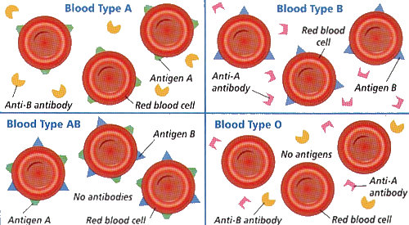
Blood Type Interaction

Slide 23
Cross I: A man with AB blood has a child with a woman who is type O.
Cross II: A man who is type A has a child with a woman who is type B. If their child is type O, what are the genotypes of the parents?

Slide 24
Blood Type: + or -
Blood type is “+” or “-” based on a second surface protein called the Rhesus factor or the Rh factor.
If the factor is present the person is “+” – this occurs in about 85% of the population
If the factor is absent (recessive), the person is “-”.
If an Rh- person receives blood from an Rh+ person then nothing will generally happen – the first time. The Rh- person will then develop “anti Rh” proteins”. If exposed to Rh+ blood again, the anti Rh proteins will cause the Rh+ blood to agglutinate (clump).

Slide 25
Epistasis: One gene at a different locus (location) alters the expression of another gene
Mice Coloration:
Black dominant over brown
BB, Bb → black
bb → brown
HOWEVER:
Also dependent upon the gene for color
Color dominant over colorless
CC, Cc → color will be deposited in the hair follicle
cc → no color despite BB, Bb, or bb
- results in an albino

Slide 26
Determine Colors:
BbCc:
BBcc:
bbCC:
bbcc:

Slide 27
Determine Colors:
BbCc: black
BBcc: albino
bbCC: brown
bbcc: albino

Slide 28
Cross heterozygous male with a heterozygous female (not 9:3:3:1)

Slide 29
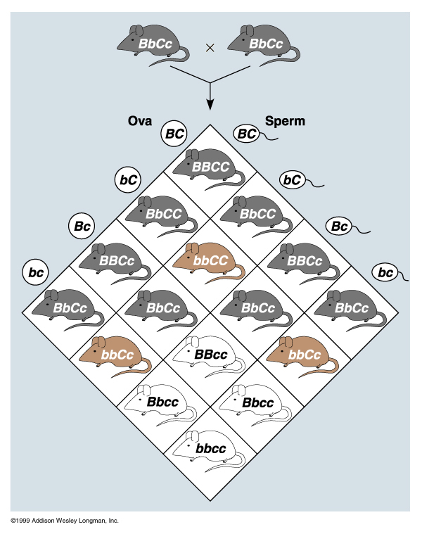

Slide 30
Polygenic Traits: one characteristic is controlled by the cumulative effect of many genes
Ex: Human height, eye color, and skin color - each controlled by at least three gene pairs
T - tallness
t - shortness
TTTttt - medium height
TtTtTt - medium height
TTTTTT - tall
tttttt- short
TtTtTt x TtTtTt - result in many different combinations

Slide 31
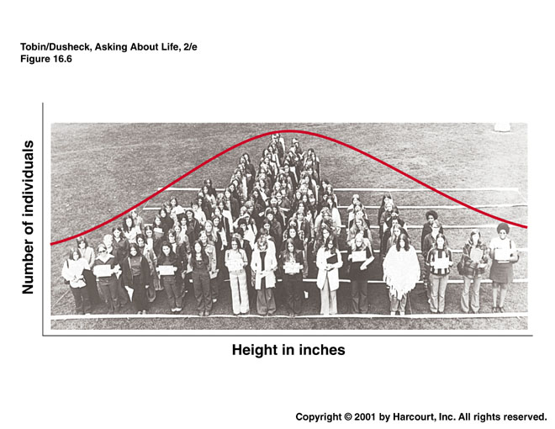

Slide 32
Human Skin Pigmentation
same basic process
- gene codes for activity of melanocytes
- all humans have the same number of pigment producing cells in their skin
- the level of activity determines skin coloration
- enhanced by exposure to UV light
- protection against FURTHER UV damage

Slide 33
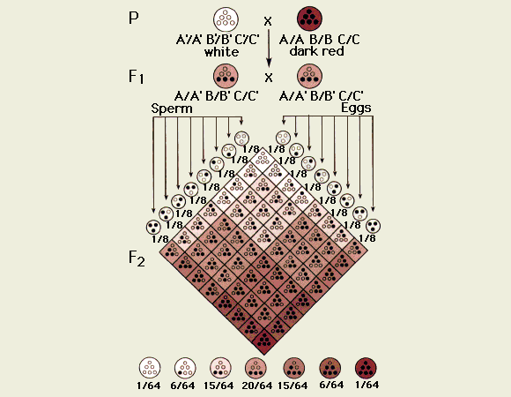

Slide 34
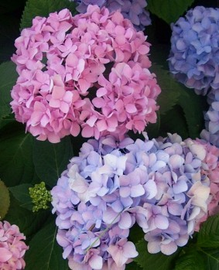
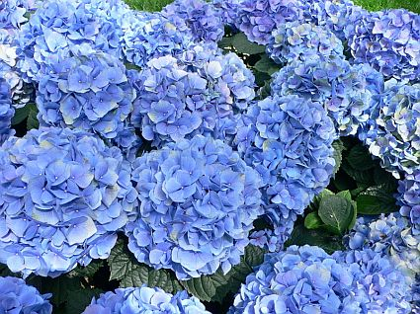
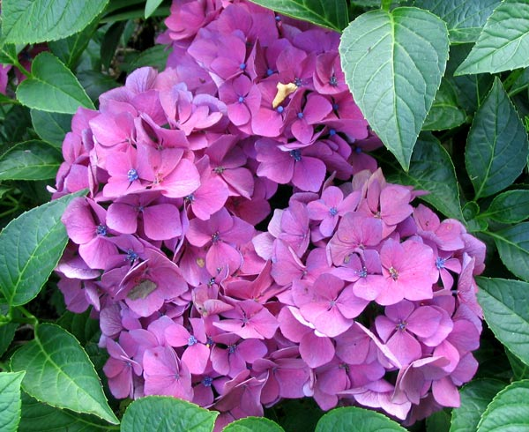
Environmental Impact on Phenotype
Environmental Conditions affect the expression of the phenotype.
Hydrangeas: Certain types have blue or pink flowers based on the pH of the soil Blue flowers in acidic soil Pink flowers in basic soil
Change the soil pH = Change the flower color
ACID (AlSO₄) Neutral BASE (Lime Dust)

Slide 35
